Slide 1
GÉANT network Evolution
Planning the Network Topology
Sebastiano Buscaglione
Trondheim
12 June 2018

Slide 2


Scoping a new network – the process
Workshops
Platform
Evolution
Financial
Modelling
RFI
Regional
Studies

Slide 3
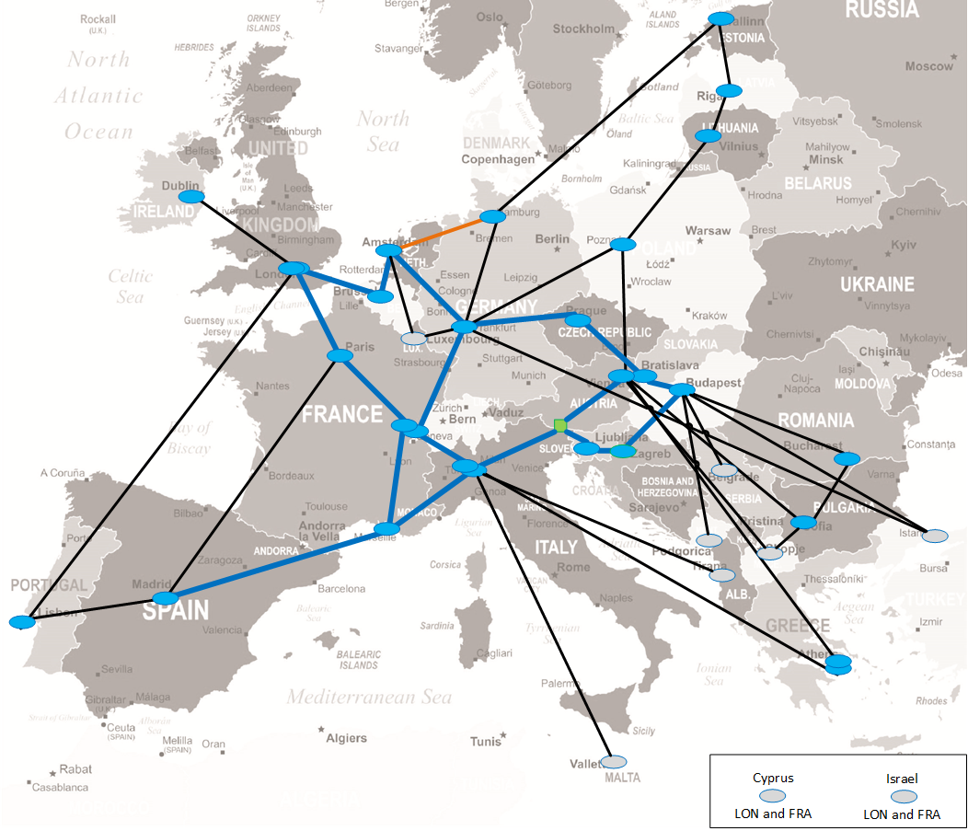
The network today
Dark fibre core
Leased capacity regions
Hub and Spoke
Short procurement cycles
Short term requirements
Cost impact
Black – Dark fibre
Blue – Lease capacity
Orange - Spectrum

Slide 4
IRU SGA – the opportunity
  Go beyond the state-of-the-art by restructuring the backbone network through exploration and procurement of long-term IRUs and associated equipment to increase the footprint, stimulating the market in cross-border communications infrastructure whilst decreasing the digital divide and reducing costs
From EC objectives for IRU SGA

Slide 5

Defining the IRU SGA size
128M€
Define optimal size
€
€
Understand what is needed
GN4-3
SGA
IRU
SGA
100% Funded

Slide 6





Building the network blueprint
Costs
Requirements
Review
€
Workshops

Slide 7
Part 1 - defining a what we need/want
Traffic projections
Model built to understand and forecast capacity requirements
Regional Studies
Technology strategy
Next Slide
Workshops

Slide 8
1st CTO Workshop and principles
November 2017 to discuss the approach
  Spend for fibre and optical equipment
  Long term planning (15y+)
  5th regional study
  GÉANT as a central network operator
  High performance flexible infrastructure
  Demarcation points in all countries
  Bridging the digital divide
  Long term sustainability
  Minimise infrastructure duplication
  Cost share reduction

Slide 9
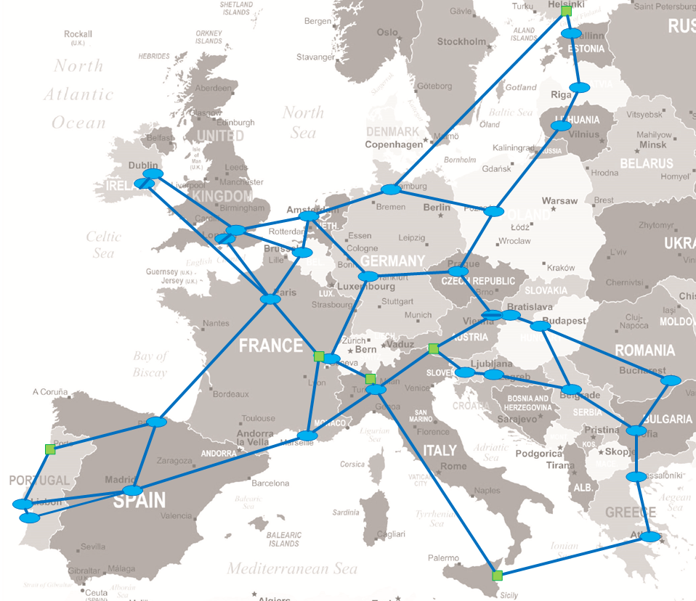
A network for the long term
SAMPLE
Fibre/spectrum to more NRENs
Increase of meshing
Tiering
Dual PoPs on large countries
Better regional connectivity
PoPs in strategical locations

Slide 10
Part 2 - optimize and define a budget
Infrastructure sharing
Equipment costs
Market RFI
Model to analyse and compare options and cost impact
€
Workshops

Slide 11
Understanding and optimizing the cost
58M
November 2017 1st CTO workshop
Estimated costs
7 most expensive routes
~50% total cost
RFI
79M
Itemised costs
Direct replacement
March 2018
Topology
67M
April 2018
More RFI
Topology optimisation
Infrastructure sharing
52M
16th April
2018 before Rome
Infrastructure sharing
Expensive routes
Next Slide

Slide 12
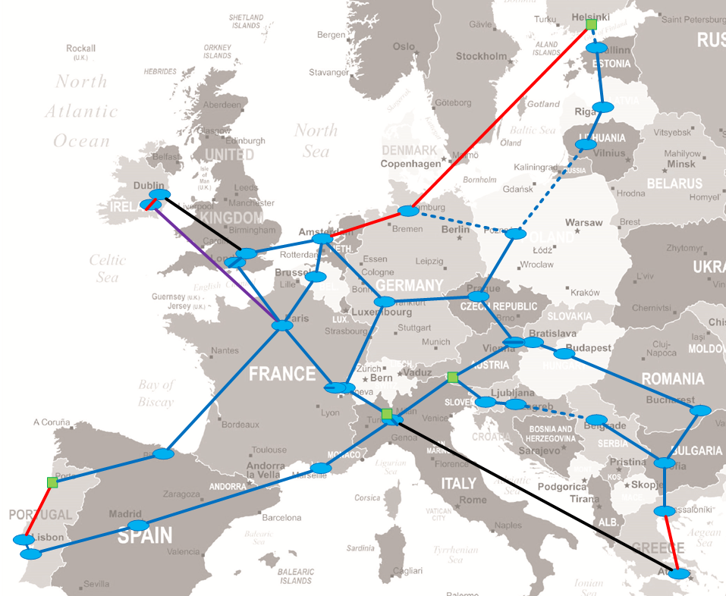

Starting to define a topology
Mainly based on commercial DF
NRENs solution for most expensive links
Cost is down from 67 to 52M
Athens Milan on lease capacity
Dublin Paris on capacity IRU

Slide 13
The Rome workshop
Two days workshop at GARR
  To consolidate regional studies
  Very good NRENs participation
  Large amount of NRENs sharing offers
  Review of the topology
  Agree on a first reference map

Slide 14
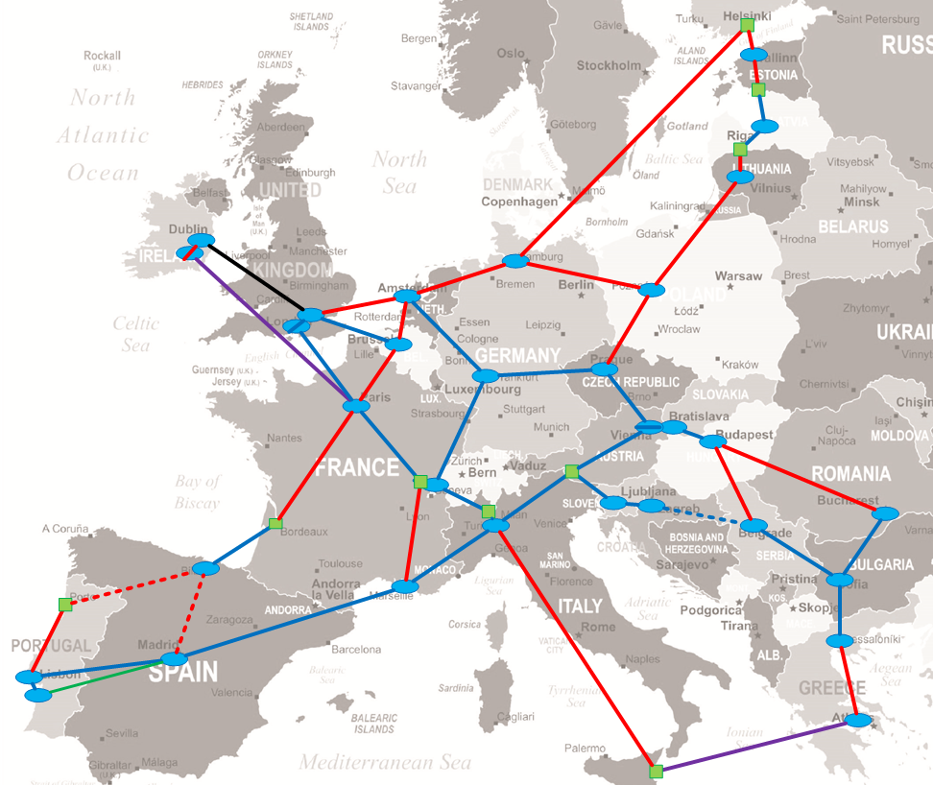
The Rome map
Increased meshing
Latest RS solutions
Cost is 41M
NRENs solutions have not been fully evaluated

Slide 15
Proposing a budget
Benchmark solutions against:
  Minimise NREN cost share TCO 2020-2028
  Capacity requirement for same period
Seven NREN offers rolled back to commercial DF
Cost is now 48M
Add 10% of contingency → 53M€

Slide 16
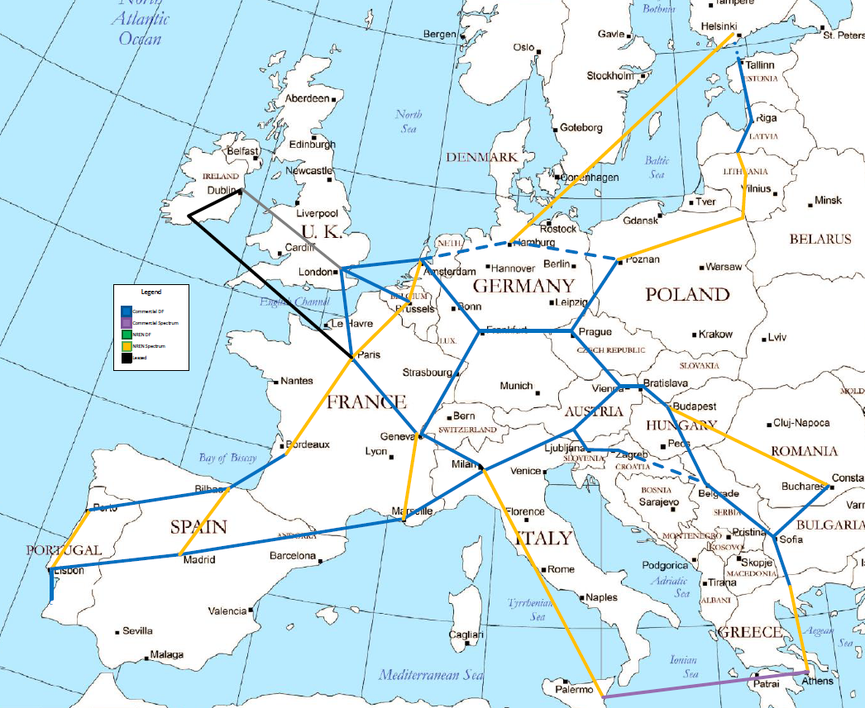
The reference map
Lowest NRENs cost share option
Map proposed and accepted at 2nd CTO workshop in Prague
Yellow = NRENs
Blue = Commercial DF
Other colors = lease
Reduction of ~35% on OPEX of directly involved items vs 2018

Slide 17
Next steps
GA to approve the budget
Further development of the topology
Engagement with providers
Improvement of NRENs share options
Connectivity strategy for countries not on footprint
Tendering preparation
Review
€

