Slide 1
IP fabric architecture for grnet Automating the DATACENTER
Christos Argyropoulos
cargious@noc.grnet.gr
GRNET
June 13, 2018, TNC18: Trondheim

Slide 2
The problem
2
Expanding from
Two small DCs
One larger one: 22 racks
To three new datacenters
Athens: 36 racks (with the expansion)
Knossos: 26 racks
Louros: 14 racks
Network architecture?
Address existing problems
Balance between already tested and more innovative solutions
Satisfy new requirement: VLAN stretch between datacenters
IP Fabric solution for GRNET Datacenters
13 Jun 2018, TNC18, Trondheim

Slide 3
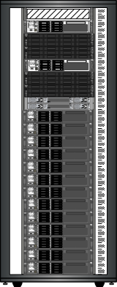
Typical GRNET DC Rack
3
Storage Lane
Distributed Object Storage: Debian, Ceph/RADOS
Also:
Traditional SAN/NAS
Baremetal servers or Colocated third party servers
Monitoring stations, PDUs, TS, …
Networking Lane
Virtual Machines Lane
Debian, KVM, Ganeti, okeanos/vima
No routing protocols between hosts & network. Simple linux bridging or ARP proxying
IP Fabric solution for GRNET Datacenters
13 Jun 2018, TNC18, Trondheim

Slide 4
GRNET DC Network
4
GRNET Core
Single switching fabric across the entire datacenter
VLANs stretching
DC router(s)
Intervlan routing
Routing with GRNET IP core
Firewalling
Server Connectivity
Active/Active (LACP)
Active/Backup
Single homed
DC Network
IP Fabric solution for GRNET Datacenters
13 Jun 2018, TNC18, Trondheim

Slide 5
Previous Architectures: Ethernet + IP
5
Legacy Ethernet + IP
HW redundancy: two of everything
First Hop Redundancy: VRRP
Redundant connections to the IP Network
No Spanning Tree
Limitations
Servers are multihomed → no LACP
Poor link utilization (no active/active scenario)
BUM & Mac learning problems due to the topology
InterDC VLAN stretch without redundancy (L2 VPNs)
Mixed mode stacking not so problem free
Core Router A
Core Router B
DC Router A
DC Router B
Stacked Switch
Stacked Switch
IP Fabric solution for GRNET Datacenters
13 Jun 2018, TNC18, Trondheim

Slide 6
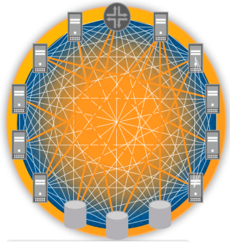
Previous Architectures: (closed) Fabric architectures
6
Limitations:
Complex implementations often problematic in large scale
Difficulty in debugging due to ‘closed’ proprietary solutions
Often platforms are immature which results to bugs
Eventually too many hours wasted in troubleshooting and bringing the solution to ‘production ready’ state.
All tested solutions already outdated
Looking for something new to avoid vendor ‘black box’ solutions
Core Router A
Core Router B
Aggregation Switch
Aggregation Switch
Linecard switch
Linecard switch
LACP
LACP
Link for multi-chassis synchronization
IP Fabric solution for GRNET Datacenters
13 Jun 2018, TNC18, Trondheim

Slide 7
IP Fabric (aka IP Clos): the recipe
7
Topology:
Build a decades old topology → IP Clos
Make use of existing hardware → Juniper QFX5K as ToR switches
Add two new powerhouse Devices for the spine layer → Juniper QFX10K
Overlay Networking with EVPN as control plane
In theory decouple the network from the physical hardware → programmatically provisioned in a much larger scale
All_active physical topologies
Anycast layer 3 gateways
All traffic is L3 with: VXLAN
Dataplane encapsulation for Overlay Tunnels
Limitations: network overhead since all VM traffic is now encapsulated with VXLAN header (+64 bits)
No STP / no MC-LAG
IP Fabric solution for GRNET Datacenters
13 Jun 2018, TNC18, Trondheim
Notes:
7

Slide 8
VXLAN: Brief introduction
8
Overview
RFC 7348
Tunneling (overlay) protocol that encapsulates all traffic in IP/UDP
Can be described as MAC-over-UDP with a globally unique identifier
VLAN-like separation, according to VXLAN ID
Tunnels are build between VXLAN Tunnel Endpoints (VTEPs)
Need of a control plane to minimize flooding and better facilitate learning
Forward traffic between IP Fabric nodes referred to as the underlay
All traffic is L3 no need for STP
Outer IP
VXLAN VNID
Payload
Service Separation
IP Fabric solution for GRNET Datacenters
13 Jun 2018, TNC18, Trondheim

Slide 9
EVPN: Brief introduction
9
Overview
Key Concepts
RFC 7432: BGP MPLS-Based Ethernet VPN
Co-authored by Cisco,Juniper, Alcatel-Lucent, Verizon, AT&T
Stated as evolution over existing L2VPN and VPLS solutions
Can use both MPLS and VXLAN as transport
Solves flood and learn problem mentioned in VXLAN
Provides redundant (anycast) gateways
Active / Active server multihoming
Implemented as another BGP address family (NLRI)
Introduces Route Types for
Ethernet Segment (ES) Auto discovery
MAC/IP advertisement
MAC addresses are treated as routable addresses and advertised via BGP
BUM traffic and loop avoidance
PE devices in same ES auto discovery (allows for active/active)
Traffic is sent to the appropriate VTEP (no flooding)
Route filtering & route distribution
IP Fabric solution for GRNET Datacenters
13 Jun 2018, TNC18, Trondheim

Slide 10
GRNET IP Fabric topology
10
Spine & Leaf topology
SPINE: Juniper QFX1002
nx10G uplink to GRNET core
LEAF: Juniper QFX5100
2x40G uplink
Server:
2x1/10G UTP
Multihoming: In pairs of racks
LACP or Active-Backup
Core Router A
Core Router B
Juniper QFX10K
Juniper QFX 10K
Juniper QFX5K
Juniper QFX5K
Juniper QFX5K
Juniper QFX5K
IP Fabric solution for GRNET Datacenters
13 Jun 2018, TNC18, Trondheim

Slide 11
The Underlay Network
11
Each IP Fabric device acts as L3
eBGP between the devices:
Route distribution of Loopbacks
Multipath load balancing between available paths
Loopbacks & Backbone links from 10.0.0.0/8
One Private AS per device
Unique assignments within GRNET (for future inter-DC connectivity)
Loopback IPs & ASN helps to identify rack number
Loopbacks are used as VXLAN VTEPs (Tunneling Endpoints)
65491
65492
65401
65402
65403
65404
IP Fabric solution for GRNET Datacenters
13 Jun 2018, TNC18, Trondheim

Slide 12
The Overlay Network
12
iBGP mesh among all devices
Additional AS# for iBGP
Spines: route reflectors
EVPN address family (nlri)
EVPN: Advertise MACs (…)
Each PE advertises its local MACs (per VXLAN)
L3 devices advertise MAC-IP bindings (per VXLAN)
L3 (gateways)@Spines
Mostly because of limitations of the leaves (QFX5100).
Distributed Gateway for redundancy and performance
Server ports
Trunk or access
VLAN <-> VXLAN
LACP with two PE devices + loop avoidance
65499
65499
65499
65499
65499
65499
IP Fabric solution for GRNET Datacenters
13 Jun 2018, TNC18, Trondheim

Slide 13
L2 stretch between Datacenters
13
Customer data routing is done at the Spines
Data Center interconnect using ‘Asymmetric routing’ → Egress PE does only L2 lookup to the local ethernet switching table that is populated from the EVPN control-plane
Spines are connected over eBGP underlay to announce the VXLAN termination points (IPs used for the overlay network)
Spines are connected over iBGP overlay to announce the MAC+IP NLRIs (EVPN)
Ingress
MAC-VRF IP-VRF
Egress
IP-VRF MAC-VRF
1
2
3
4
5
MAC REWRITE
IP Fabric solution for GRNET Datacenters
13 Jun 2018, TNC18, Trondheim

Slide 14
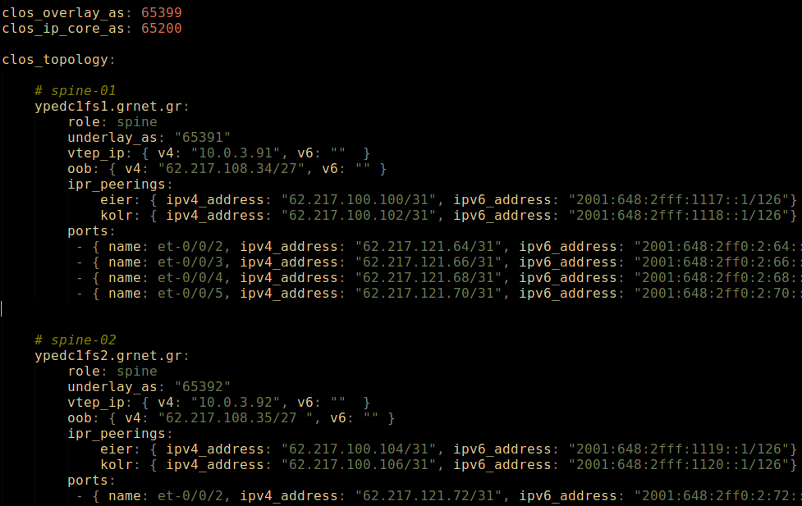
Automation
14
Describe the topology with the addressing scheme in one YAML file
IP Fabric solution for GRNET Datacenters
13 Jun 2018, TNC18, Trondheim

Slide 15
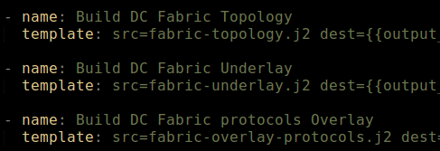
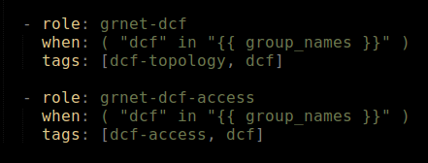
Ansible and IP Fabric
15
Allow new tasks to be executed and build underlay/overlay topologies
New roles (templates + tasks) to our Ansible playbooks
dcf-topology
dcf-service
IP Fabric solution for GRNET Datacenters
13 Jun 2018, TNC18, Trondheim

Slide 16
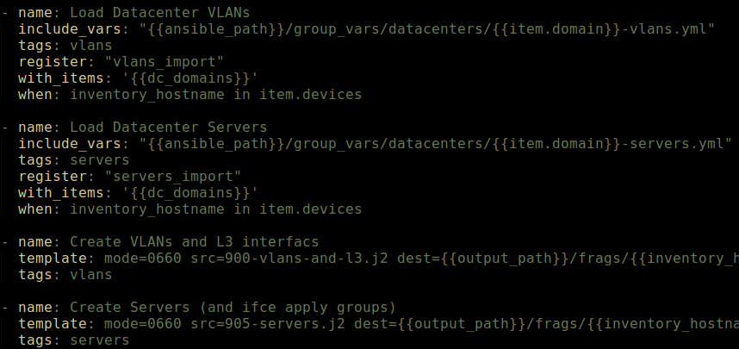
Introduce a new service
16
Build server interfaces, VLANs and Layer 3 redundant gateways via Ansible
IP Fabric solution for GRNET Datacenters
13 Jun 2018, TNC18, Trondheim

Slide 17
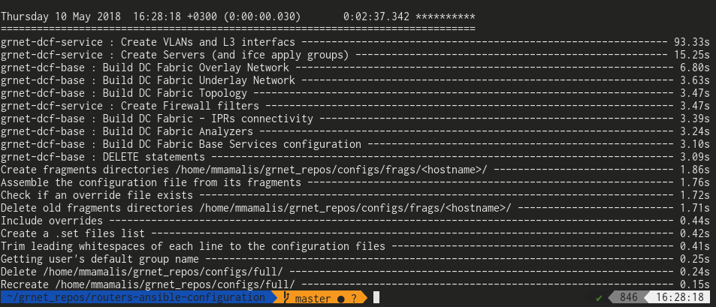
Compete playbook run
17
Build one complete IP Fabric DC configuration and deploy L2 and L3 services in under 3 minutes!
In this example Ansible has produced configuration for 36 Leaves and 2 Spine switches with 597 interfaces and 377 VLANs (!!!)
IP Fabric solution for GRNET Datacenters
13 Jun 2018, TNC18, Trondheim

Slide 18
Reality: An adventure
18
Addressing scheme for
VTEP IPs
IN-band management -> loopbacks
Eventually a new carrier VRF to completely separate the management traffic
Underlay ASNs
Multiply by number of DCs
Many limitations on the Broadcom chipset on QFX5100
Early adoption of EVPN implementation on QFX platforms
Bugs…
Easier troubleshooting due to openness of the solution
Lot of support/attention from Juniper (win-win case)
Netconf support from the beginning: ease of service deployment and configuration changes with Ansible
IP Fabric solution for GRNET Datacenters
13 Jun 2018, TNC18, Trondheim

Slide 19
Thank you!
19
IP Fabric solution for GRNET Datacenters
13 Jun 2018, TNC18, Trondheim

