Slide 1
Innovating in the Trenches: Enhancing AD FS and Azure for Research & Education (R&E)
Chris Phillips, Technical Architect, CAF,
Johan Peterson, IT Architect, Linköping, SUNET | Trondheim 2018| June 11 2018
Notes:
Edit from original– added additional speaker

Slide 2
It Started with a Question
Can we augment AD FS to sufficiently support R&E federations, given its lack of support over the last decade?
  The answer was ‘yes’.
Notes:
[Tom comment – “... participate in our federation” >> “... participate in Canadian Access Federation...”]

Slide 3
Why did we build ADFSToolkit?
Frequently asked for solution: “I already have AD FS installed in production, can I use it?”
CANARIE & SWAMID responsive to feedback from our community
Technical capabilities to install and sustain can be a challenge
Institutional technical roadmap often aligns with AD FS

Slide 4
Introducing ADFSToolkit
A toolkit that uses native Powershell to augment AD FS to support R&E federations
Simplifies participation for institutions that can’t/don’t leverage Shibboleth or other platforms
Enhancements & benefits:
  Agnostic to federation
    Will load any signed aggregate
  Has easier/more clear attribute mapping
  Easy installation and sustainment practice
    Uses existing Microsoft tools and lifecycle practices

Slide 5
Features
Configurable aggregate retrieval
Signature validation by federation operator key
Ingests entities using one-at-a-time trust paradigm
Automatic attribute release policy for R&S Entity Category
Site-specific, per service attribute release capability
Ability to fetch aggregates on hourly basis (scheduled job)
Uses Windows Event Log for easier problem diagnosis

Slide 6







What are the strengths of each solution?
Built for and by R&E Community
Built by Commercial Sector
Multilateral-First (SAML) Solutions
Bilateral-First Solutions
Notes:
Take away:
Multi-lateral tools adept at bi-lateral functions
Bi-Lateral tools not as adept unless work is applied

Slide 7
Installation Process – Shibboleth or ADFSToolkit
4.
Post-installation tailoring
1.
Download
2.
Plan & prepare installation
3.
Install
6.
Contact FedOp to complete registration
5.
Local acceptance testing
Tool benefits:
Federation Pre-configured
Fewer Steps
Hides Complexity
Rapidly Deployed
Proven Interop

Slide 9
Under the Hood
Notes:
Walk through of the installation process using youtube video cues

Slide 10






ADFSToolkit Software Lifecycle
Institution
Produces:
Published To:
Installed by:
github.com/fedtools/
adfstoolkit
PowerShell Module
Published to Repository
Sites pull from trusted Microsoft report
Notes:
[Tom comment – Add “Code signed by CANARIE” bullet to PowerShell Gallery]
Github.com/fedtools/adfstoolkit
Code management
Version Management
Issue ingestion
Linked documentation
Origin for builds
PowerShell Module
ADFSToolkit
One Module
Performs all tasks
Agnostic to organization
Published to Repository
Easily discoverable
Conformant to MSFT Packaging
Official distribution technique for scripts
Code Signed by CANARIE
Sites pull from Trusted MSFT repo
Uses built in commands
Eases Maintenance
Standard Practice

Slide 11
Implementation Approach
Install and run out of the box with default settings
Sites can customize as needed
Implemented sustainably
Notes:
To be spoken to:
Dynamic Category building engine
Caching technique
Configuration

Slide 12
ADFS Toolkit Main Workflow

Slide 13
ADFS Toolkit – Sub Process

Slide 14
ADFS Toolkit - Configuration
Attribute values can be retrieved from 3 different stores
  Active Directory
  SQL
  Custom Store (REST)
  Future store: LDAP
Attributes can be…
  based on value(s) from object(s)
  based on group membership (AD store only)
  static
  restricted, based on value
  restricted, based on Registration Authority

Slide 15
What’s Next for ADFSToolkit?
Review of enhancement requests
  White/black listing of entities
  Load based on entity category filters
  Ability to support MetaData Query (MDQ) protocol
Notes:
To be spoken to:

Slide 16
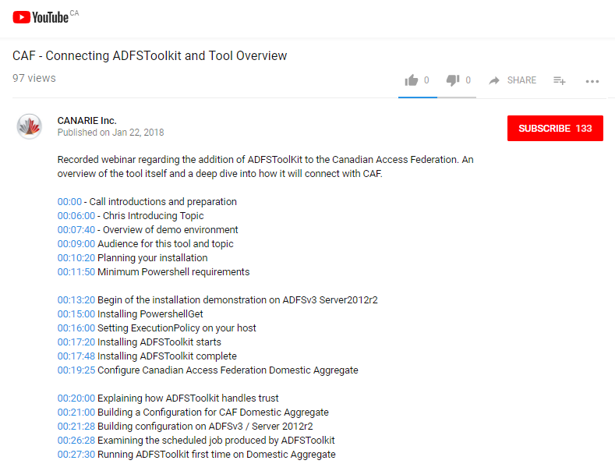
ADFSToolkit Links
Full length installation training
  https://youtu.be/jbHkXOPjYZw
  90 min, chaptered by function & installation step
Link to ADFSToolkit
  https://www.canarie.ca/identity/support/fim-tool
Github issue tracker for feature requests
  https://github.com/fedtools/adfstoolkit/issues

Slide 17
Connecting to Azure / Office365
Notes:
Walk through of the installation process using youtube video cues

Slide 18
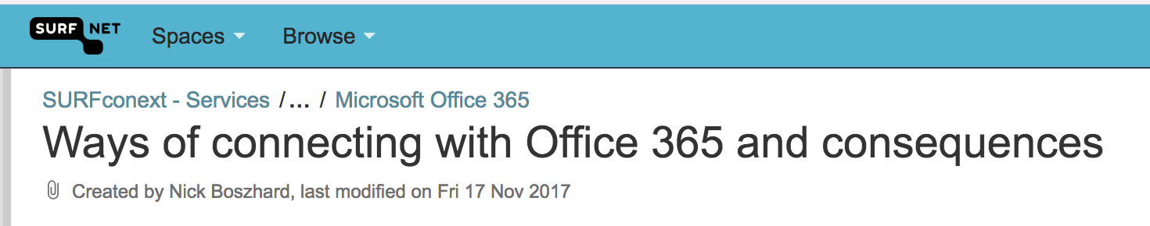
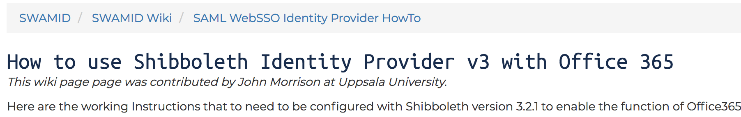
Current State
Still in flux and under review by CAF and our global peers
https://wiki.surfnet.nl/display/services/Ways+of+connecting+with+Office+365+and+consequences
https://wiki.sunet.se/display/SWAMID/How+to+use+Shibboleth+Identity+Provider+v3+with+Office+365
Notes:
[Tom comment - Still a topic in flux and review by us and our peers >> Still in flux and under review by CAF and our global peers]
[Tom comment – Important to communicate that CANARIE has “Integrated cloud solutions” on the CAF roadmap, currently in exploratory/experimentation stage.]
Chris: will talk to those points.

Slide 19
Recommendations
Plan and review your technical roadmap carefully
  What does your current and future application portfolio look like?
  Where will your students, researchers, and staff need to collaborate?
Element | ADFS | Active Directory | FIMS Options
Office365+on Prem | On premises | On premises | ADFSToolkit or Shibboleth on premises
Azure AD+LDAPS, On Prem AD | None | On premises | Shibboleth on premises
Azure or Office365 only | None | Azure | Shibboleth on premise or in VM deployed in Azure
Notes:
[Tom comment – I’m assuming you will speak to potential pitfalls w.r.t. vendor lock-in and cost (not to be included in the slide especially if needs to be made available for public consumption)]
Chris: will speak to it.
[Tom comment – “Azure ADS+LDAPS” >> “Azure AD+LDAPS” according to MSFT]
Resolved.

Slide 20
Conclusion
Regardless of IT platform preference, there’s a path to Federated Identity Management (FIM)
We can leverage on premise or cloud scenarios in both models
See our tools at:
  https://www.canarie.ca/identity/support/fim-tools
  https://wiki.sunet.se/display/SWAMID/How+to+consume+SWAMID+metadata+with+ADFS+Toolkit
Latest announcements:
  https://www.canarie.ca/identity/support/fim-announcements
Notes:
[Tom comment – Add bullet to bottom and draw user attention to our recently updated website, where they can “Check regularly for the latest FIM information by bookmarking: https://www.canarie.ca/identity/support/fim-announcements/“ ]
^^ Will speak to this. We are not very regular on this yet.

Slide 21

Questions?
Notes:
What are the 1 or 2 main/key actions that you HAVE taken OR would like to take for you campus services ?

