Slide 1
Integrating and managing services for the European Open Science Cloud
European Open Science Cloud: From known unknown to known known
Gergely Sipos
Customer and Technical Outreach Manager (EGI Foundation)

Slide 2
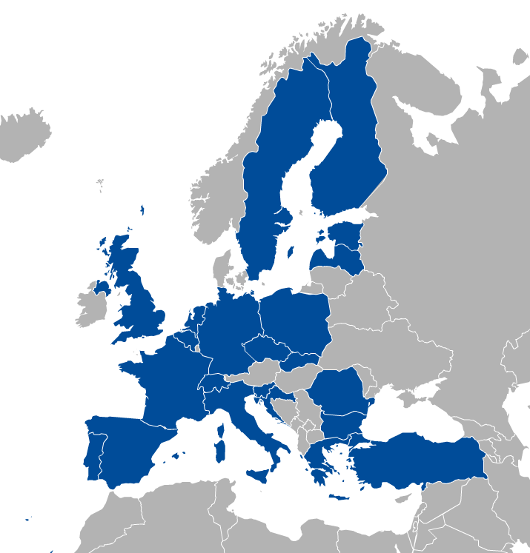
EGI: Federation of national e-infrastructures
Established in 2010
EGI Foundation: Coordinator (Amsterdam, Science Park)
NGIs: National e-infrastructures (22 country + CERN)
Membership fees sustain the federation; Projects innovate (e.g. EOSC-hub)
EGI = Compute, Storage, Data, Training, Consultancy services
Institutional representatives

Slide 3
Outline
EOSC & history in a nutshell
Research community engagement
EOSCpilot & EOSC-hub
EOSCpilot Science Demonstrators, CCs, TSs, BDs, tech-talks, 1-on-1 meetings, …
Findings so far
Partnerships
What’s next?

Slide 4
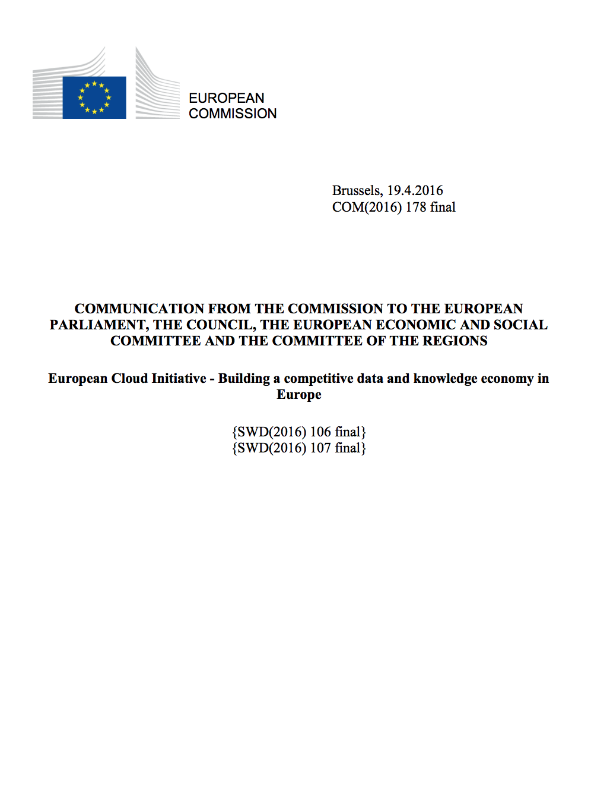
EOSC - Problem statement
How to maximise the incentives for sharing data and to increase the capacity to exploit them?
How to ensure that data can be used as widely as possible, across scientific disciplines and between the public and the private sector?
How better to interconnect the existing and the new data infrastructures across Europe?
How best to coordinate the support available to European data infrastructures as they move towards exascale computing?
European Cloud Initiative by the European Commission (April 2016)
“…a trusted, open environment for the scientific community for
storing, sharing and re- using scientific data and results…”
^{“…by 2020…”}

Slide 5
1st HLEG report (late 2016)
4 Policy; 4 Governance; 7 implementation recommendations
Cloud (=Utility)
For Open Science
Data – Services – People
Rules of Engagement
Federate the gems
F.A.I.R.
Innovative funding (credits?)
Action with Member States
. . .
Notes:
The European Open Science Cloud (EOSC) aims to accelerate and support the current transition to more effective Open Science and Open Innovation in the Digital Single Market. It should enable trusted access to services, systems and the re-use of shared scientific data across disciplinary, social and geographical borders.

Slide 6
What happened since then…
EC activities:
EOSC summits (2017, 2018)
2nd EOSC HLEG (draft report)
EOSC implementation Roadmap (April 2018) (link)
6 action lines (Archi., Data, Services, Access & Interf., Rules, Governance)
Consultation with member states
H2020 projects:
eInfraCentral (2017-19)
EOSCpilot (2017-19)
EOSC-hub (2018-2020)
OpenAIRE-Advanced (2018-2020)
FREYA (2018-2020)
…

Slide 7
EOSCpilot: High Level Aims
The EOSCpilot project supports the first phase in the development of the EOSC. It will between 2017-2019
Establish the governance framework for the EOSC and contribute to the development of European open science policy and best practice;
Develop a number of demonstrators functioning as high-profile pilots that integrate services and infrastructures to show interoperability and its benefits in a number of scientific domains;
Engage with a broad range of stakeholders, crossing borders and communities, to build the trust and skills required for adoption of an open approach to scientific research.
Scientific demonstrators
5x3 demonstrators
1FTE for 1 year / demonstrator
One ‘shepherd’ / demonstrator

Slide 8
List of demonstrators
Environmental & Earth Sciences – ENVRI data integration and harmonised access
High Energy Physics – DPHEP/WLCG long-term data preservation
Social Sciences – TEXTCROWD (PANOSC): Collaborative environment for text enrichment
Life Sciences - Pan-Cancer: Big data analyses
Physics (including materials science): Scale-out community computing facilities
Energy Research – PROMINENCE: HPCaaS for Fusion
Earth Sciences – EPOS/VERCE: Virtual environment for earthquake simulation
Life Sciences / Genome Research: offload regular dataset updates to off-premise system
Life Sciences / Structural Biology: Workflow development, execution and sharing service
Physical Sciences / Astronomy: Easy access to LOFAR data and knowledge extraction
Generic - Frictionless Data Exchange Across Research Data, Software, Paper Repositories
Life Sciences – Genome Research / Bioimaging: Mining a large image repository
Astro Sciences: VisIVO: Data Knowledge Visual Analytics Framework for Astrophysics
Earth Sciences – Hydrology: Reproducible Computational Hydrology by FAIR-ification
Social Sciences, Humanities - VisualMedia: sharing, visualizing visual media files on the web
Recurring needs? – Ongoing analysis in EOSCpilot
Moving beyond demonstration? - Discussion with EOSC-hub…

Slide 9
EOSC-hub mobilises providers from 20 major
digital infrastructures, EGI*, EUDAT CDI** and
INDIGO-DataCloud jointly offering services,
software and data for advanced data-driven
research and innovation.
23 research communities already in the project:
17 academic; 6 SME
* EGI is not an acronym (any more)
** CDI – Collaborative Data Infrastructure

Slide 10
Project figures
European Commission Horizon2020 programme
100 Partners, 76 beneficiaries (75 funded)
3874 PMs, more than 200 staff involved
€33,331,18, funded by:
European Commission: €30,000,000
EGI Foundation and its participants: €2,155,540
EGI participants: €1,221,094
36 months: Jan 2018 – Dec 2020

Slide 11
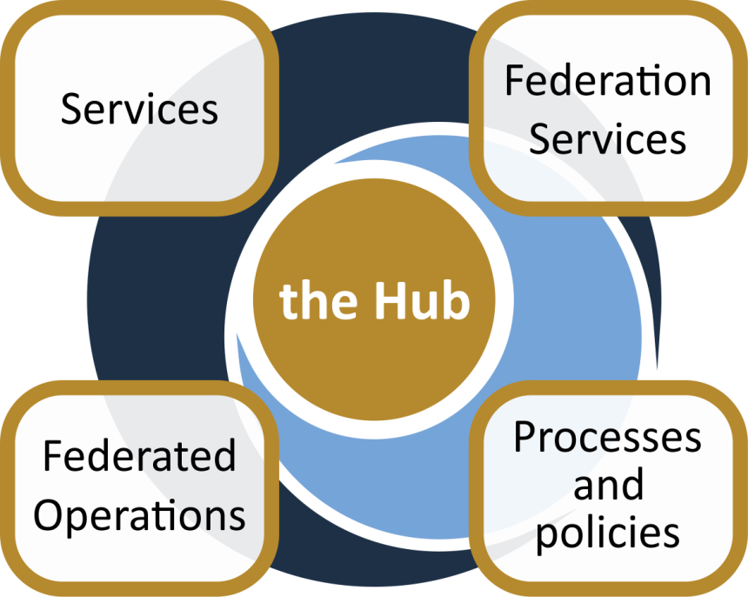
The project creates EOSC Hub:
a federated integration and management system for EOSC
From the consortium AND from external contributors
Usage according to Rules of Participation
Data
Applications & tools
Baseline services (storage, compute, connectivity)…
Training, consultants
Marketplace
AAI
Accounting
Monitoring
…
Lightweight certification of providers
SLA negotiation
Customer Relationship Management
…
Security regulations,
Compliance to standards,
Terms of use,
FAIR implementation guidelines
…
Based on FitSM

Slide 12
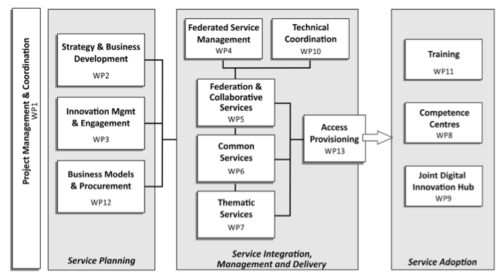
Work packages

Slide 13
Service Integration, Management & Delivery
e-Infra
EGI Federation
EUDAT CDI
Humanities
Language and literature (CLARIN)
Arts (DARIAH)
Engineering
Environmental engineering (sea vessels, LNEC)
Civil Engineering (Disaster Mitigation)
Medical and Health Sciences
Biological Sciences (ELIXIR)
Structural biology (WeNMR)
Natural sciences
INDIGO-DataCloud
Physical Sciences
Astronomy (LOFAR)
Fusion (ITER)
High Energy Physics (CMS and VIRGO)
Space Science (EISCAT-3D)
Thematic services
Generic services
Earth Science
EO Pillar
GEO
Climate Research (ENES)
Seismology (ORFEUS, EPOS)
Biological Sciences
Marine and freshwater biology (IFREMER)
Biodiversity conservation (LifeWatch)
Ecology (ICOS)

Slide 14
Service catalogue
http://www.eosc-hub.eu/catalogue
WP5
WP6
WP7
Open Collaboration services
Basic infrastructure and added-value services
Thematic services
Applications Database
Repositories
ECAS
DARIAH Gateway
OPENCoastS
GEOSS
EO Pillar
WeNMR
DODAS
LifeWatch
CMI
From month 19:
IFREMER
EISCAT_3D Portal
EGI High-Throughput Compute
EGI Cloud Compute
EGI Cloud Container
DIRAC4EGI
EGI Online storage
EGI DataHub
B2HANDLE
B2FIND
B2DROP
B2SAFE
B2STAGE
B2NOTE
ETDR
Sensitive Data Service
Advanced IaaS
TOSCA for Heat
OPIE
WP5
Federation services
Accounting
ARGO
Check-in
GGUS
GOCDB
Marketplace
Operations Portal
RC Auth
SPMT
DPMT
B2ACCESS
TTS
SYMON
+ new service from outside the consortium

Slide 15
Generic services
Open Collaboration services
Applications Database: Virtual appliances and application software repository and management
Repositories: Repositories of verified software to be deployed by the Service Providers

Slide 16
Generic services
Federation services
Accounting: Infrastructure composed by repositories and portal to collect usage statistics of the EOSC-hub services and present them to the stakeholders
ARGO: Monitoring infrastructure to track services status and collect statistics
Check-in: AAI platform for federated authentication to EGI services
GGUS: Helpdesk platform for the EGI infrastructure
GOCDB: Configuration database, service registry
Marketplace: Exposes the service catalogue to services and collects service orders
Operations Portal: Operational tools to manage distributed infrastructures
RCAuth: Online CA for the translation of credentials to X.509 certificates
SPMT: Service portfolio management tool
DPMT: Configuration management & data management tool for the users
B2ACCESS: AAI platform for federated authentication to EUDAT services
TTS: RT-based helpdesk service for the EUDAT infrastructure
SYMON: Service to monitor the deployed service versions

Slide 17
Generic services
Basic infrastructure and added-value services
EGI HTC: High-throughput compute
EGI Cloud Compute: Infrastructure as a service cloud compute
EGI Cloud Container: Docker containers cloud computing
DIRAC4EGI: Workload management service for computational tasks both on cloud and HTC
EGI Online storage: Store data in a reliable and high-quality environment and share it across distributed teams
EGI DataHub: Access public datasets and consume them from compute services
B2HANDLE: Persistent ID management
B2FIND: Metadata based data-discovery service
B2DROP: Secure and trusted data exchange service for researchers
B2SAFE: Distribute and store large volumes of data based on data policies
B2STAGE: Data transfer between resources and computational facilities
B2SHARE: Store / publish research data
B2NOTE: Data annotation service
ETDR: European certified Trusted Digital Repository
Sensitive Data Service
Advanced IaaS
TOSCA for Heat: Support for TOSCA templates in OpenStack heat component
OPIE: Open source implementation of spot instance virtual machines for OpenStack

Slide 18
Disciplinary services
Thematic services
ECAS: Climate Analytics Service
DARIAH Gateway: A portal tailored for the digital arts and humanities communities
OPENCoastS: On-demand Operational Coastal Circulation Forecast Service
GEOSS: GEO DAB (Discovery and Access Broker), GEOSS portal
EO Pillar: Earth observation services coordinated by ESA. The tools are: MEA, EPOSAR, Sentinel playground, Datacube analytic service, Geohazards exploitation platform, OSS-X Sentinel service
WeNMR: Online portals for structural biology analytics: DISVIS, POWERFIT, HADDOCK, GROMACS, AMPS-NMR, CS-ROSETTA, UNIO, FANTEN
DODAS: Dynamic On Demand Analysis Service
LifeWatch: PAIRQURS, Citizen science services, GBIF, Digital Knowledge preservation framework, remote monitoring and smart sensing.
CMI: The Component MetaData Infrastructure, including the Virtual Language Observatory and the Virtual Collection Registry. Provided by CLARIN-ERIC

Slide 19
Mapping Services to the research data lifecycle
4
Access, Deposition & Sharing
Application DB (software & VM)
B2DROP (data)
B2Note (data)
B2SHARE (data)
DataHub
3
1
Data Management, Curation & Preservation
Federation Services
Discover & Reuse
B2HANDLE
B2SAFE
European Certified Trusted Repository
Federated AAI. monitoring, accounting
SLA and order Management
Security incident response and policies
Technical support & Training
B2FIND (data)
Marketplace (Services)
2
Processing & Analysis
Applications on Demand
Federated HTC & Cloud Compute IaaS & PaaS
Processing of sensitive data
Jupyter Notebook
Thematic data analytics
Scientific Workflow Management, Orchestration (DIRAC, PaaS Orchestrator)

Slide 20
IT Service Management
Why IT service management (ITSM)?
About 80% of all IT service outages originate from "people and process issues"
Duration of outages and degradations significantly dependent on non-technical factors
IT service management
Focuses on the provision of high quality IT services that meet customers' and users’ expectations
Defines, documents and maintains service management processes through assigned roles and responsibilities
Reasons for service outages
[Gartner]

Slide 21
FitSM: Requirements
Example – Service Portfolio Management requirements:
PR1.1 A service portfolio shall be maintained. All services shall be specified as part of the service portfolio.
• PR1.2 Design and transition of new or changed services shall be planned.
• PR1.3 Plans for the design and transition of new or changed services shall consider timescales, responsibilities, new or changed technology, communication and service acceptance criteria.
• PR1.4 The organisational structure supporting the delivery of services shall be identified, including a potential federation structure as well as contact points for all parties involved.
FitSM defines 85 requirements that should be fulfilled by an organisation (or federation) offering IT services to customers
Compliance with the 85 requirements can be regarded as a "proof of effectiveness"
The 85 requirements are structured as follows:
16 general requirements (GR)
69 process-specific requirements (PR)
Consideration of the 14 IT service management processes from the FitSM process model
Between 2 and 8 requirements per process
FitSM service management processes:
Service portfolio management
Service level management
Incident management
Change management
Capacity management
Information security management
…

Slide 22
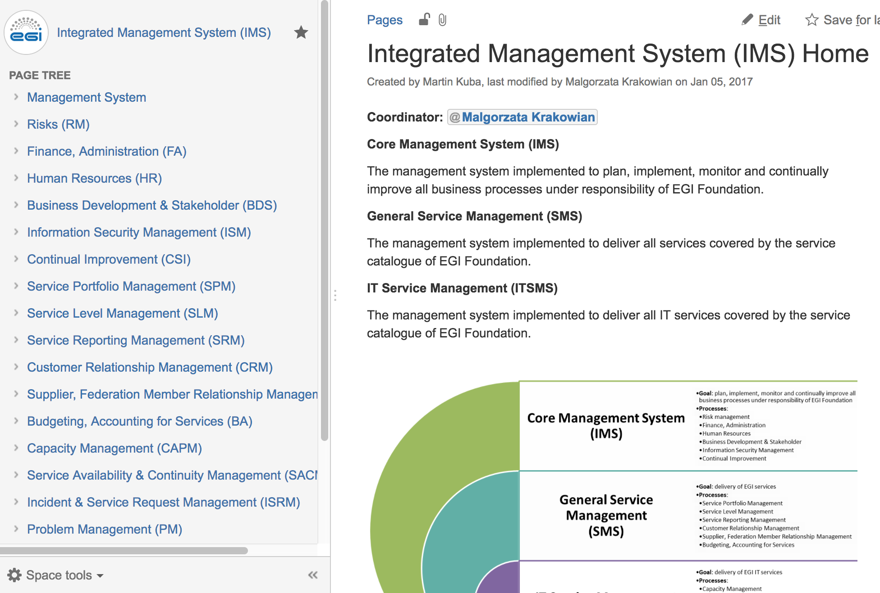
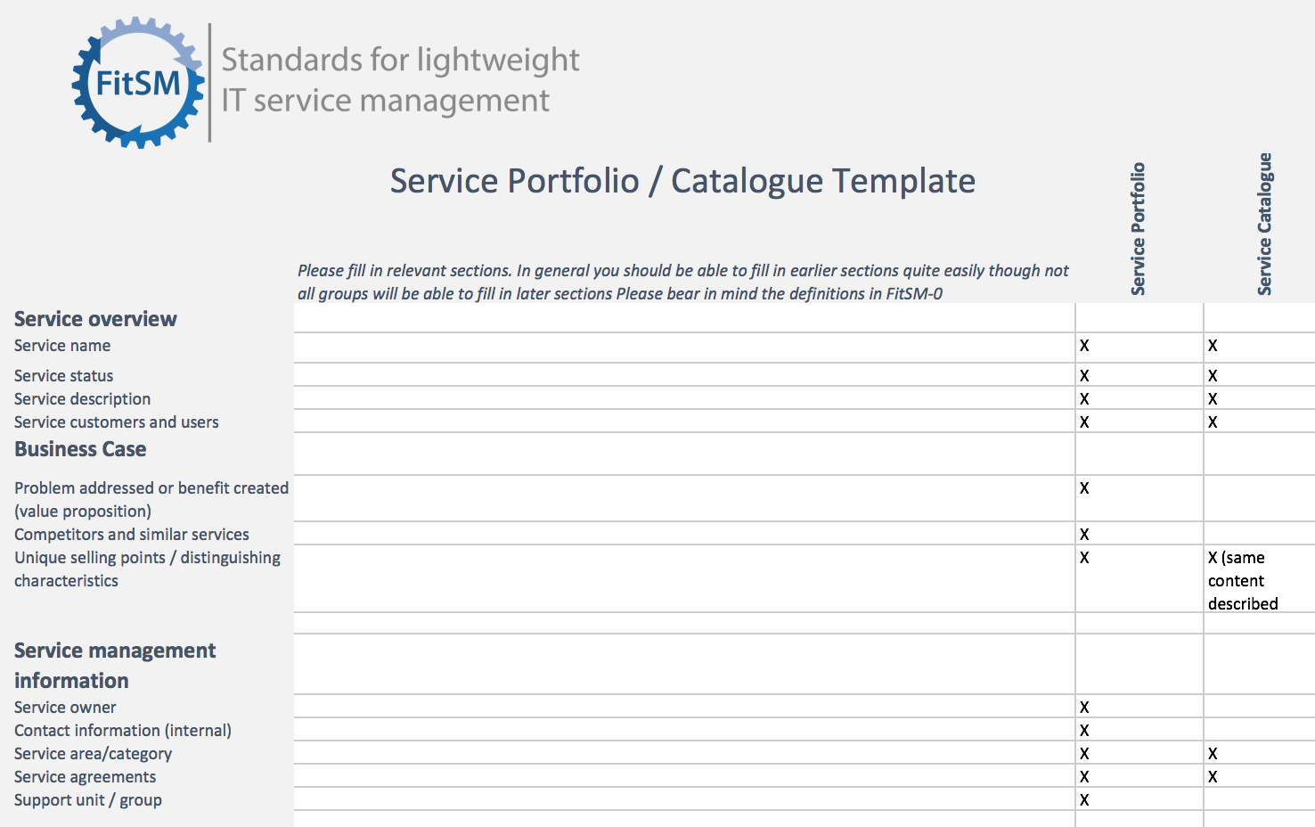
Addressing requirements: Technical tools
Process documentation
e.g. Confluence, Wikimedia
Ticket tool
e.g. GGUS, JIRA, RT
Templates
e.g. Word docs, Excel, Google Apps, Forms

Slide 23
Work packages

Slide 24
CLARIN
CMS (DODAS)
Climate (ECAS)
GEOSS
OPENCoastS
WeNMR
EO Pillar
DARIAH
LifeWatch
CyberHAB (SME: Ecohydros)
Moxoff (3 SMEs + CINECA)
Bot Mitigation Engine (2 SMEs + PSNC)
Suite5Pilot (2 SMEs + CINECA)
ACTION Seaport (SME: Bentley Systems)
DS-DRACO (SME: Hidronav + CESGA)
Service adoption
ELIXIR
Fusion (ITER)
Marine
EISCAT_3D
EPOS-ORFEUS
LOFAR
ICOS-eLTER
Disaster Mitigation
EOSC federating core
Thematic services (9)
WP5
WP6
WP5
WP7
Federation Services
AAI, Accounting, Monitoring, Operations, Security
Added value services
Compute, data, software management, curation & preservation
Open Collaboration Services
Application/software repository, Configuration management, Marketplace
WP10
integration
WP6
Basic infrastructure
Compute and storage
integration
integration
Engagement and support for new communities
integration
WP10
WP10
Provide
WP10
incubate
Integrate & Consume
incubate
Competence Centres (8)
Business pilots (6)
New communities
WP3
WP4
WP8
WP9

Slide 25
Community requirements odyssey
Focus in 2018: 23 existing communities
We built a truly community proposal (using open calls)
Community events (~every months)
Kickoff meeting; EOSC-hub Week, DI4R, …
1-on-1 engagement teleconferences
WP10 tech support
Tech-talks → Area-specific consultancy web-meetups
Storage; AAI; Cloud-Containers-Orchestration
Webinars
Cost efficient training
→ Confluence-based DB for tracking and analysis

Slide 26
Use cases - Competence Centres (WP8)
 | Challenges | Relevant EOSC-hub services
ELIXIR CC | Establish a federation of cloud providers to replicate ELIXIR Core Datasets and Applications Bring these cloud-data providers into EOSC Enable federated AAI across life science and EOSC services | Federated Cloud AAI Operational policies Experience with Virtual Access Code of Conduct for sensitive data
Fusion CC (ITER) | Port fusion workflows to federated compute environment Federate and enable access to distributed datasets Application and data provenance | AAI Data and compute federation (containers) Workflow management Monitoring, helpdesk, PIDs, ...
Marine CC (Ifremer, Euro-Argo) | Cloud-based data subscription and data delivery service (from EMSO, Argo, SeaDataNet, etc.) Enabling users’ simulations to run within custom environments on ‘subscribed data’ Operate the setup as an EOSC service | Storage and compute clusters Data discovery and staging (B2Find, B2Stage) Jupyter service (24/7) FitSM (IT service management)
EISCAT_3D CC | Make EISCAT data accessible via a ‘data webshop’ Enable online data analytics for researchers (based on community and custom applications) Operate the data-compute portal as an EOSC service | B2Share (metadata schema management) DIRAC file catalogue and application manager for researchers Federated compute sites (cloud) User authentication, authorisation (VOMS, Perun) FitSM (IT service management)

Slide 27
Use cases - Competence Centres (WP8) (cont)
 | Challenges | Relevant EOSC-hub services
EPOS - ORFEUS CC | Effective transfer and staging of big data Harmonised data management policies at seismic observatories Enable researchers to analyse data, create and publish ‘user-defined data products’ | AAI Data staging and transfer services Federated compute services Jupyter (data access and analytics environment) Data Management good practices
Radio Astronomy CC (LOFAR→ SKA) | Enable researchers to find, access and process data from the LOFAR Telescope Support application developers in deploying workflows for researchers Support research users in data analytics on federation of compute clusters | B2Find - B2Share B2Stage B2Safe B2Handle (PIDs) Jupyter Federated compute and storage resources
ICOS-eLTER CC | Enable researchers to find, access and process data from ICOS and eLTER Integrate ICOS Portal and analysis tools with large-scale storage and compute resources Support research users in data analytics on federation of compute clusters | B2Safe B2Find B2Stage Federated cloud
Disaster Mitigation Plus CC | Setup simulation web portals for simulation of natural hazards (storm surge, dust transportation, forest fire, flood) Federate environmental data from agencies in Asia-Pacific region | Federated compute resources (HTC and cloud) Operational tools FitSM

Slide 28
Distilled use cases (WP8)
Distilled use case | Implementation by | Relevant services
Application and data platform (portal/mobile) | EISCAT_3D ICOS-eLTER | DIRAC B2Stage, B2Share B2Safe | EOSC-hub AAI Fed.Cloud Containers Storage (online, archive)
Data and application replication ‘backbone’ | ELIXIR EPOS-ORFEUS | FTS, B2Stage Kubernetes Life science AAI; EPOS AAI
‘Dropbox with pattern-matching’ for data streams | Marine | B2Find, B2Stage Jupyter
User workflows over distributed data and compute | Fusion Radio astronomy Disaster Mitigation | DODAS OneData Jupyter

Slide 29
(Some) open questions
EOSC for the long-tail
Reaching and serving inter/multi-disciplinary researchers
EOSC portal vs. eInfraCentral vs. EOSC-hub Marketplace vs. …
Capacity allocation

Slide 30
Partnerships
OpenAIRE-Advance (EINFRA12)
EOSC-hub ~ storage, compute, application services
OpenAIRE ~ RDM; Publication services
National & research community building; Tech. integration; Governance
National e-infra contacts: https://docs.google.com/spreadsheets/d/1sRyUFx5oEVZrtkiQ8t1Bg2amh1qU1M2rvfs7H1i3JlQ/edit#gid=0
GEANT 4-2 (MoU in prepapration) Strategy and Business Development; Innovation Management…; Federated Service Management; AAI Cloud interoperability & integration; Technical Coordination
NRENs pls get in touch with your peers!

Slide 31
What’s next?
2018:
EOSC-hub Rules of Participation (for providers)
EOSC-hub Marketplace (to replace the Web catalogue)
DI4R in Lisbon (Oct 9-11)
Call for contribution is now open (until Jun 29)
2019-:
Focus on external communities
Interfacing with new INFRAEOSC-* projects
Governance; RI clusters; Commercial procurement; etc.

Slide 32
Thank you for your attention!
Contact:
www.eosc-hub.eu
Gergely.sipos@egi.eu
Questions?

