Slide 1
Global NREN Collaboration platform
Nick Buraglio
ESnet Planning Team
Lawrence Berkeley National Laboratory
TNC 18
Lightning talk
06/2018

Slide 2
NRENs
Regardless of size, geography, funding
NRENs are a unique and specialized resource
We are driven by a significantly different mission need than a commercial network
We have specialized problems and issues
NRENs often require creative solutions to the unique complications and obstacles
We are more similar than different
International network collaboration is critical
Security policy discussion
Coordination and collaboration

Slide 3
Ongoing discussions on...
Automation
Discussions on
Progress
Models
Platforms
Troubleshooting
Tactical issues
“How do we get in contact with X”
“How can we temporarily get traffic to Y”
Future and planning efforts
Platforms
Protocols
Deployment models
Architecture changes
Coordination of efforts
See above
NREN specific discussions
Peerings
Locations
Interconnect
Conferences
Camaraderie
Notes:
based on a brief conversation with David Wilde from AARnet and a bunch of coordination with Mary Hester of nordunet, we put together a slack. At this time we have 104 members from 20 distinct NREN or international networking entities. We’ve had ongoing conversations

Slide 4
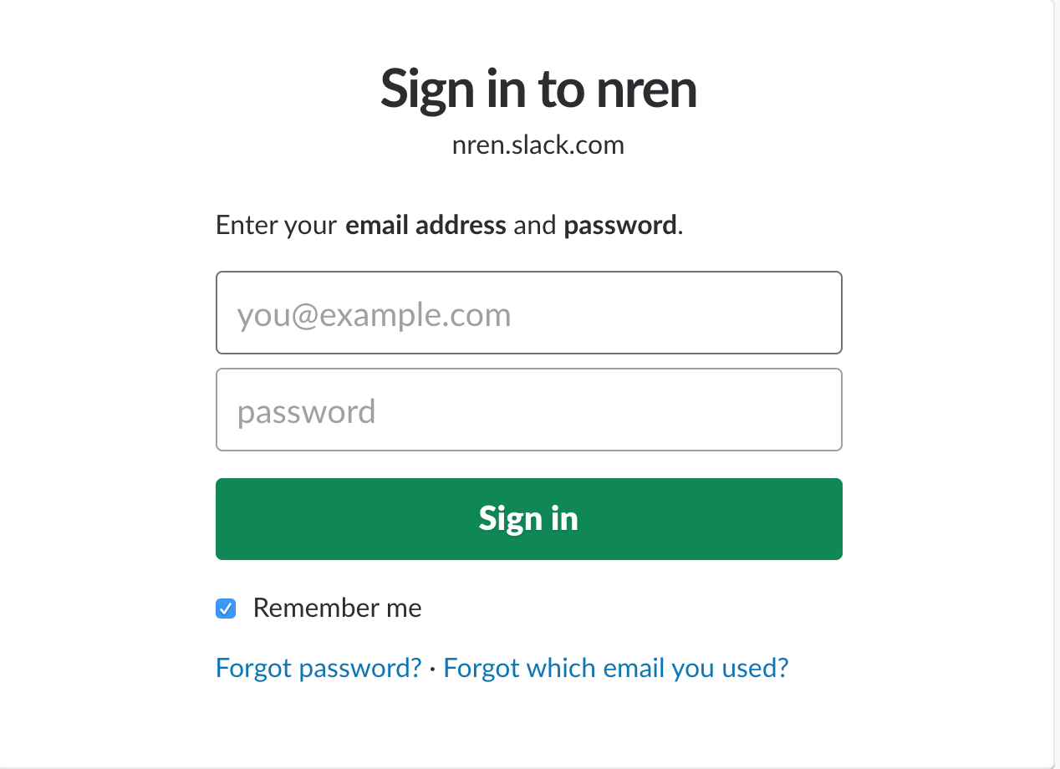
If you’re an NREN, Lets talk...
Notes:
based on a brief conversation with David Wilde from AARnet and a bunch of coordination with Mary Hester of nordunet, we put together a slack. At this time we have 104 members from 20 distinct NREN or international networking entities. We’ve had ongoing conversations

