Slide 1
GÉANT Network Evolution
Guy Roberts, Sebastiano Buscaglione, Mian Usman
Trondheim
12 June 2018

Slide 2

Building a new network
Challenges:
Traffic growth/cost control
GN4-3 IRU
Infrastructure sharing
CTO
Workshops
& approval
Platform
Evolution
Financial
Modelling
RFI
Regional
Studies
Notes:
July 2017 - regional studies established to define regional needs and gathering local intelligence
First CTO workshop Nov 2017
An additional regional study for central Europe
Large RFP to market for connectivity (525 quotes / 35 providers)
Built financial model for traffic forecasting and analyse cost impact of options
Regional studies meeting in Rome to consolidate topology
Second CTO workshop May 2018
Governance review and ratification

Slide 3

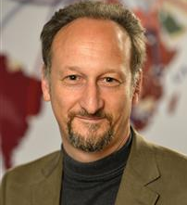
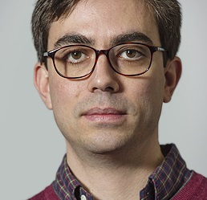

GÉANT network architects
Guy Roberts
Regional Studies
Sebastiano Buscaglione
Planning the Network Topology
Mian Usman
Platform Evolution
Notes:
Three network architects in GÉANT
They have developed the network evolution strategy

Slide 4
GÉANT Network Evolution
Regional Studies
Guy Roberts
Trondheim
12 June 2018

Slide 5

Scoping a new network – the process
CTO
Workshops
& approval
Platform
Design
Financial
Modelling
RFI
Regional
Studies

Slide 6
Regional studies - objectives
Preparation for next network, began 12 months ago. Fibre contracts expire in 2020
Network topology – fibre and circuits
Survey users and network capacity requirements
Review existing infrastructure and potential to share NREN fibre
Pricing intelligence
Regional Study reports & consolidation
Notes:
Existing infrastructure
Review of GÉANT topology and PoPs
Review of existing NREN infrastructure
Review of commercial fibre availability in the region
Cost Analysis
Intelligence in the local region
Moving to more infrastructure sharing with NRENs
Collect offers from NRENs and commercial providers

Slide 7







































Five regional studies
Baltic - Led by Ieva Muraškienė
Belarus
Latvia
Estonia
Lithuania
Finland
UK/Ireland
Led by Guy Roberts
Denmark
Sweden
Norway
Russia
Poland
Central Europe region - Led by Sebastiano Buscaglione
UK
Ireland
Austria
Czech
Republic
Italy
Malta
Holland
Belgium
UK
Hungary
France
Germany
Poland
Switzerland
Slovenia
Croatia
Spain
Luxembourg
+ Nordunet
Iberian Peninsula
Led by Emanuel Massano
South East Europe - Led by Pavel Skoda
Portugal
France
Greece
Hungary
Bulgaria
Albania
Israel
Macedonia
Croatia
Spain
Romania
Cyprus
Serbia
Slovakia
Turkey
Montenegro
7

Slide 8
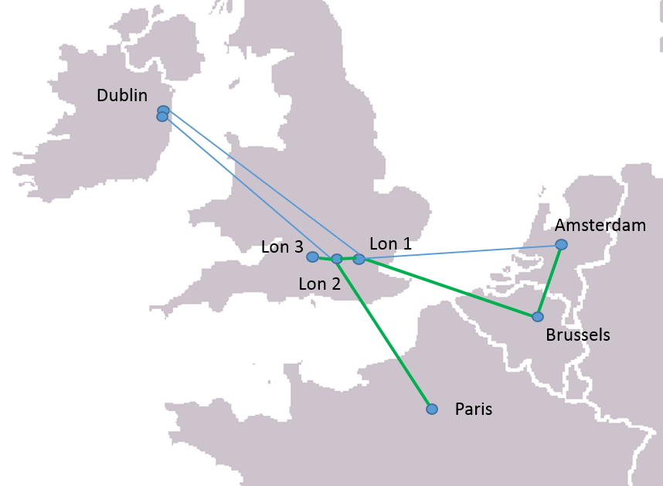
UK/Ireland - Current
Western dark fibre ring passes through London
Two PoPs in London with extension link to Jisc
2 x 100G leased circuits to Dublin
Two PoPs in Dublin
Notes:
Existing connectivity:
Western dark fibre ring passes through London
Two main Pops in London with extension link to Jisc
2 x 100G leased circuits to Dublin
Two PoPs in Dublin

Slide 9
UK/Ireland – Challenges
Challenges
Meet growth for 15 years
Remove London shared risk
100G transatlantic circuit landing in Dublin
Second Ireland PoP outside Dublin
Meet GÉANT core from another UK city
More subsea diversity
Solutions
IRU on subsea system will support London bottleneck bypass
Manchester PoP and third link out of UK

Slide 10
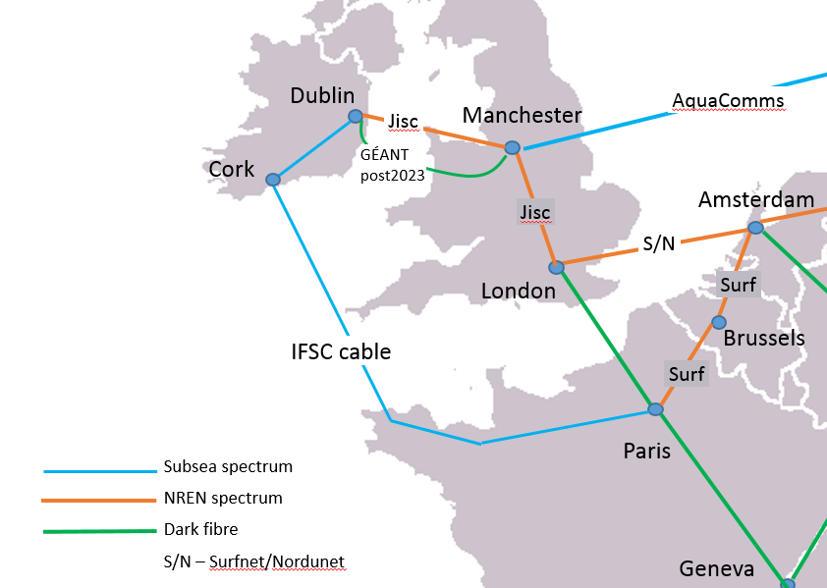
UK/Ireland – Proposal
Subsea bypass of UK
Make use of UK fibre in future
Third link out of UK
Notes:
Lon-Dub route uses Jisc spectrum and proposes moving second UK PoP to Manchester
Aqua Comms link used for third link to Europe
Requires a collaboration after 2023 to updated Manchester-Dublin fibre
Reserve some IRU contingency for this

Slide 11
Iberian Peninsula – Current
LON
Dark fibre extends to Madrid
100Gbps to Paris, 20Gbps to London
Each PoP has two links back to dark fibre core
PAR
Dark Fibre
100 Gbps leased circuits
20 Gbps leased circuits
20 Gbps CBF from NRENs
MAR
LIS
MAD
LIS
LIS-Lisbon, MAD-Madrid, PAR-Paris
MAR-Marseille, LON-London
Notes:
Current dark fibre footprint extends to Spain (Madrid – Marseille)
100Gbps link to Paris
20Gbps link to London
Each PoP has two links back to a GÉANT dark fibre PoP

Slide 12
Iberian Peninsula – Challenges
Challenges
No fibre to Portugal
Long-line to fibre core
-> poor latency
Need connectivity for
BELLA
Solutions
Fibre IRU will support growth and services
Fibre ring for in region will remove long-line back to fibre core for smaller NREN
Link BELLA landing station on fibre will allow capacity expansion

Slide 13
Iberian Peninsula – Proposal
Dark Fibre
100 Gbps managed service
NREN CBF
PAR
Establish an Iberian ring with fibre to Portugal
New PoP in Bilbao, move PoP to Porto or Sines
Results in improved resiliency/latency
Support BELLA traffic
BIL
POR
MAR
MAD
LIS
SIN
LIS-Lisbon, MAD-Madrid, PAR-Paris
MAR-Marseille, LON-London

Slide 14
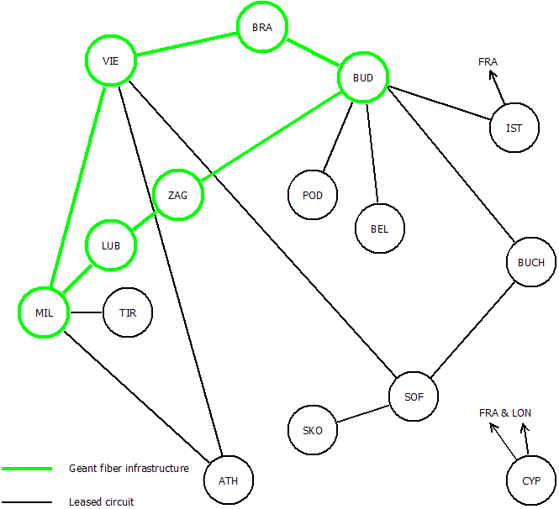
South East Europe - Current
Dark fibre in Croatia, Slovenia and Hungary
20Gbps leased ring to Athens
20Gbps ring to Bulgaria and Romania
‘off-net’ PoPs has two links back to a GÉANT dark fibre PoP where possible

Slide 15
South East Europe - Challenges
Challenges
Many large countries not on dark fibre
Remove hub-and-spoke architecture
Use NREN spectrum
Solutions
Dark fibre allows for traffic growth, and GÉANT Lambda service
Allows small to be connected to nearby country
Mesh of architecture will reduce latency
Reduced cost

Slide 16
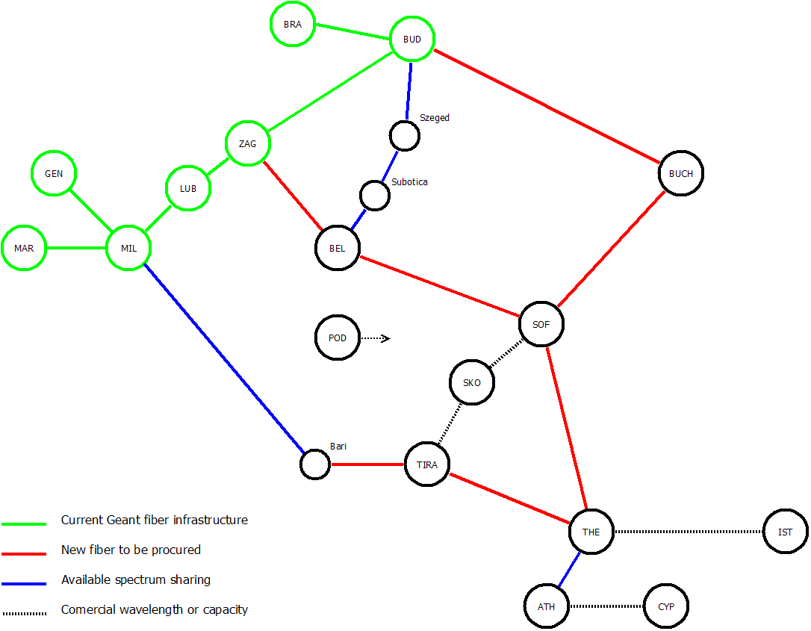
SE Europe - Proposal
Notes:
Ring to Athens
Ring allows Macedonia, Montenegro and Albania to be connected locally
Improved latency for local traffic
Spectrum on GARR, GRNET, NIIF, AMRES, RoEduNet

Slide 17
Baltics – Current
Ring with 2x10G
Commercial and NREN circuits
Dark Fibre
NREN operated leased circuits
Leased circuits
TAL-Tallinn, TSIR-Tsirguliina, RIG-Riga, SIAU-Siauliai, KAU-Kaunas, POZ-Poznan, FRA-Frankfurt, HAM-Hamburg, HEL-Helsinki, AMS-Amsterdam, LON-London, GEN-Geneva, PRA-Prague

Slide 18
Baltics – Challenges
Challenges
Traffic growth
Lack GÉANT lambda services
Solutions
IRU will support growth and services
Fibre ring

Slide 19
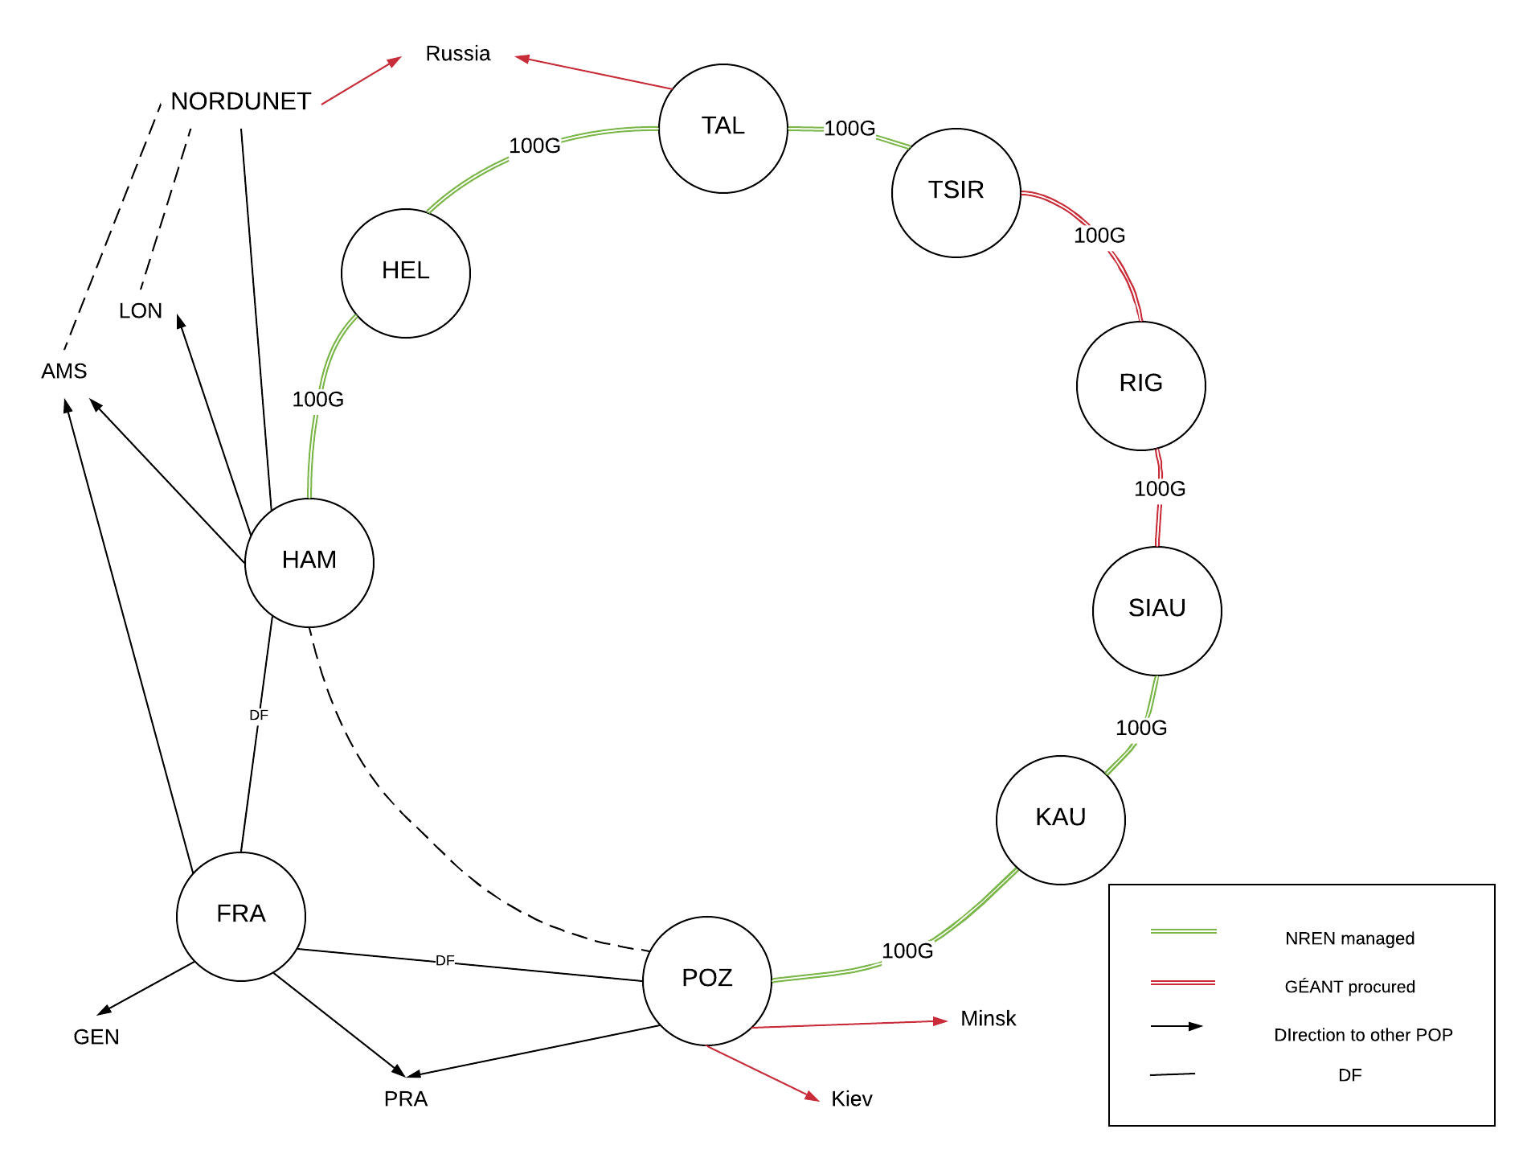
Baltics - proposal
TAL-Tallinn, TSIR-Tsirguliina, RIG-Riga, SIAU-Siauliai, KAU-Kaunas, POZ-Poznan, FRA-Frankfurt, HAM-Hamburg, HEL-Helsinki, AMS-Amsterdam, LON-London, GEN-Geneva, PRA-Prague
Notes:
Objective: to close the Baltic Ring with NREN fibre where possible
Fibre based services available all through the region
Spectrum offers available from NORDUNET, PSNC, LITNET, EENET

Slide 20
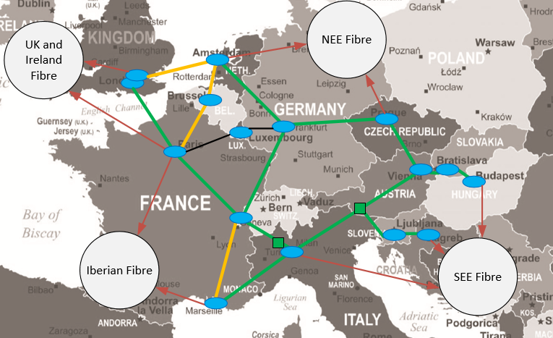
Central European - Proposal
More fibre sharing.
Shortcut through Brussels on Amsterdam – Paris to form two smaller rings. Reducing latency and improving re-routing.
Smaller sites on Eastern ring moved out of the Central ring to be connected via Eastern European fibre infrastructure.
Luxembourg still connected via lease capacity, but fibre sharing explored. Included potential Paris – Frankfurt shortcut.

Slide 21
Summary
Five studies carried out
Each have reported the requirements for their region
These are being used as inputs to the network design
Local expertise key to good solution
Full results available in reports

