Slide 1
SA NREN’s strategic investment in the WACS undersea cable
12 June 2018
By Siju Mammen
Head of Network Engineering, SANReN

Slide 2
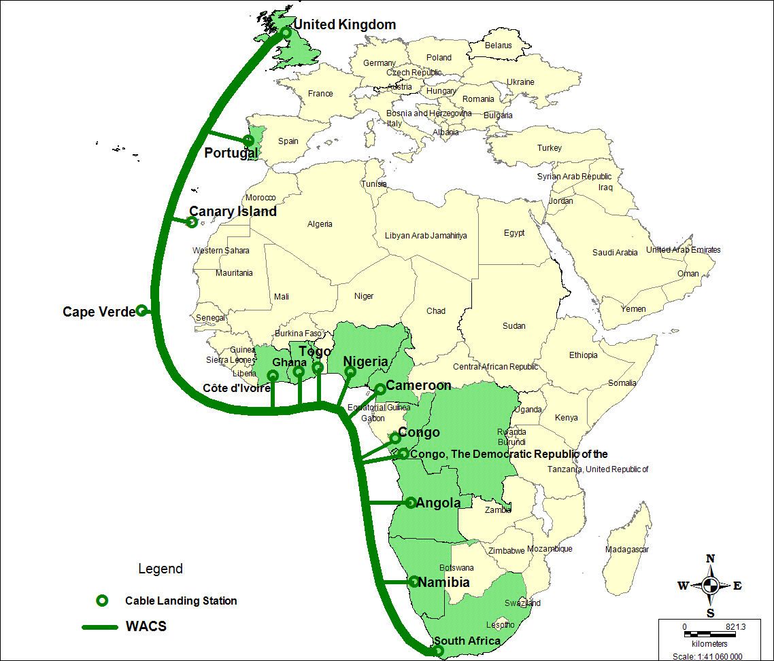

Slide 3
SANReN’s WACS Investment
USD60m investment in 2013 for 7.4% right-of-use in the WACS undersea cable.
This investment is mediated through one of the South African Telecommunications companies, BBI
Access to all WACS drop-off points along West African coast

Slide 4
What does this practically mean?
Currently SANReN has the right to light up to 210Gbps between SA and UK, of which the SA NREN has already lit 110 Gbps.
If the SA NREN requires more capacity, we simply request more wavelengths to be lit.
This capacity may grow to a possible 1,5 Tbps through future WACS upgrades.

Slide 5
Purpose
The plan was to set aside 50% of the WACS capacity for the SKA, and 50% for rest of higher education and science communities
SKA’s current planned international capacity requirement will be in the region of 100Gbps in 2023.
SKA’s requirement turns out to be a small fraction of the available capacity for SANReN.

Slide 6
Uses for the Capacity
Over and above lighting the capacity for the SA NREN’s own needs, we can swap capacity on WACS for capacity on other undersea cables.
This has allowed the SA NREN to obtain 60Gbps undersea capacity on both the east and west coast of Africa
Other swaps are being negotiated
Swaps for terrestrial capacity is also possible.
SANReN may also assist other NRENs and RRENs with their undersea capacity requirement.

Slide 7
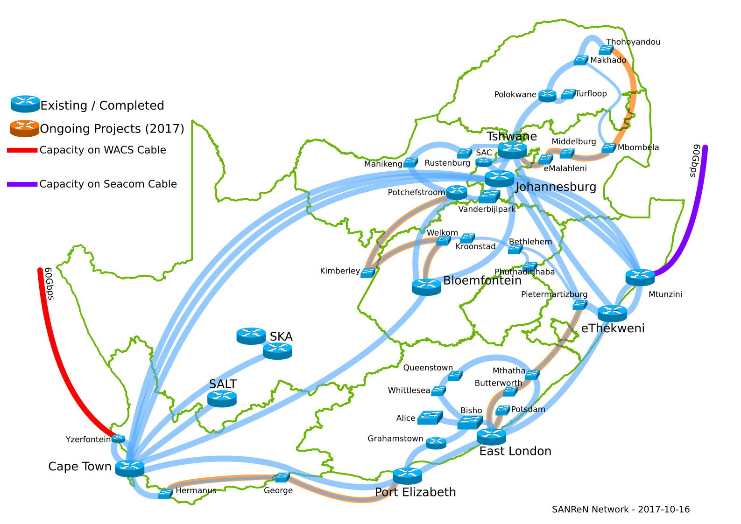

Slide 8
Message to the Community
If possible, invest in an undersea cable system rather than simply buying capacity from suppliers
Preferably at an early stage.
Upfront costs are significant, but gives access to cheaper capacity in the long run and affords greater flexibility in term of adding capacity as needed.
The ability to do swaps has effectively normalised the cost of undersea capacity for the SA NREN in South Africa.

Slide 9
Learn from the SA NREN’s experience
Try to invest directly on the cable system and not through a telco.
Plan for resources to participate in the strategic/operational decision making mechanisms of the cable system.
Budget for and participate in all equipment upgrades.

Slide 10
Questions and Comments
Please direct all questions and comments to:
Siju Mammen
Email: siju@sanren.ac.za
Tel: +27 12 841 4213
Cell: +27 82 303 4657

