Slide 1
In and Out of Africa: Improving Routing for International R and E Traffic
Edward Moynihan, Andrew Lee June 10, 2018

Slide 2
Indiana?
Notes:
But first a little context
10th largest public – 50 thousand
We are a team of 6 - IN@IU –
Home of the GlobalNOC, operates the campus network, the state network, the national Internet2 network, and the IRNC network, among others
Host Loss% Snt
1. 0.0% 263
2. 0.0% 263
3. unknown.uni.net.za 0.8% 263
4. 196.32.210.33 0.4% 263
5. ubuntunet-srv.tenet.ac.za 0.0% 263
6. 196.32.210.2 0.0% 263
7. xe0-0-1-500-ua-uk-ldn1-01.ubuntunet.net 0.8% 263
8. xe-0-0-0.pr1.ldn1.uk.ubuntunet.net 0.0% 263
9. ubuntunet.mx1.lon.uk.geant.net 0.0% 263
10. ae0.mx1.ams.nl.geant.net 0.0% 263
11. ae0.mx1.fra.de.geant.net 0.0% 263
12. abilene-wash-gw.mx1.fra.de.geant.net 0.0% 263
13. et-5-0-0.104.rtr.atla.net.internet2.edu 0.0% 263

Slide 3
Goals for Session
Overview of IN@IU and NEAAR
Present Routing Research and a few examples
Consistent venue for further discussion?
Shared routing policies?

Slide 4
The NEAAR Collaboration
Funding from US National Science Foundation
$3.25M over 4 years
Partners:
Indiana University
GEANT
UbuntuNet Alliance
WACREN
ASREN
SANREN/TENET

Slide 5
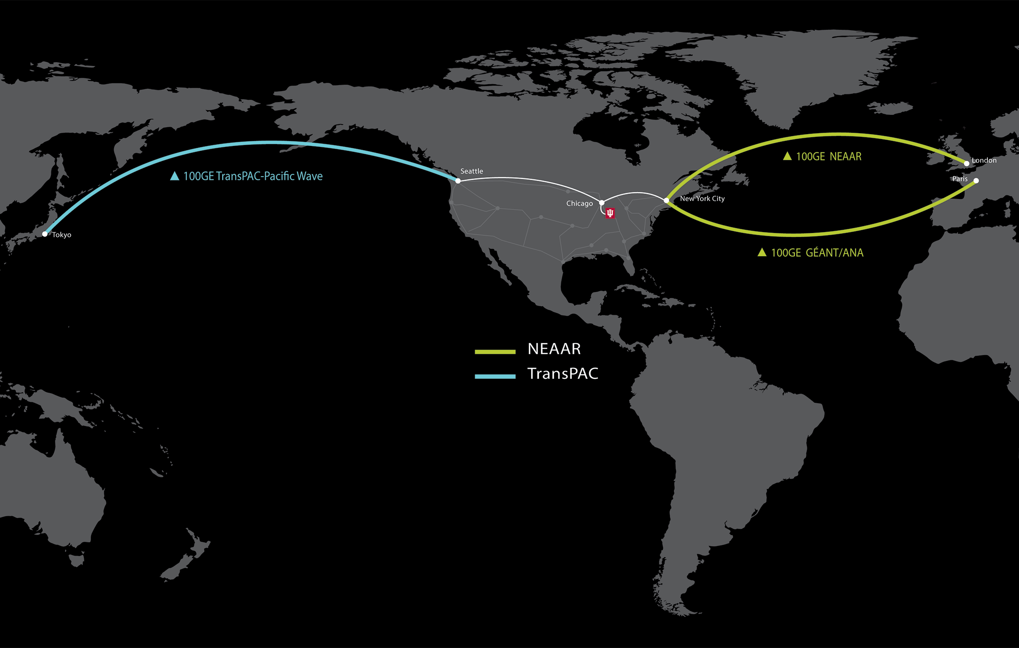
NEAAR and TransPac
100G circuit US to Europe
100G circuit Seattle to Tokyo
Notes:
NEAAR is a follow-up to the ACE project – a 10G transatlantic circuit
The NEAAR transatlantic circuit is a 100G New York to London – from ManLan in NY to the GEANT Open Exchange in London – up since April 2017
The circuit is on the Aquacomm AEConnect cable to Dublin and extends across to England on the Celtix Connect cable
When GEANT extends and upgrades their London to Dublin connection to 100G, the circuit will terminate in Dublin
This was designed to be a diverse path from the ANA and ESNet circuits to provide mutual backup
NEAAR is also helping support an exchange point in West Arica –
The EC funded AfricaConnect2 project will fund a 10G circuit from London to somewhere in Africa – likely Lagos or Accra
We can’t fund the circuit but we can support the hardware
Likely late this year or early next year

Slide 6
IN@IU is more than just circuits
Enhancing and enabling science collaborations
Understanding User Needs
Relationship Building and Management
PR and Communications
Using and Promoting Effective tools and technologies
Measurement and monitoring to better understand and improve performance
NetSage
perfSONAR training workshops
Notes:
The NEAAR collaboration is more than just the network
We are also devoting resources to enabling measurement and monitoring support - data for the NEAAR circuit is archived in the NetSage framework, including SNMP, perfSONAR, and flow data. The New York exchange point site included rack space for monitoring equipment, and both a perfSONAR node and a Tstat collection device are up and running.
We also have a program that supports small perfSONAR node deployment and training for NRENs in Africa – there is high demand within in Africa for this training. We’ve done workshops in Kenya and just last week in Ghana
I will also be giving a one day introductory workshop at the upcoming UA meeting in Ethiopia
In addition to the perfSONAR workshops we focus on Science Engagement
This effort attempts to better understand who is using the link? What does their performance look like? Who has data transfer needs but isn’t using the link? And targeted outrech to US researchers in Africa and Europe

Slide 7
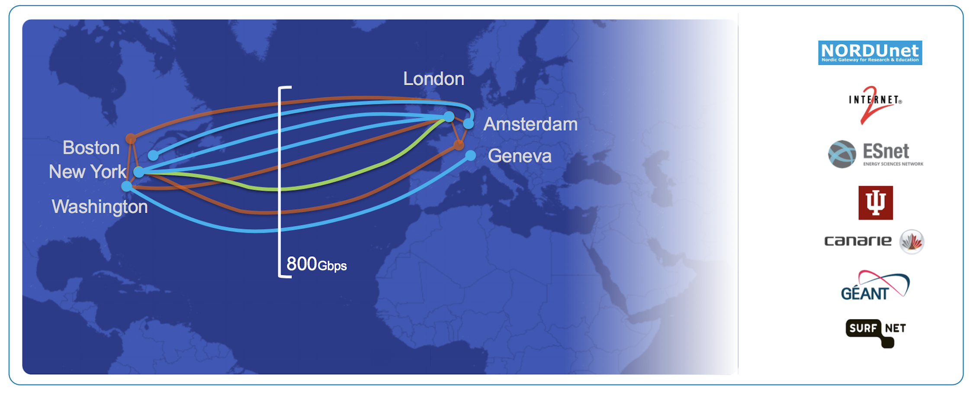
ANA Collaboration

Slide 8
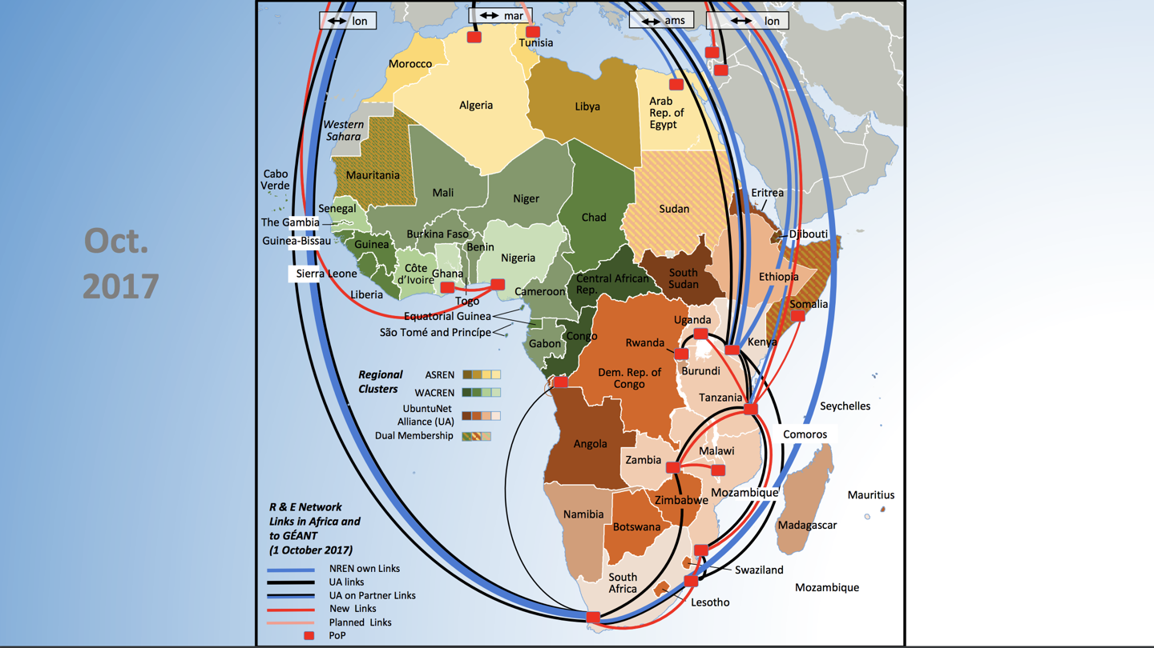
African R and E Landscape

Slide 9
Routing Research
Flow data
Looking at who was sending or receiving data on IU circuits
Used TENET perfSONAR for trace routing in and out of Africa
Not saying these things are bad/wrong
These are IN@IU observations from our networks in NYC and Seattle.
What are other networks seeing?
Notes:
Andrew!
Generally describe our networks in terms of endpoints - we have a 100g circuit from NY to London. Which can be ok for engineers, but might be confusing for scientists (‘I don’t work with anyone in the UK, why are you talking to me’). So we set out to find a way to better communicate to the world (and find out for ourselves) where all this data is going. We started digging through our flow data from the Autumn of 2017 and along the way we discovered some things that stuck out to us. Not necessarily bad, more like ‘I wonder why that is’, and maybe there are other networks that see similar

Slide 10
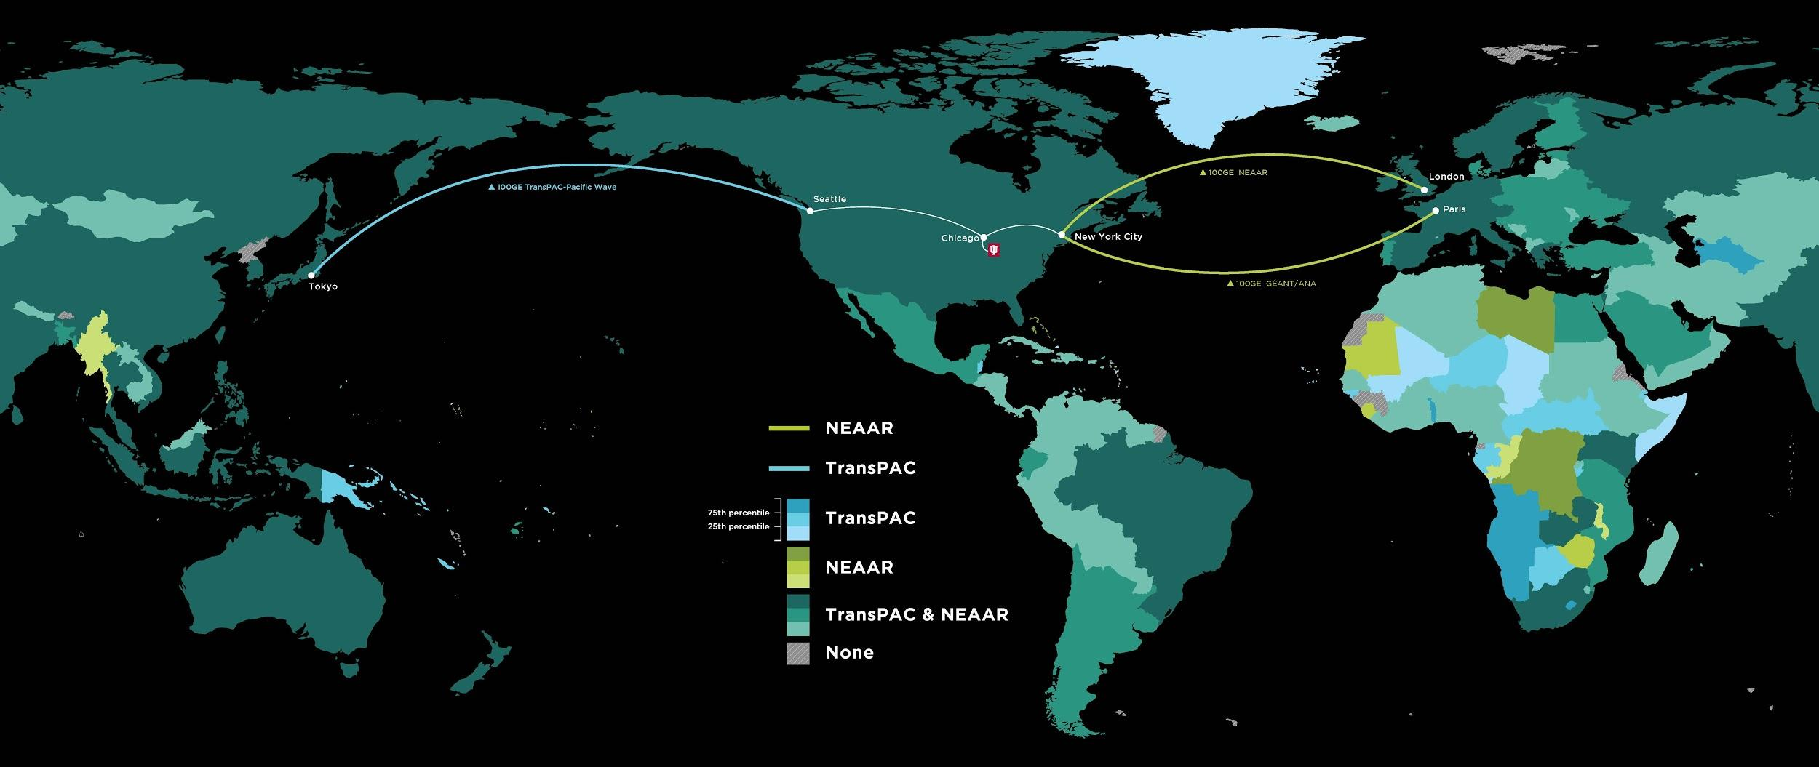
Notes:
This is what came out. To put this up front: we were working with our communications office, they picked the color pallette
Andrew can describe methodology - flow data aggregated to a /24 over 3 months, geolookup to find iso country code, total bytes tracked to find correct shading

Slide 11
Research Results
Of 249 Countries (ISO 3166-1)
NEAAR: 166 (17)
TransPAC: 181 (32)
Both: 198
Just looking at the map, some things seemed odd
African and European countries showing up on the TransPAC circuit
Traffic for countries that don’t have an established NREN
Notes:
Country count - so in a sense we accomplished our primary goal by having a result we can point to that gives an indication the range of countries that utilize our networks
It also caused some things to stand out to us, even just by looking at the map

Slide 12
DNS Strangeness
DNS Traffic between South Africa and WIDE-Japan M-Root Servers?
DNS misconfiguration? There are closer servers.
Purposefully done?
Anycast issue?
Routing misconfiguration?
Global best practices may be needed to keep Anycast in Region
Why Africa-GEANT-ANA/NEAAR-Internet2-TransPAC-Japan?
Why not over the TEIN or other links between EU and Asia?
Notes:
Possible Traceroute to Asian destination that traverses US.. Might not be bad.. Just interesting that it doesn’t go across TEIN. TENET / South Africa to WIDE Japan destination
Do the backwards trace as well
MAke this dumber without the results.. layman

Slide 13
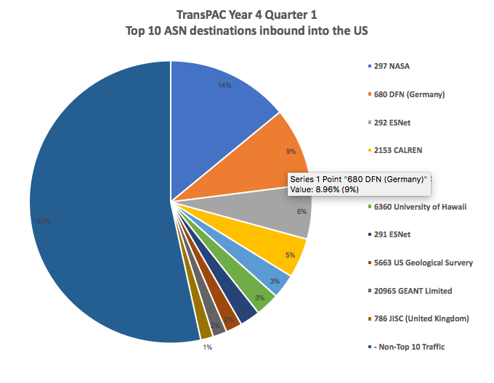
Routing thru US for traffic destined to Asia
European hosts consistently show up in Top 10 reports
Are there possible routing changes that could be employed? 15 vs 25 or more hops in some instances.
Steer traffic to TEIN?
Political / Financial choice?
Some Asian NRENs specifically AS pad their announcements to European NRENs to steer traffic to US.
Notes:
ASGC to Africa.
Notice Germany, UK, and GEANT all show up in TOP10 traffic graphs on TransPAC

Slide 14
More...
Routing of Commercial Traffic
African RENs advertising Google Global Cache in route table
Should NRENs accept these routes?
Paths in/out of Africa?
Data shows that from South Africa most traffic will incur ~170ms of latency to the EU before it heads to Asia or US.
Traces in both directions from various African sources to various Asian sources show 400-450ms RTT.
Does RTT matter?
Notes:
Is there enough research data and money to justify new links yet?
US - AFrica Link needed? AFrica - Asia Link needed? ~400ms between Africa and US and Africa Asia. ~170ms to get from Africa up to Europe before actually moving towards destination
15 hops vs last slide of 24 hops.. Interestingly still about the same round trip time (

Slide 15
Summary
More countries connecting; more links
Routing has improved, but not optimal
Need for a formal venue to discuss international routing policies
Are shared routing policies desirable and/or necessary?
What are you seeing?

Slide 16
Acknowledgements
IN@IU is funded by
NSF awards #0962968, #0962973, #1450904, #1540933, #1638863
edmoyn@iu.edu; leea@iu.edu; www.in.iu.edu

