Slide 1


SCIONLab - A Deployment of the
SCION Secure Internet Architecture
Kurt Baumann (SWITCH), Alex Gall (SWITCH), David Hausheer (U. Magdeburg), Adrian Perrig (ETH), Matthew Smith (U. Bonn)

Slide 2

SCION: A Secure Internet Architecture
  SCION: Scalability, Control, and Isolation on
  Next-Generation Networks [1]
  SCION Design Goals
  Availability in the presence of adversaries
  (e.g. DDoS)
  Transparency and control over forwarding paths
  Multipath forwarding
  Efficiency, Scalability, and Extensibility
  Strong incentives for deployment
[1] Adrian Perrig, Pawel Szalachowski, Raphael M. Reischuk, Laurent Chuat: SCION: A Secure Internet Architecture - http://scion-architecture.net/pdf/SCION-book.pdf

Slide 3
SCION as a Research Testbed
  SCION supports research activities in
  several areas, e.g.:
  Multipath communication
  Advanced and highly secure PKI systems
  In-network DDoS defenses
  Next-generation routing architecture
  policy definitions
  Path-aware applications
  Path-based inter-domain routing architectures
  Those are difficult to evaluate on the current Internet!
Notes:
Path-aware applications: It would be good to emphasize the path awareness a bit more. For decades, we wanted to have a path-aware architecture that enables the end points to be aware of and even select the forwarding path. Now we can actually start working on this at scale. It's a big deal in the IRTF, as a new research group has been started on that topic: PANRG.

Slide 4
SCION Enhancements for Key Stakeholders
  SCION architecture provides opportunities for several parties:
  Researchers so far needed to rely on simulations, e.g.:
    Path-aware networking
    Multipath communication
    DDoS defenses relying on inter-domain mechanisms
  End users can benefit from several improvements:
    Enhanced availability and reliability for applications
    Increased bandwidth thanks to multi-path operation
    Path optimization during a connection ➔ increased bandwidth and/or decreased latency.
  NRENs:
    Better utilization of network resources through multi-path support
    ➔ network hotspots will be diminished due to the abolishment of shortest-path routing
    Potential cost-savings in leased-line connections

Slide 5
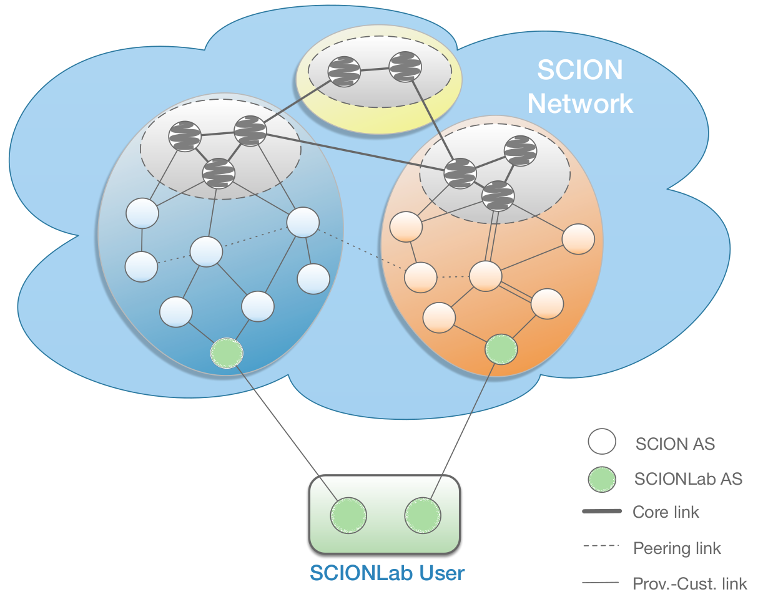
SCIONLab

Slide 6
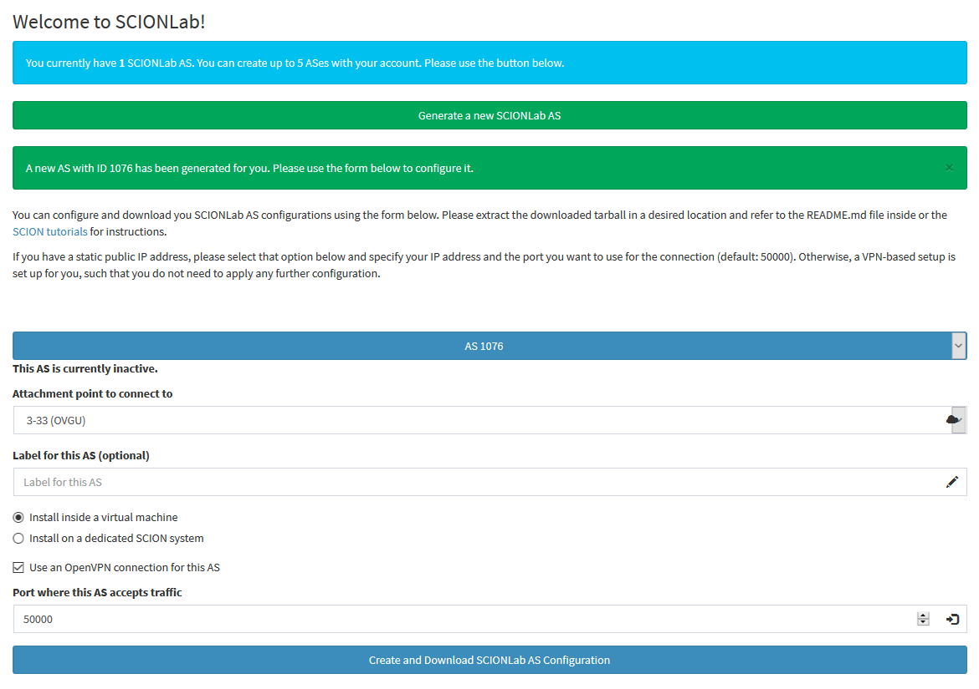
SCIONLab
  Fast setup, low entry bar for users
  Little required technical expertise: Setup of
  SCION should be simple, intuitive and automated
  SCION AS can be instantiated as a VM in few clicks
  taking around 10 min
  http://www.scionlab.org/
  Multiple attachment points
  Support of NATed devices
  using OpenVPN
  Provision of ARM images
  (RaspberryPi, Odroid)
  BYOC = Bring your own
  computation ➔ Scale
  deployment as desired
  and connect anywhere
  to SCIONLab

Slide 7
Global SCIONLab Network

Slide 8
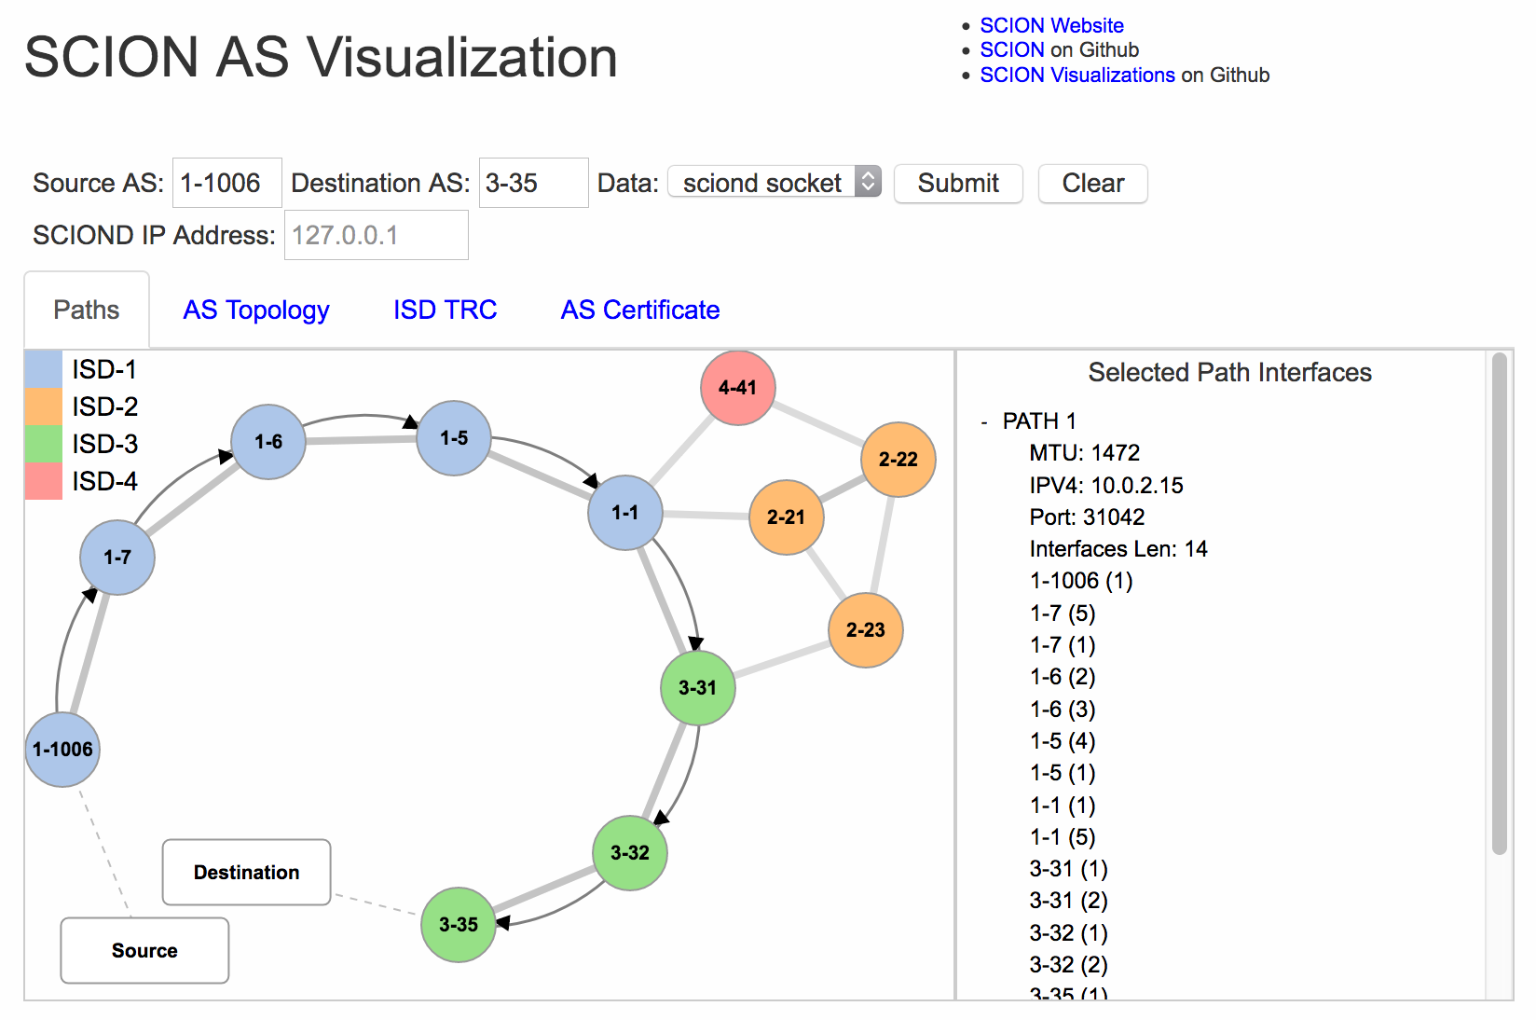
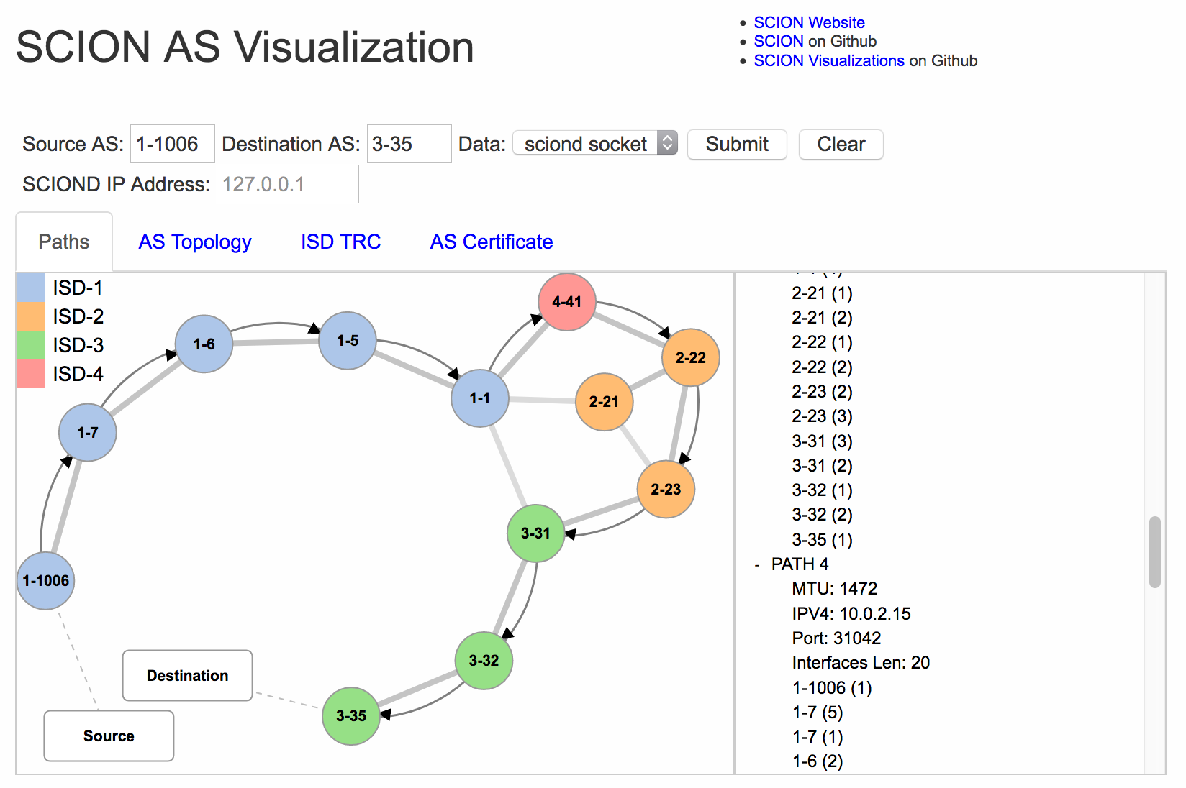
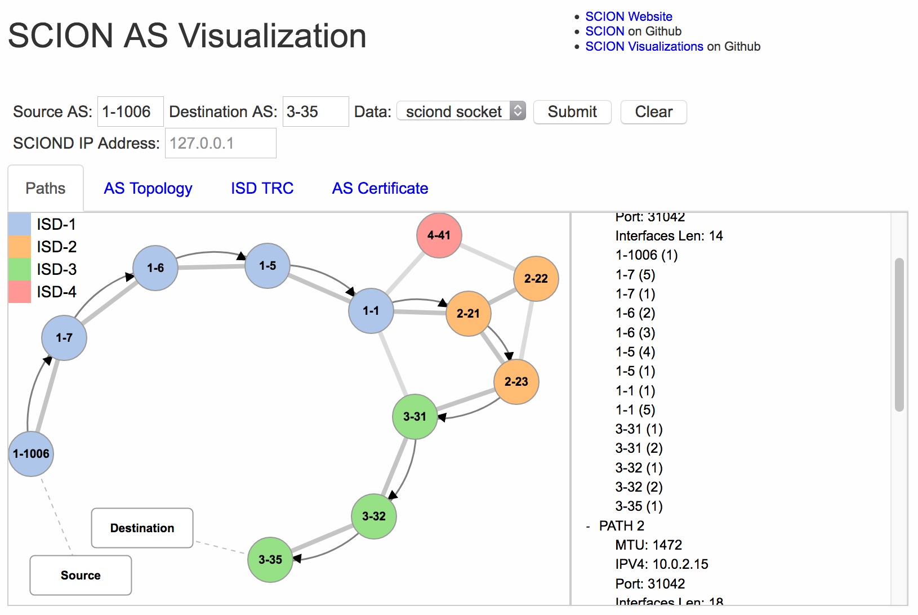
SCION Visualization System

Slide 9

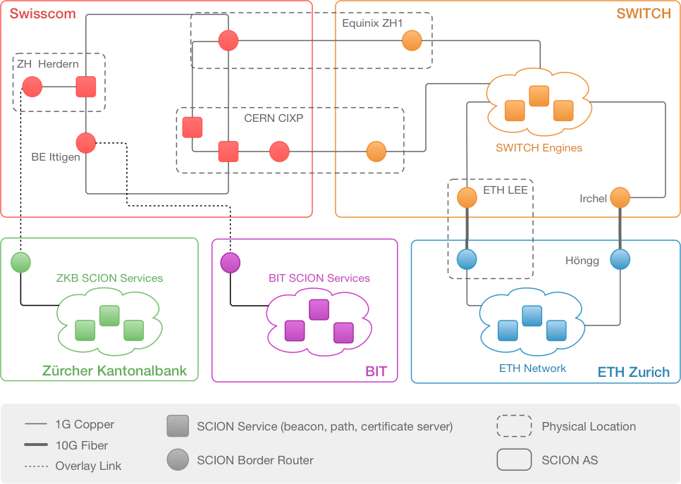



Swiss SCION Network
  SCION running in test environments at SWITCH, Swisscom, and ETH over the past 18 months

Slide 10


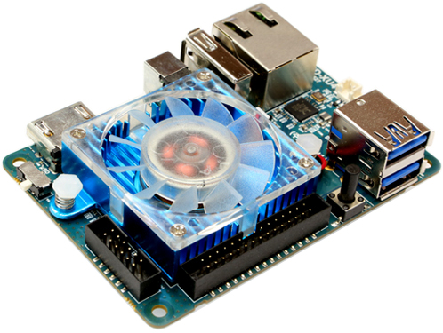
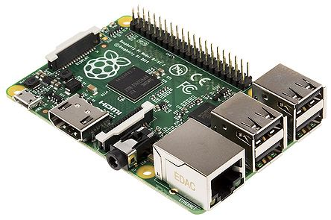
SCION AS runs on Small Scale Devices
  SCION as a platform for smart home environments, IoT applications
Raspberry Pi

Slide 11

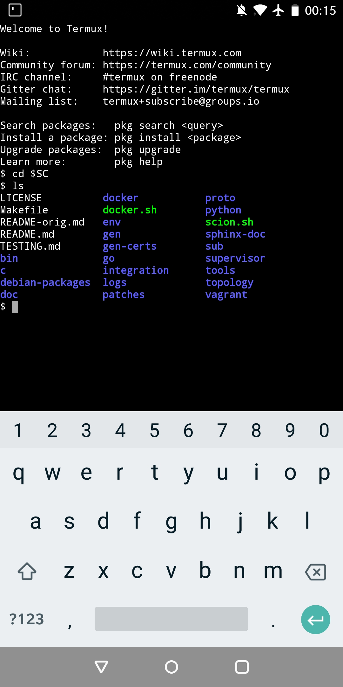
SCION Endhost runs on Android
  SCION running within Termux environment
  Prefixed Arch-Linux environment
  Usage e.g. in combination with a SCION AS
  running on a home gateway
  Potential use cases:
  Access to SCION-based IoT applications
  Use of multipath forwarding

Slide 12
SCIONLab Integrated Bandwidth Tester

Slide 13
Application: IoT Access

Slide 14



Use Case: IoT Protection through Default Off
Monitoring
Site
FW
SCION
SCION
SCION
SCION
IoT
Domain
Legacy device
SCION device

Slide 15
Use Case: VPN-based Deployment
Central
Office
VPN
SCION
SCION
FW
SCION
ER
SCION
Branch
VPN
FW
Legacy device
SCION device
Notes:
Potential Use Cases
▪Highly available cloud / datacenter / main office access
▪SCION-enabled cloud offers customers option to reach cloud via SCION network
▪Lower cost than leased lines
▪High-availability Internet access for nano-branches
▪No need for expensive leased lines for small branches
▪SCION can be used as backup system in case of Internet outage

Slide 16
SCION-IP Gateway (SIG) Deployment
C
A
BR
FW
BR
BR
BR
BR
B
Legacy device
SCION border router
SIG

Slide 17
Future Plan: SCION Pilot Service within GEANT
  SCION has matured
  SCION prototype software in its 5th generation
  Successful course assignment in a network security course over the prototype SCIONLab environment
  SCION is now ready for a large-scale pilot service deployment!
  ➔ Future Plan: SCION Pilot Service within GEANT
  SCION pilot service can contribute to several planned GEANT research activities:
  Next-Generation Internet (NGI) activity
    SCION provides a scalable and reliable platform for future Internet applications, e.g., IoT
  Security activity

Slide 18
Goals of the Planned SCION Pilot Service
  Development of the SCIONLab pilot software environment
  Deployment of the SCIONLab infrastructure
  Providing a platform for NGI research
  Enabling real-world research that is otherwise only possible in simulated environments
  Interaction with other deployed SCION networks and services
  SCIONLab enables a broad range of applications:
  Nodes can contribute to the routing within the SCION topology
  Researchers can attach their own computing resources anywhere within the SCIONLab network

Slide 19
Planned SCION Pilot Activities
  SCION pilot aims to contribute to SCIONLab with several activities:
  Development activities:
    Supporting extension of SCIONLab
    SCIONLab resource monitoring and enforcement mechanisms
    Tools to help writing SCIONLab applications
  Operations/support activities:
    Purchase and management of SCIONLab nodes within GEANT, NRENs and associated universities ➔ serving as attachment points for SCIONLab users and application developers
    Study usability of the infrastructure for administrators and end users
  Potential target KPIs:
    Ease-of-use for researchers
    Network availability and performance (bandwidth and latency)
    Supported features (PKI, DDoS defense mechanisms, path selection support, end host / application support)
    Usability
    Scalability in terms of network size and amount of usage

Slide 20
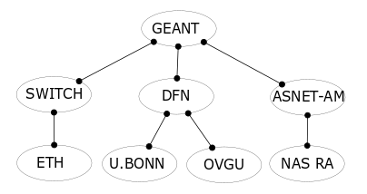
Planned Roadmap: Year 1
  Building up the SCION pilot service infrastructure
  Pilot partners:
  (N)RENs: SWITCH, DFN, ASNET-AM
  GEANT
  Universities and research institutes: ETH,
  U. Bonn, U. Magdeburg, National Academy of Sciences of Armenia
  Initial deployment:
  15 SCION nodes across 3 GEANT PoPs and at the universities
    Border router network for SCION pilot backbone
    Routers only needed at interconnection points with other SCION networks
    Internally: standard communication infrastructure used for SCION traffic
  Key milestones after Year 1:
  Support of SCION pilot service users through SCIONLab
  Path-aware networking and hidden paths for secure IoT operation
  Basic resource allocation system and control-plane PKI
  in place for SCIONLab users

Slide 21

Potential Deployment of SCION over GEANT GTS
Internet
SCIONLab
Administrator
GEANT
GTS
VPN_GW
Other
Location
e.g. Hamburg
Control Layer
(over IP)
h2
h1
Data Layer
(over SCION)
Swisscom
DFN
SWITCH
ETH
Uni Bonn
OVGU
Magdeburg

Slide 22
Planned Roadmap: Year 2 & 3
  Year 2:
  Multi-path research, delivery of a multi-path QUIC socket that applications can use
  Accurate resource monitoring throughout SCIONLab
  End-to-end PKI system that application developers can rely on to build highly secure TLS applications
  Year 3:
  SIBRA inter-domain resource allocation system ➔ strong DDoS defense mechanism.
  Resource monitoring and policing ➔ enables detection and mitigation of users that exceed their allocated resources
  Improve easy-to-use control- and end-to-end PKI systems

Slide 23
Trial Extension
  Planned SCION pilot service may be extended to further NRENs
  Requirements:
  NREN should be interconnected with GEANT
    Ideally enabling a "native" SCION connection
  NREN should be willing to contribute
    Minimum: deploy, housing the nodes
    For each NREN at least 3x SCION nodes are required
  Ideally, have customer organizations (associated universities, research labs, etc.) who are willing to deploy a SCION network
  Contact us in case you are interested to participate in the SCION pilot service:
  hausheer@ovgu.de, kurt.baumann@switch.ch

Slide 24
Conclusions
  SCION is a secure Internet architecture that has matured and is now ready for a large-scale pilot service deployment!
  SCION prototype software in its 5th generation
  Running in test environments at SWITCH, Swisscom, and ETH over the past 18 months
  Running prototype SCIONLab environment
  Numerous benefits for researchers, end users, and NRENs:
  Researchers: Path-aware networking, multipath routing architecture, in-network DDoS defenses
  End users: Enhanced availability and reliability, increased bandwidth, decreased latency, dynamic path optimization
  NRENs: Better utilization of network resources, cost-savings in leased-line connections

Slide 25
Further Information
  https://www.scion-architecture.net
  Book
  Papers
  Videos
  Tutorials
  Newsletter signup
  https://github.com/scionproto/scion
  Source code
  https://www.scionlab.org
  SCIONLab Administration Software

Slide 26

Thank you for your attention!
Questions?
hausheer@ovgu.de
http://www.netsys.ovgu.de

