Slide 1
Don’t forget the underdog!
Helga Spitaler, Sr. International Engagement Officer, GÉANT
TNC18, Trondheim
12 June 2018

Slide 2
The dilemma of a mum who loves her job…
The debate…

Slide 3
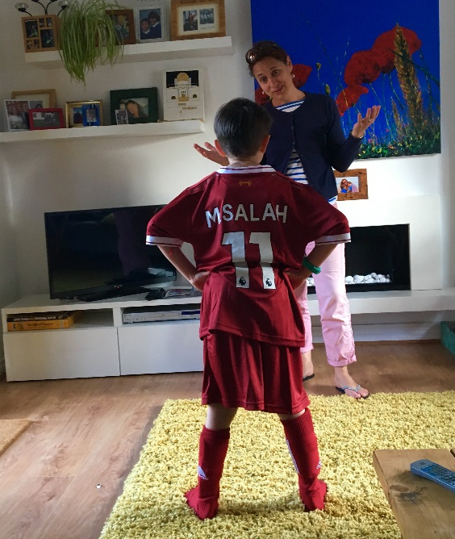
The story of Duong
The debate…

Slide 4
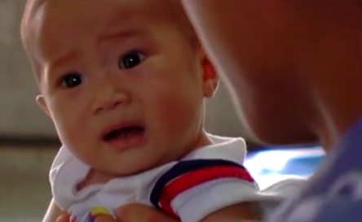
Helping get Duong better…remotely
The dilemma …

Slide 6
A short-term agenda with a long-lasting impact
Preparatory Meeting for the ASEM ICT Ministerial Meeting
8-9 June 2006
Halong Bay, Vietnam

Slide 8
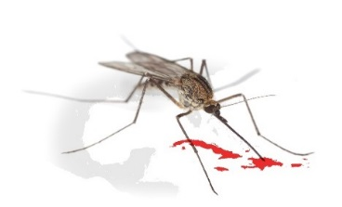
NREN and medical communities join forces in the fight against Dengue Fever

Slide 9
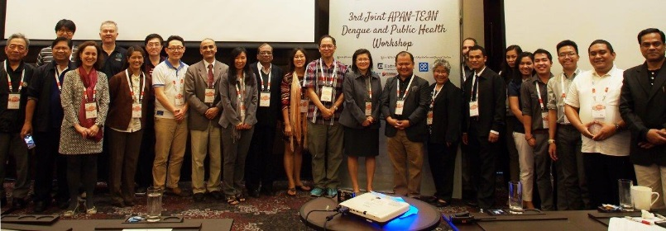
It pays off in the end…
“We share the mosquito and the virus, let’s also share our data”
Dr Raul Destura, National Institute of Health – University of the Philippines in Manila
3rd APAN-TEIN Dengue Workshop, Manila, Jan 16

Slide 10
Fringe user communities
Not necessarily bandwidth-hungry
BUT
Huge community-building and societal benefit potential
for us NRENs to tap!

Slide 11
Fascinating impact stories from around the world
www.inthefieldstories.net

Slide 12
But why bother?

Slide 13
Don’t forget the underdog!

Slide 14
helga.spitaler@geant.org

