Slide 1
A new tool for network telemetry analytics.
Dominic Oyeniran
Trondheim, Norway
Tuesday June 12, 2018
Notes:
In order to cope with the increasing complexities of managing existing network services, addressing the growing demand for new network services in addition to the ability to capture, and keep vital historical records of where a service have been physically connected and deployed overtime, avoid manual synchronisation upon service migration, and loss of data granularity.

Slide 2
GÉANT currently uses Cacti for SNMP telemetry data collection and visualisation, but with some limitations…
Notes:
Telemetry, utilisation, analytics, persistence, network traffic, network services, business intelligence, message broker, enterprise service bus, microservices.

Slide 3
The Quandary
Notes:
GEANT is exploiting a new telemetry solution that reduces some of the above challenges and is capable of automatically identifying a service when it comes live, provide input for business intelligence, analytics and possible new opportunities.

Slide 4
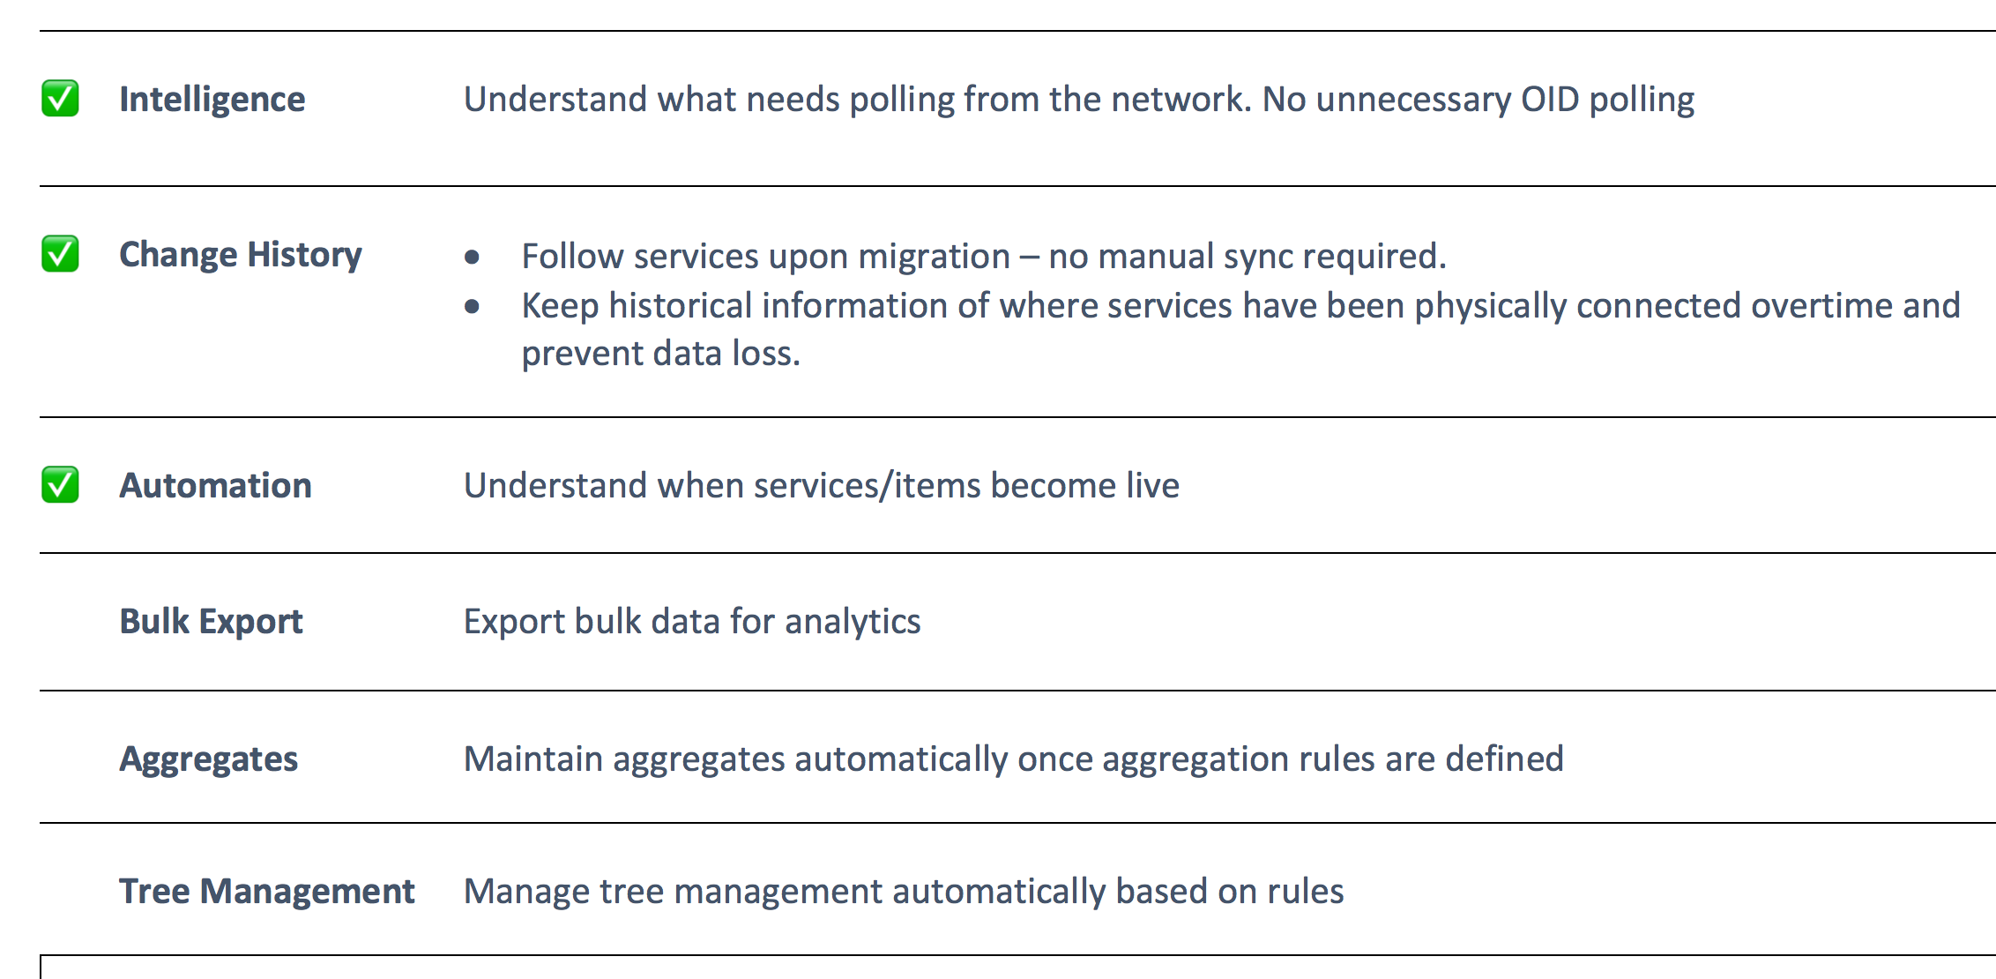
Solution
Notes:
GEANT Poller Telemetry Solution; is a suite of applications consisting of loosely coupled components using an event-based architecture that leverages on a message broker middleware.
But first step, a naming convention change..

Slide 5
Naming Convention
A new machine readable naming convention allows the software to gather required information about the relevant objects
A unique identifier is also assigned to the interface.
A customer is connected to this interface.
SRV_GLOBAL CUSTOMER TEST SRF9965248 | ASN9999 | For demonstration only
This is a point of access to a service and the service accessed is the global R&E Internet.
Following the “|” character is a human readable field allowing for additional information to be entered. This is ignored by the system.
The name of the connected customer is “Test”.
Notes:
e.g:-
SRV_GLOBAL INFRASTRUCTURE BACKBONE LON SRF0000001 | ams-lon
SRV_L2CIRCUIT CUSTOMER SWITCH AMSIX SRF9913005 | ams-gen_IX_SWITCH-AMSIX_13005

Slide 6
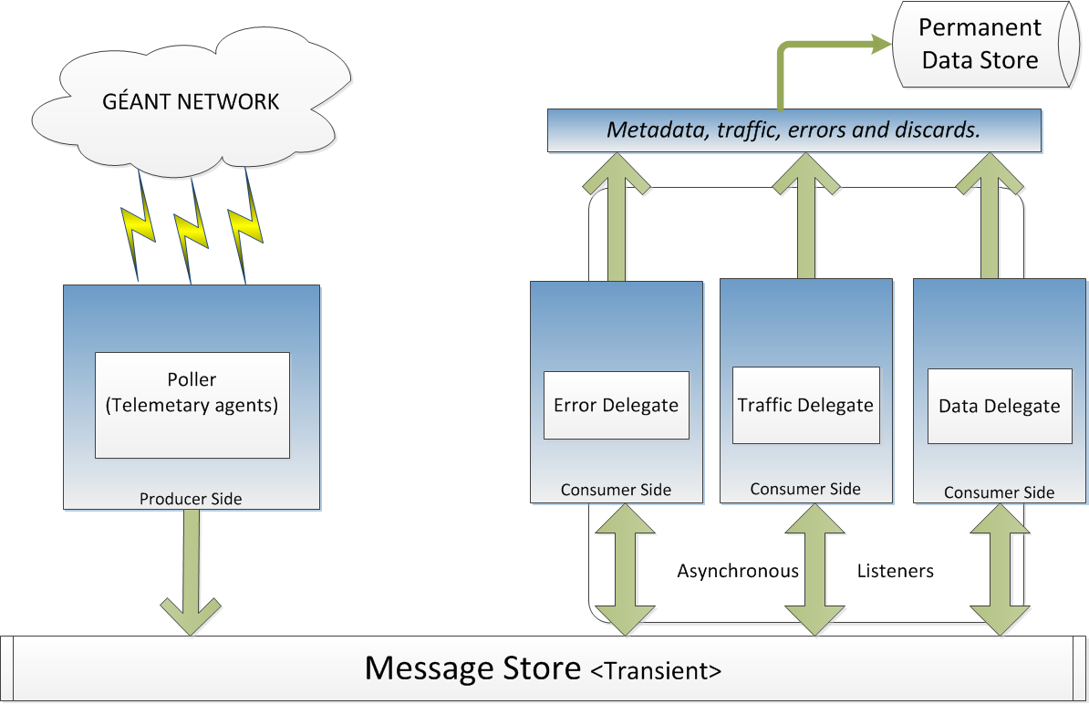
Application Architecture
Notes:
Technologies used for the project:-
- event driven messaging with asynchronous listeners.
- metric agents : a thread per router.
- metadata agents : executors in both single threaded and multithreaded pool mode.
- message broker activemq / considered kafka
-

Slide 7
Appreciation & Future Work
Visualisation
Microservices architecture
Separation of concerns
Resource optimisation
We’d now like to recognize and thank the people who worked on the project…
Notes:
Other benefits of the telemetry solution, includes separation of concerns and resource optimisation as memory, CPU and I/O requirements differ for each module within the application.
Docker
Product owner - Seb, Software Dev team, Service Assurance, Network Engineering & Implementation team.

Slide 8
dominic.oyeniran at geant.org

