Slide 1
Organic, Self-Adjusting Optical Networks
Hayim Porat, CTO, ECI
Rob Smets, Optical Transport Architect, SURFnet

Slide 2
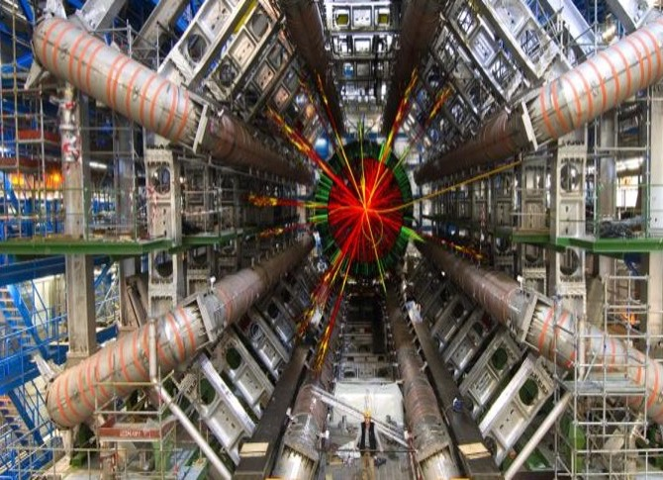
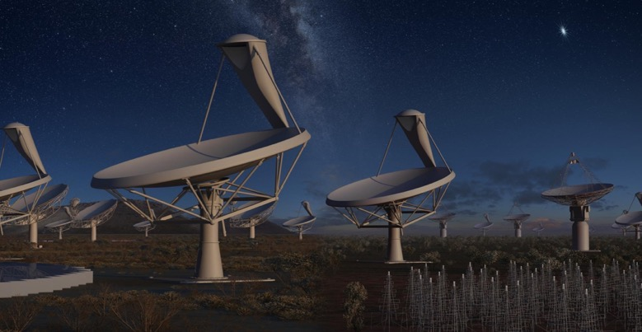
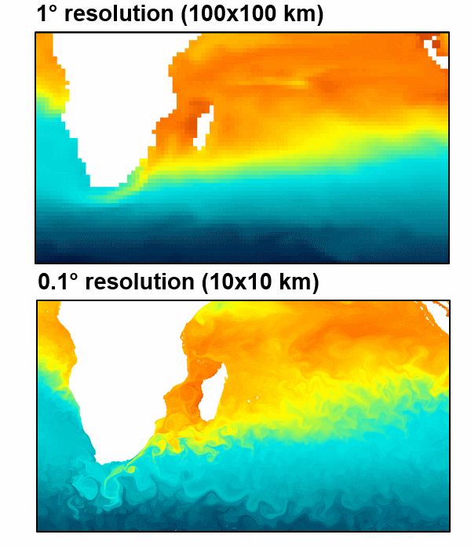
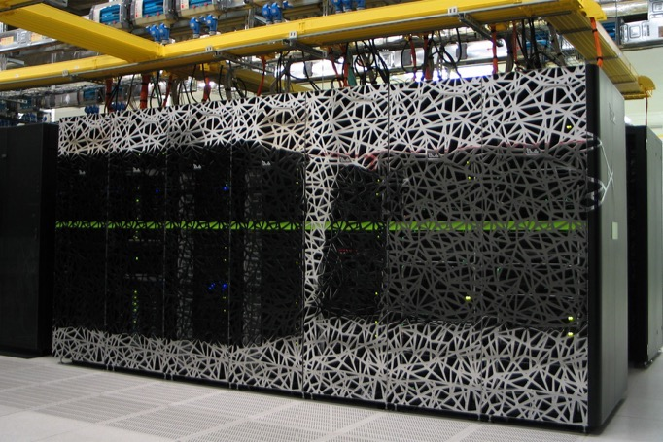
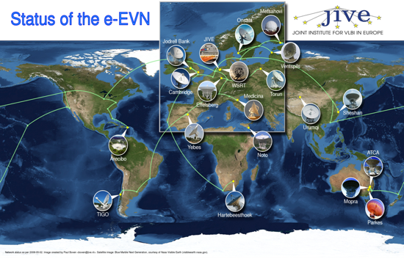
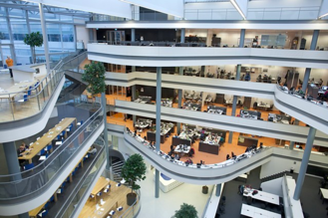
Drivers for a new transport-network paradigm
CERN’s Large Hadron Collider
30 PB/year of data
1 week vs.100 years processing
Dutch eScience center: Big Data Analytics, Efficient Computing and Optimized Data Handling
Enables and multiplies transport bandwidth consumption
SURF SARA computing resources e.g.: Cartesius SMP system 1.843 Pflops/s
>100Gbps
Squared Kilometer Aray
Generates more traffic than the Internet in 2020
Virtualization and cloud based services
100Gbps and beyond per campus
Jive E-VLBI Correlator
Up to 16 stations per pass
12GB / hour output
LOFAR
World’s largest radio telescope 7000 antenna’s / 100km²
Notes:
SKA:
South Africa 2 TBs/sec (340,000 laptops each day)
Australia 150 TBs/sec (5 times whole internet 2015)
LOFAR:
Processes in one month what would otherwise take 100Years on a single high-end PC
The more transport bandwidth can be provided, the better the correlation takes place and details are obtained.
CERN’s LHC:
the Tier-1 site of the Large Hadron Collider of CERN. Together with Nikhef, SURFsara has been storing and processing the huge amounts of data produced in Geneva and transferred at high rates to Amsterdam; helping scientists across the world, to make discoveries, publish papers and compete with each other hoping all to win the Nobel prize.
170 computer centres, tier-0 at CERN, 13 tier-1 locations, one of them is Nikhef/SURFsara. = LHC Compute Grid
What would take 100 years to process, can be done in 1 week.
Jive:
Gathers data of many radio telescopes with tens of Gbps rates.
SURFsara’s Carthesius
47,776 cores + 132 GPUs used for example to compute models for analyzing ”plastic soup”.
eScience center:
Promotes digital enhanced research. Visualization, big data analytics act as a

Slide 3
Drivers for a new transport-network paradigm
Fiber capacity turns out to be finite after all!
Availability and reliability becomes more important to our customers and users
Latency becomes more relevant
Developments in photonic technologies have reduced cost
Cost effectiveness and optimization
Relocations of SURFnet PoPs at customers and data centers.
Different and changing requirements on the optical transport network

Slide 4
Requirements that make the network grow organically
Any customers, also, in the access rings can be connected as if they are in the core
10Gbps becomes the minimum port capacity
100Gbps access ports for any customer requesting such
Profit from, route diversity, increased transport capacity, lower blocking probability, and avoiding Shannon’s NL limit.
Allow the fiber footprint to be deployed more flexible and cost-effective
Spectrum sharing with customers (both ways!)
Equipment sharing with customers
Assign “roles” to fiber spans rather than technologies
No more CWDM or DWDM spans
No more Core or Access spans
But: Wavelength Routable Span, or Traffic Aggregation Span, or both

Slide 5
Requirements that make the network self-adjusting
RFS
customer service request
Optimize the transport network in support of the service layer:
To meet capacity flows in the network
Feature the lowest latency possible
Allow transponders to function optimally
Automation and measurements:
Capacity planning for transport can be automated.
Re-use the current automation platform introduced for customer facing services
Do we feel comfortable knowing the network makes decisions autonomously?
What level of autonomy in self-adjusting actions?
NOC
SURFnet Network Dashboard
Orchestration Layer
Core DB
Ticketing
Authentication
&
Authorization
CRM
IMS
IPAM
Influx
LightSoft
NSO
NMS
NMS
Apollo
9608/03
Juniper
MX-series
NFV domain
…
Technology domain

Slide 6
Self-adjustment of transport layer when traffic matrix changes
ND ≥ 3
ND = 2
Core
ILA
Access
C
A
10G Access
100G
Daisy Chained
100G
Express
B

Slide 7
Two processes allow the transport network to self-adjust
Streaming telemetry from Juniper platforms provide insight into coarse transport matrix
Assessment and decission making on new 100G trail, possibly with NOC approval
NOC instructed to dispatch engineering
LightSoft instructed to activate trail
CoreDB updated
Service layer instructed to off-load traffic to newly added transport service
NOC
SURFnet Network Dashboard
transport service request
Core DB
Ticketing
Authentication
&
Authorization
Infra-agent
Decission
CRM
IMS
IPAM
Orchestration Layer
Influx
LightSoft
NSO
NMS
NMS
Apollo
9608/03
Juniper
MX-series
NFV domain
…
Technology domain

Slide 8
A growing core absorbs access rings and increases photonic functionality on existing nodes (six cases)
ND ≥ 3
ND = 2
Core
B
F
B
F
E
E
ILA
Access
A
A
D
D
10G Access
100G
Daisy Chained
100G
Express
C
C

Slide 9
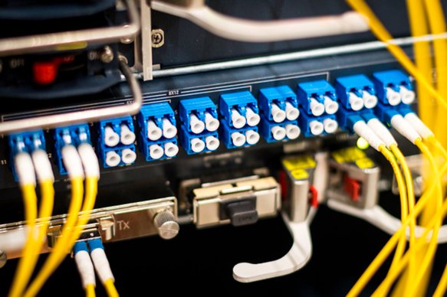
Six possible growth and shrink scenarios benefit from:
Each span in the network supports both CWDM and DWDM
SPoF- and cost-optimized when connecting customers
Using of a custom-made line-filter featuring
DWDM C-band
CWDM channel 1611nm for OTDR and 10GbE
OSC-wide port for remainder of spectrum:
CWDM 1471nm, 1491nm, 1511nm (OSC-A), 1590nm (OSX-B)
O-band
L-band
Implementing a uniform layout of chassis configurations
ROADM chassis Apollo 9608 per direction
Line ROADM
Optional Collector for CD Add/Drop
Different amplifier strategies depending on the fiber footprint
ILA chassis Apollo 9603 per node

Slide 10
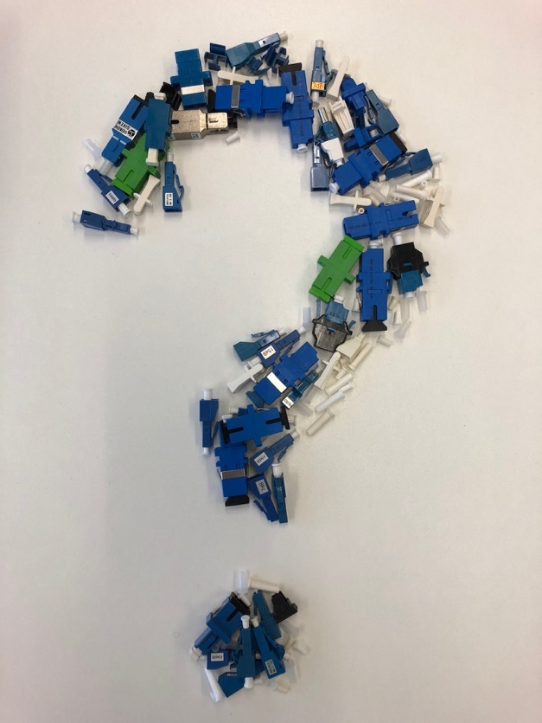
Summary conclusions
SURFnet’s internal and external drivers for an architecture, which can easily grow and shrink have been outlined.
The programmable photonic layer, SURFnet currently deploys, enables automation features to allow the network to self-adjust to shifts in required bandwidth and topology.
The automation layer, currently implemented for the creation, modification, and deletion of services, will also be the foundation of adjusting the transport resources for the benefit of the service layer.
Future SURFnet network releases will benefit from an automation platform where both service-layer and optical transport-layer control planes join and enable automated network planning.
Questions…
Notes:
This paradigm automates network planning and allows network automation.

Slide 11
On the road to AI-based self organizing networks
Hayim Porat, CTO, ECI
Rob Smets, Optical Transport Architect, Surfnet

Slide 12
WHERE ECI FITS
Complex network environment
Huge variety of edge devices and applications
Traffic increasingly difficult to predict
Multiple levels of SLA
Devices & Things | Access Points | THE NETWORK | Data Centers | Applications & Services
IoT
Notes:
Which brings us to ECI’s place in the telecommunications revolution.
We don’t provide access devices and technologies like mobile phones, radio base stations, and set top boxes.
We also don’t engineer data centers or the applications that reside in them.
But what ECI does do is provide the high bandwidth connectivity fabric that ties everything together.
ECI’s solutions carry the rivers of data, video, and voice traffic to and from business, industrial, residential and mobile access points, and data centers.
Our solutions power the global bandwidth engine. In short, ECI enables the heavy lifting that takes place behind the scenes that makes telecommunications work.

Slide 13
Demand as a black box
S₁
S₆
S₂
E₁
S₃
E₂
E_{N}
S₄
S₅
S_{N}
Service Flows S_{X} = Bandwidth, Latency, Availability, etc.
Events E_{x} = Failures, Degradations, etc.
Notes:
Which brings us to ECI’s place in the telecommunications revolution.
We don’t provide access devices and technologies like mobile phones, radio base stations, and set top boxes.
We also don’t engineer data centers or the applications that reside in them.
But what ECI does do is provide the high bandwidth connectivity fabric that ties everything together.
ECI’s solutions carry the rivers of data, video, and voice traffic to and from business, industrial, residential and mobile access points, and data centers.
Our solutions power the global bandwidth engine. In short, ECI enables the heavy lifting that takes place behind the scenes that makes telecommunications work.

Slide 14
The Goal: Self Organizing network
AI /Machine learning
Service requests
New equipment
Repairs
Controls
Data
S₁
S₆
S₂
E₁
S₃
E₂
E_{N}
S₄
S_{N}
S₅
Notes:
Which brings us to ECI’s place in the telecommunications revolution.
We don’t provide access devices and technologies like mobile phones, radio base stations, and set top boxes.
We also don’t engineer data centers or the applications that reside in them.
But what ECI does do is provide the high bandwidth connectivity fabric that ties everything together.
ECI’s solutions carry the rivers of data, video, and voice traffic to and from business, industrial, residential and mobile access points, and data centers.
Our solutions power the global bandwidth engine. In short, ECI enables the heavy lifting that takes place behind the scenes that makes telecommunications work.

Slide 15
But what do we need to make this work?
HINT: It’s not the voodoo AI

Slide 16
We need three things
AI /Machine learning
Service requests
Feedback
New equipment
Repairs
Multiple degrees of freedom for network control
Quality data at scale
Feedback
Controls
Data
S₁
S₆
S₂
E₁
S₃
E₂
E_{N}
S₄
S_{N}
S₅

Slide 17
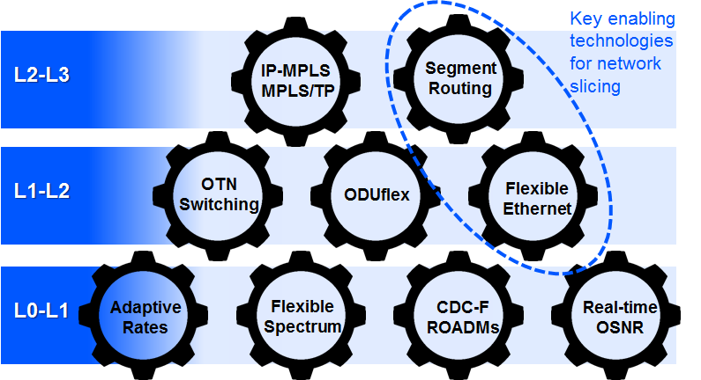
Multi degree network & control
Controls
The more degrees of freedom the better
Best when coupled with multiple service attributes

Slide 18
Quality data at scale
Firehose volume, variety and veracity
Real time
Designed and built-in from the start
Data
S₁
S₆
S₂
E₁
S₃
E₂
E_{N}
S₄
S_{N}
S₅

Slide 19
Feedback (reinforcement learning)
AI
Feedback
Service requests
KPI
Analysis
Light touch guidance on priorities and weightings
New equipment
Repairs
Controls
Data
S₁
S₆
S₂
E₁
S₃
E₂
E_{N}
S₄
S_{N}
S₅
Notes:
Which brings us to ECI’s place in the telecommunications revolution.
We don’t provide access devices and technologies like mobile phones, radio base stations, and set top boxes.
We also don’t engineer data centers or the applications that reside in them.
But what ECI does do is provide the high bandwidth connectivity fabric that ties everything together.
ECI’s solutions carry the rivers of data, video, and voice traffic to and from business, industrial, residential and mobile access points, and data centers.
Our solutions power the global bandwidth engine. In short, ECI enables the heavy lifting that takes place behind the scenes that makes telecommunications work.

Slide 20
Bringing it together
Prime the AI/ML pump with a small part of the live network (a must!)
Grow as confidence is gained
Improve AI/ML algorithms using a “shadow network”

Slide 21
Thank YOU!
Come and meet us at Booth #14

