Slide 1
Common Authentication and Authorisation Service for Life Science Research Mikael Linden, ELIXIR Finland

Slide 2
background
Since 2015, thirteen ESFRI Research Infrastructures from the field of BioMedical Science (BMS RI) joined their scientific capabilities and services to transform the understanding of biological mechanisms and accelerate its translation into medical care.
biobanking & biomolecular resources
curated databases
highly pathogenic microorganisms
functional genomics
microorganisms
translational research
marine model organisms
screening & medicinal chemistry
structural biology
clinical trials
plant phenotyping
biological/medical imaging
systems biology
Notes:
-> hyperlinks placed on each logo, active only in presentation mode

Slide 3
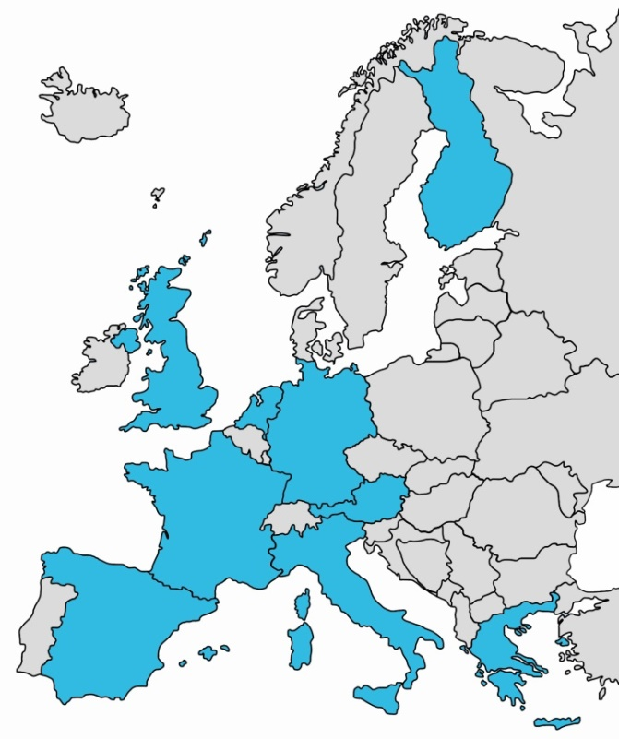
background
4 year project: 2015-2019
37 partners in 13 BMS RIs
budget: €14.8 million
builds on BioMedBridges (2012-2015)
co-coordinated by ELIXIR and BBMRI-ERIC
Notes:
-> hyperlinks placed on each logo, active only in presentation mode

Slide 4
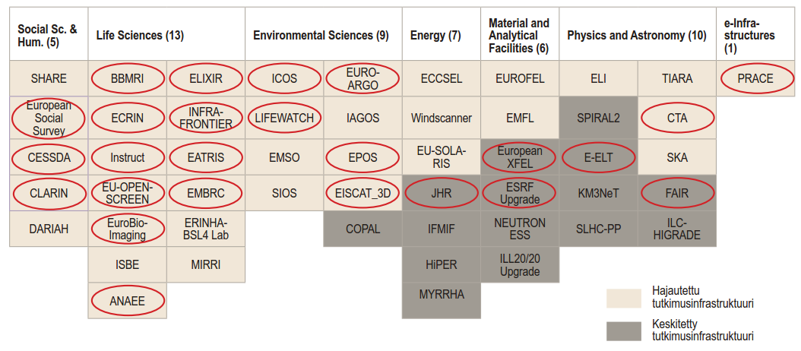
How many research infrastructure AAIs needed? Any cooperation possible?
Figure: Academy of Finland
Life Science Authentication and Authorisation Infrastructure (AAI)

Slide 5
research infrastructures and AAI
Why RIs active in research AAI?
Research infrastructures are permanent
Have sustainable funding model
Research infrastructures are there to provide research support services
Research infrastructures have contact to research communities and services
Understand their research domain’s needs
Why not?
AAI is not core business for research infrastructures
=> Partner with e-infrastructures

Slide 6
Use scenarios of a Life Science AAI
Producing research data (instruments, e.g. microscopes, genome sequencers)
Storing research data (data archives)
Transferring research data (to a computing environment, e.g. gridFTP)
Computing environments (e.g. clouds, computing clusters)
Various collaborative tools (wikis, intranets, mailing lists)

Slide 7
History of the Life Science AAI
June 2016: CORBEL WP5 workshop on AAI
Autumn 2016: use case documentation
Spring 2017: developing requirements specification
Autumn 2017: call for a pilot with e-infrastructures
Spring 2018: pilot with e-infrastructures
Applied funding for a deployment project starting in 2019

Slide 8
Requirements of the Life Science AAI
See our full paper for the requirements on the LS AAI
There is really nothing specific to Life Sciences!
The requirements could apply to any other research infrastructures
Potential for
Wider cross-research infrastructure collaboration
E-infrastructures to provide focused services

Slide 9
Identity and authentication
User identifiers
Life Science identifier, e.g. 28c5353b8bb34984a8bd4169ba94c606@lifescienceid.org
Life Science username, e.g. mike@lifescienceid.org
One identity for one person assumed
User authentication
By external authentication providers (e.g. eduGAIN, ORCID, Google, …)
By Hostel Identity Provider
Users can link several authentication providers to their Life Science ID

Slide 10
Attributes and authorisation
User’s Home Organisation
eduPersonAffiliation received from eduGAIN, if available
Otherwise, manually assign Home organisation attribute to users
Groups
Group managers can add, invite and remove members
Group hierarchy
Controlled access data
Researcher applies for data access
Dataset owner approves applications
Registered access data
Researcher prove and attest that they qualify as a bona fide researcher
Service owner decides what a bona fide researcher can access
Active role selection
User can access X when working with project A
User can access Y when working with project B
User must not access Y when working in project A
User selects their current project in the beginning of the session

Slide 11
Integration to relying services
SAML 2.0
The legacy protocol
Wide deployment base and support
OpenID Connect
3-tier scenarios
Non-web scenarios (CLI, app)
Refreshing attributes
Simpler and more modern
X.509
Mostly, for grid interoperability (gridFTP)
RCAuth.eu
Provisioning/deprovisioning
For batch-based syncronisation
E.g. management for mailing lists based on group memberships
E.g. shutting down user’s VMs in a cloud when they depart

Slide 12
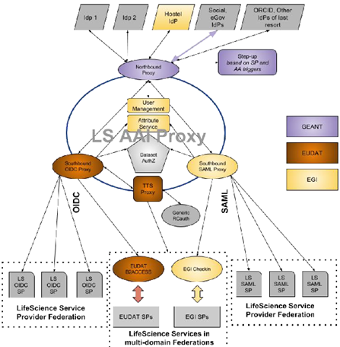
Pilot with e-infrastructures
In the context of AARC2 project
E-infrastructures operating the pilot environment (EGI, EUDAT, GEANT)
Phase 1 January 2018
Phase 2 May 2018
Phase 3 autumn 2018

Slide 13
Non-technical considerations
Policies
For end users (AUP)
For relying services (qualification, obligations)
Service management and sustainability
Funding model after the deployment phase
Bodies and procedures for decision making
Service operations
Partnering with e-infrastructures to operate the service
Data protection model
Data controller/processor
Purpose, legal grounds
Organisational and technical measures
etc

Slide 14
Questions? The projects receive funding from the European Union’s Horizon 2020 research and innovation programme under grant agreements No 654248 (CORBEL) and 730941 (AARC2).

