Slide 1
User-focussed service development
A Generic Research Data Infrastructure - GeRDI
Jakob Tendel – DFN-Verein

Slide 2
Intro to GeRDI
Research Communities
Community Managers
Community Interactions
User driven development

Slide 3
Research Data Lifecycle
FAIR principles
Create
Find
Research Data
Findable
Re-Use
Process
Accessible
Give Access
Analyse
Interoperable
Reusable
Preserve

Slide 4
GeRDI Goals
Central Services
Community Services
Enable lifecycle
Central services
Community-specific federated services
Access to existing data processing services
Generic
User AAI
Community-Specific
Specific Frontend
Specific Frontend
Bookmark
Data Transfer Manager
API
Extended Services
Storage
Storage
INDEX
Storage
Analysis
Analysis
Analysis
Publishing Repositories
Publishing Repository
Publishing Repository

Slide 5
The GeRDI Project
Phase1
Phase2
A few committed research communities
Proving approaches
Developing a base of generic services
Focus on Harvesting and Search
More research communities
More Community-specifics
More depth to services

Slide 6
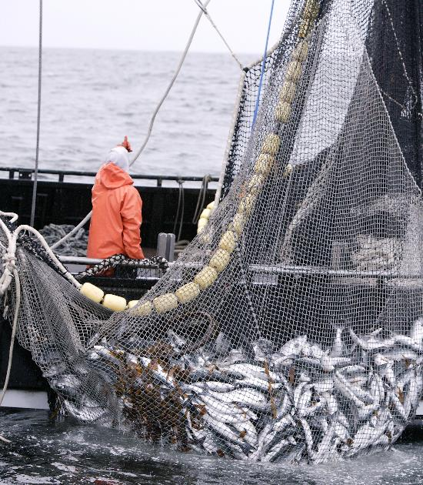
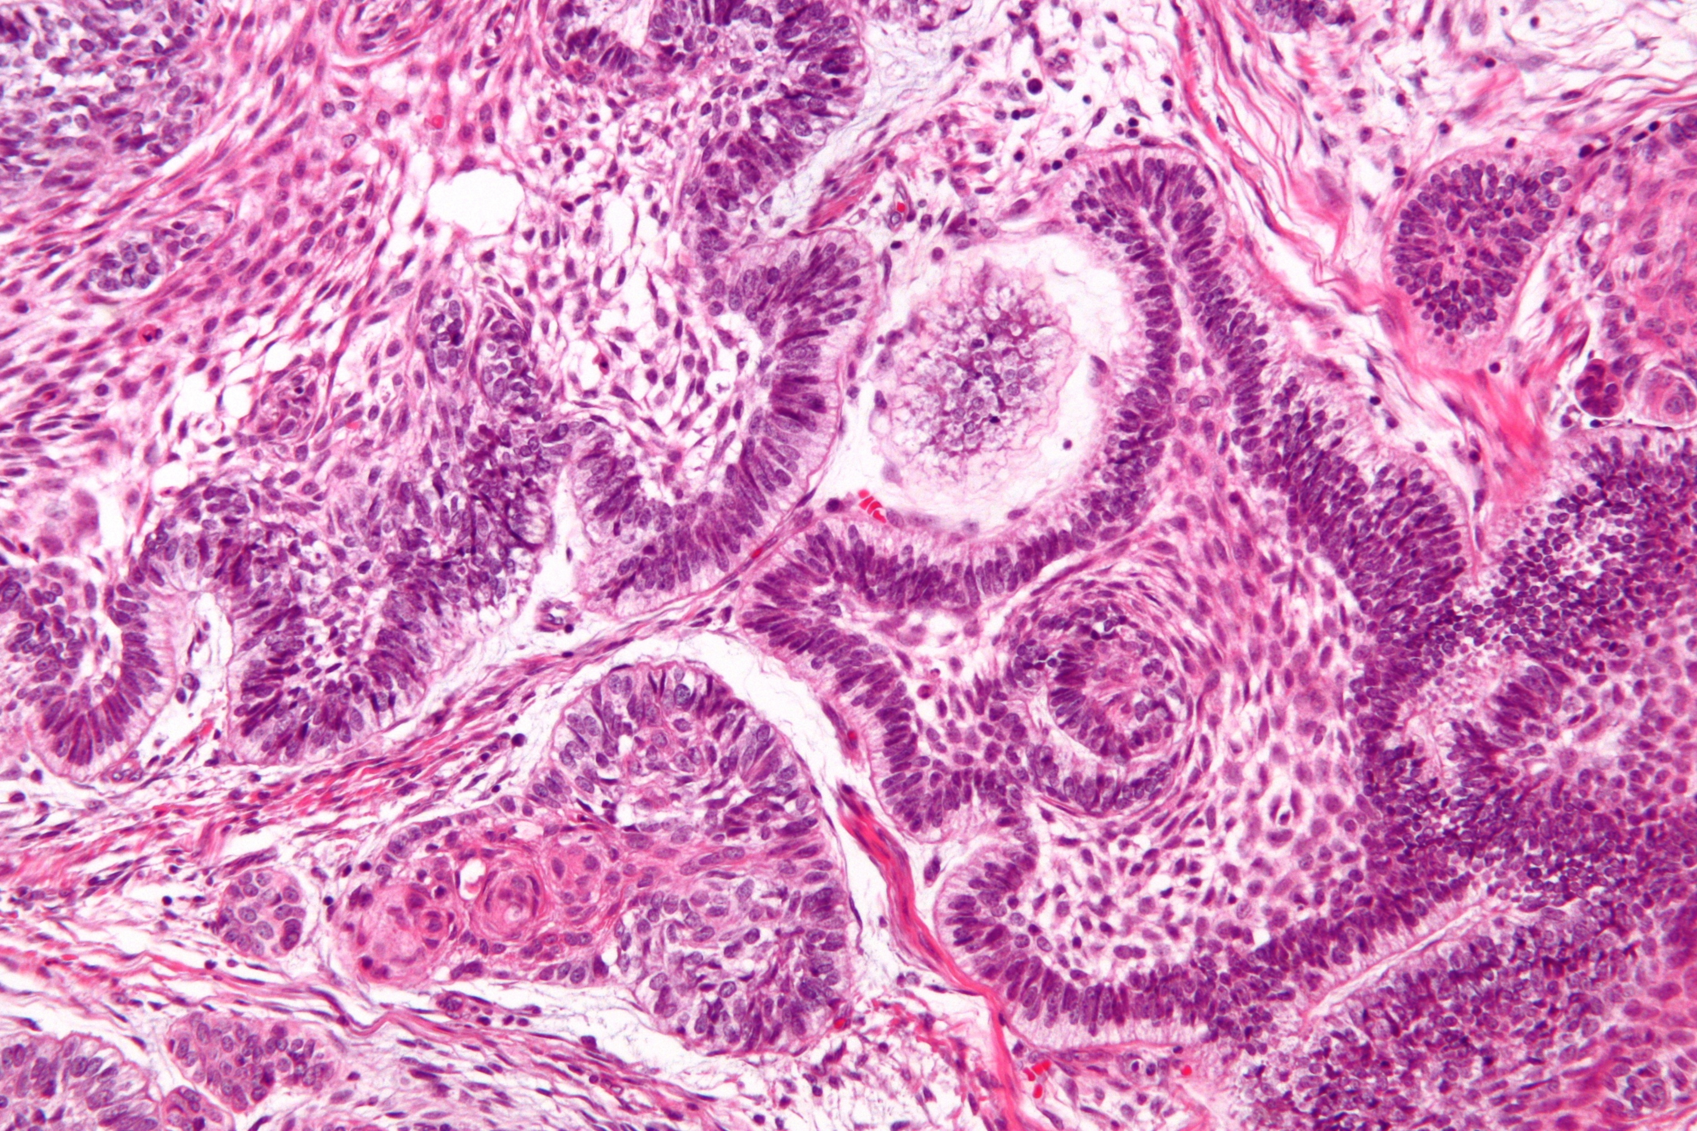
Research Communities
Volunteer research groups
Wide variety of research domains
Diverse set of data-intensity and experience
Environmental Sciences
Marine Sciences
Life Sciences
Socio-Economics

Slide 7
Community Managers
Marine Sciences
Life Sciences
Environmental Sciences
Socio-Economics

Slide 8
Requirements Gathering
Use Cases
Data Sources
Feature requests
Socio-Economics
Life Sciences
Prototype software
Support
Marine Sciences
Environmental Sciences

Slide 9
Continuous Development
Experiences
Bug reports
FAQ
Socio-Economics
Life Sciences
Quarterly updates
New Versions
Training
Marine Sciences
Environmental Sciences

Slide 10
Relationship management
Building the greater GeRDI community
Engage stakeholders beyond Research Communities
Open Communication channels
Dialogue
Attention
Visibility
Reputation
Collaboration
Trust

Slide 11
Community building
“Sharing and spreading knowledge
over many heads to preserve collective knowledge”
Research communities
+
stakeholders

Slide 12
Communication Channels
„Interconnecting our community
+
continous communication about project progress“
Community Workshop
Website
Newsletter
Social media: Blog; forum, social networks

Slide 13
Support/training forum
„Knowledge in one place“
Different Support by:
Data providers (e.g. SOEP)
GeRDI team
User-user
FORUM:
User postings: questions/answers
Bug reports
Blog articles
Event News

Slide 14
Summary
Early engagement with volunteer testing communities
Community Managers on the development team
Initial feature-set based on real-world requirements
Iterative and interactive development cycles
Focus on community and engaged communication

Slide 15
Questions?
?
?
?

