Slide 1
eduroam Troubleshooting 2.0
TNC18, Trondheim
Stefan Winter <stefan.winter@restena.lu>

Slide 2
Troubleshooting
Situation: roaming end-user tries to connect to eduroam, but it doesn’t work
Answer_{TODAY}: Tough luck. Phone home.
Answer_{FUTURE}: We have isolated the problem and have notified the responsible administrator. Please sit back and wait for a notification that things are back to normal.

Slide 3
Is this complicated?
It’s not, if you have all the equipment in your hand
Your typical Telco operator certainly has mechanisms like that.
E.g. provide your phone number, and the operator performs measurements across its infrastructure to find faults, if any.
Access to all equipment means the operator can follow deterministic flow chart

Slide 4
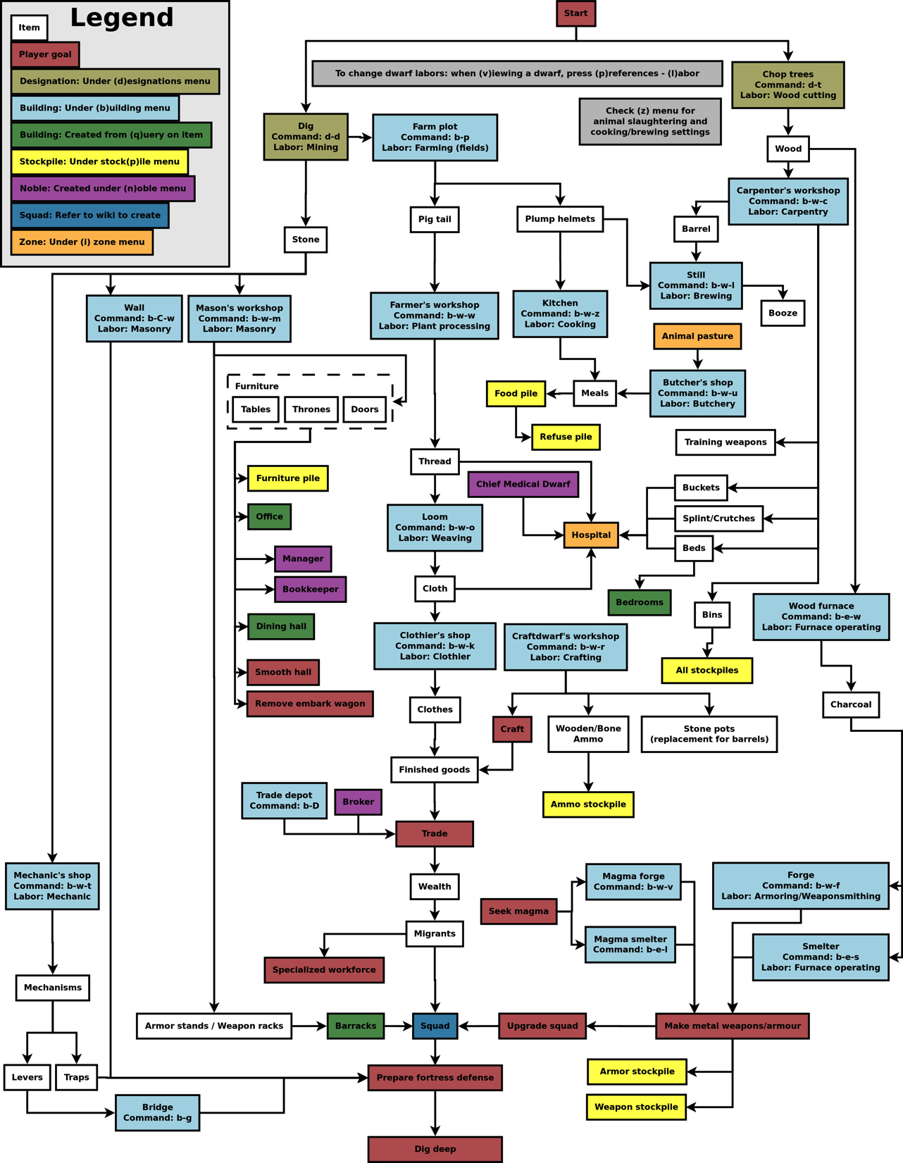
© Dwarf Fortress Wiki, GFDL License

Slide 5
This is complicated ☹
Unfortunately, in eduroam, no single entity has full visibility over the entire infrastructure
Federated nature: access is partitioned
Between world regions
Inside world regions, between federation
Inside federations, between IdPs and SPs
There is no way to access equipment with any out-of-band communication, not even central logging
Diagnostics is limited to being able to observe faults in-band

Slide 6
In-Band Observation Limits
Limited to the RADIUS protocol
There is no visibility of individual RADIUS nodes along a (roaming) chain
SP
A
Proxy
P1
Proxy
P2
Proxy
P3
IdP
B
(A talks to B, it works)
SP
A
?
?
?
?
Proxy
P1
Proxy
P2
Proxy
P3
IdP
B
(A wants to talk to B, it does not work)

Slide 7
What to make of that?
eduroam Operations has RADIUS test connections to most nodes in the roaming fabric
Can test either individual servers or connections between such
Limitation: tests are executed over the internet; link outages will be mistaken for node outages
eduroam CAT also has own set of tests reaching out to different set of nodes

Slide 8
The Diagnostic Philharmonic
OT: ETLR
OT: NRO
OT: NRO
OT: Country-to-ETLR
OT Monitoring: Country-to-Country
CAT: “Realm Check”
SP
Wi-Fi/LAN
SP
RADIUS
NRO
SP-side
ETLR
NRO
IdP-side
IdP
RADIUS
IdP
User
DB
TBD: Hotspot On-Site Probes
TBD

Slide 9
Complications
There might be more than one issue
national proxy down plus links to other servers
SP issue together with IdP issue (bogus VLAN assignments sent and accepted)
…
Wetware may introduce additional problems
One transient issue in infrastructure ...
... and user changes their device config because they think that helps.
Not all problems are RADIUS; and especially Wi-Fi specific problems are transient and highly location-dependent.

Slide 10
Flow Charts don’t work very well here.
Radically different approach:
Identify all pieces of infrastructure, and start with the assumption that all of them are broken; with varying level of “suspicion”
Perform observational in-band tests and mark piece as working if test succeeded
Failing tests modify the “suspicion” rating
“Once you eliminate the impossible, whatever remains, no matter how improbable, must be the truth.” (Arthur Conan Doyle)

Slide 11
eduroam Diagnostics: A three-stage approach
Perform automated tests based on user
realm (plus optionally: current location)
Telepath
Interactive questions to user to narrow
down problem beyond automated tests
Sociopath
Communicate findings
to concerned parties
Logopath(*)
(*) My apologies to the English language; I know that the word doesn’t actually exist. But it fits so nicely into the series.

Slide 12
Telepath

Slide 13
Telepath: Eliminated Problem Sources
We’ve got some
questions for you…

Slide 14
Sociopath
Always ask question for the current top-scoring suspected issue
Answers either raise or lower suspicion
Have you EVER used your device successfully?
Did it previously work when roaming?
Is the place you are at right now heavily crowded?
…
Once certainty threshold is reached (or we run out of questions), conclude.
Normalise final scores into percentage rating - humans like that.

Slide 15
Logopath
Inform the user about final normalised rating
Most probable cause of issue
Runner-up information (extent under discussion)
For the most probable cause of issue:
Give immediate advice to user (e.g. “don’t change your configuration, it’s not something you can fix!”)
Create E-Mail to all those who can do something about the problem
Apologise in E-Mail for possible false alerts – after all this is all full of heuristics! ;-)

Slide 16
Conclusion
We operate a federated environment with many actors – fault finding is inherently difficult.
Heuristics are the only remedy to generate some amount of clue end-to-end.
We need more measurement instruments to reduce need for interactive questions.
In the end, hopefully provide a useful one-stop shop in case of connectivity issues.
And it‘s all coming to you in CAT 2.0 ☺

Slide 17
Q&A?
Thank You!

