Slide 1
The Indigo Project: e-Infrastructure in the Asian Century
TNC 2018, Trondheim, Norway
Peter Elford, Director, Government Relations and eResearch – peter.elford@aarnet.edu.au

Slide 2
Evolution in Research collaborations (IRU)
https://www.iru.edu.au/wp-content/uploads/2017/02/Strengthening-Research-in-Asia-Publication-2016.pdf (SCOPUS)

Slide 3
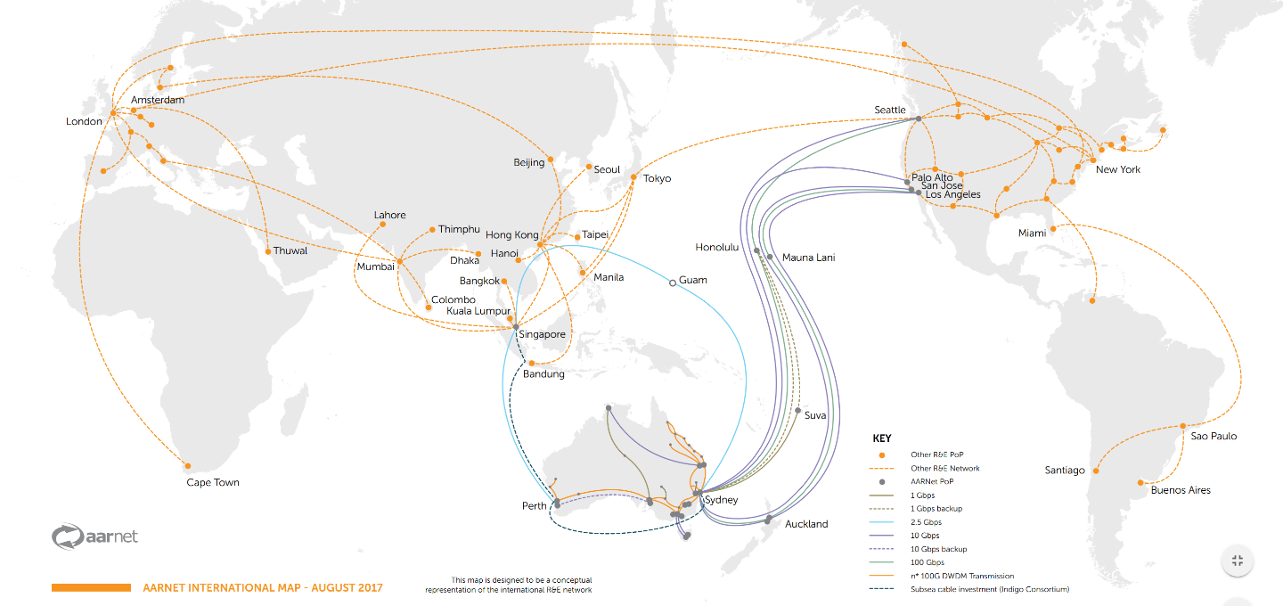
International network
.
240Gbps
5Gbps
20Gbps

Slide 4
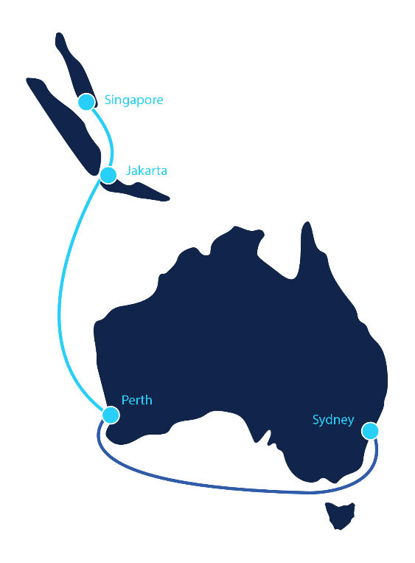
Project indigo – april 6 2017
AARNet, Google, Indosat, Singtel, SubPartners, and Telstra
Two pair fibre system Singapore – Sydney via Perth – 9,000 km
Ready for Service (RFS) Q1 2019
Minimum capacity 18Tbps per fibre
This is the FIRST subsea project where a National Research and Education Network (NREN) has been a consortium partner
This is one of the first subsea projects to make available portions of the fibre (spectrum or frequencies) to investors
This investment involves no Federal government funding, either for the initial investment or for the operational support
The contracted life of this system is multiple decades

Slide 5
IMPACT
Terrestrially, access to fibre underpins AARNet’s ability to provide differentiated price/performance
Indigo provides this for international sub-sea broadband capacity
Increases in capacity facilitated by upgrading optical transmission equipment
Provides overall greater flexibility, low latency, increased redundancy for international traffic
Addresses network diversity challenges for between Perth and East coast

Slide 6
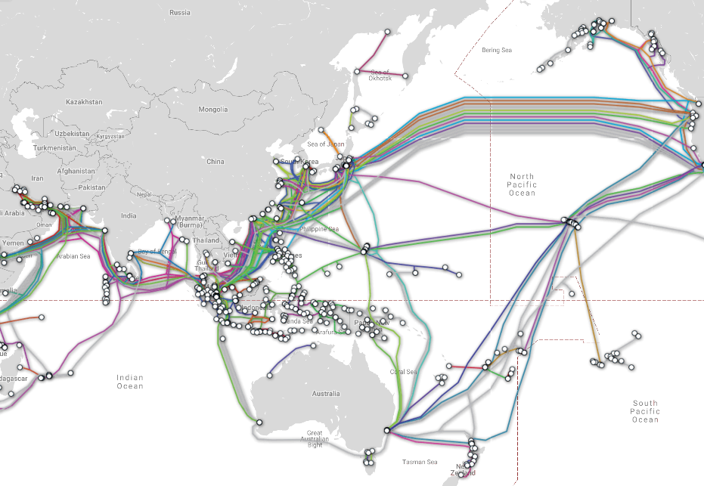
Regional context
NREN capacity from multiple directions meets in Guam
GOREX
Hawaiki cable under construction AU-NZ-US
Increasing connectivity options for Pacific Island Countries
https://www.submarinecablemap.com/ Updated May 5, 2018

Slide 7
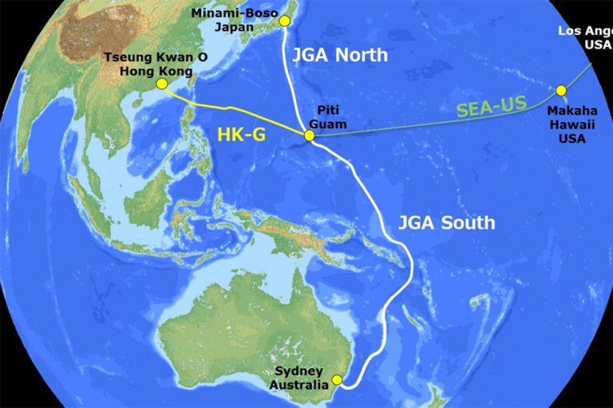
JAPAN-GUAM-AUSTRALIA (JGA) South – April 4 2018
AARNet, Google, RTI
ASN and NEC
Two pair system 9,500km
North – Japan-Guam (RTI only)
South – Guam-Australia
Due for completion 4Q2019

Slide 8
Thank you

