Slide 1
SDN & The Engineering Team of the Future
Richard Nelson & Angela Nash
TNC18 Trondheim, Norway
Notes:
SDN , particularly OF has been around for a few years. This is about how we have learned to apply it in production and you can too.
Synopsis - built an SDN controller, learned some stuff and are now working out how to apply the learning and scale it up in the context of an NREN
I’ll talk about the Past and Present. Angela gets to talk about the Future.
It is not news that Software Defined Networking, along with other disruptive technologies is rapidly changing how we Build and Manage our Networks.
What is starting to become apparent is how this is affecting what you need your technical teams to do and what they need to know.
This talk will explore how the world of SDN is Rapidly Evolving to create tangible, real ­world applications, such as Faucet, that are increasingly more usable and easy to implement.

Slide 2
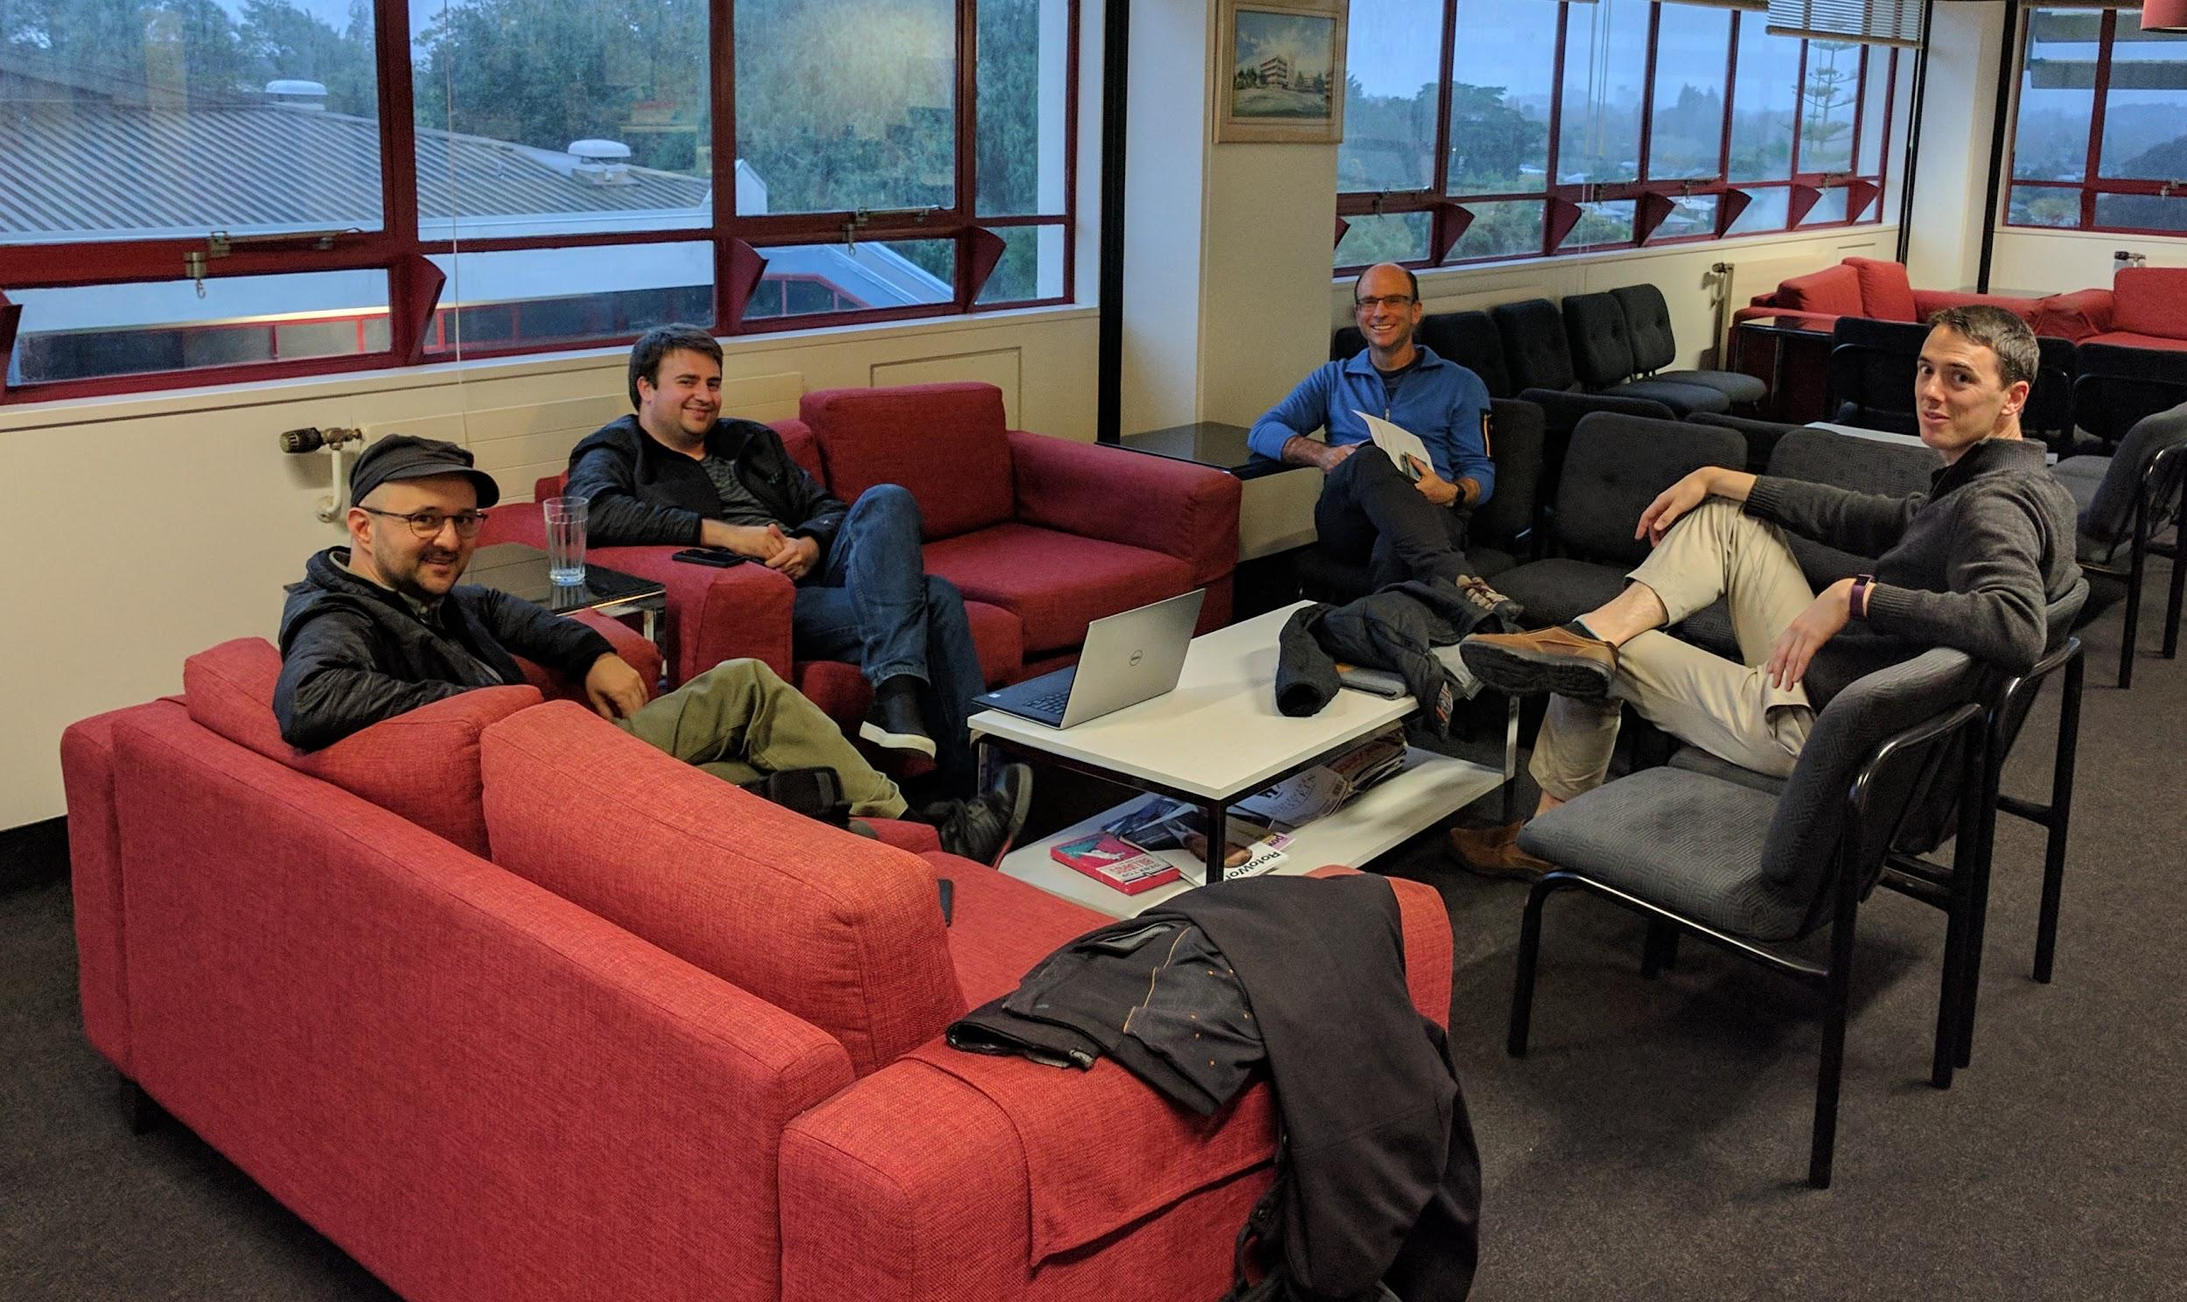
Faucet: In the beginning...
Notes:
Josh Bailey encouraged us to get involved with SDN and Openflow
Itch to Scratch - Brad developed Valve to connect OF switch to the University Network supporting VLANS
Chris started work for REANZ - think his brief was to “do something with SDN”.
Based on the concept of Valve he wrote Faucet and made it able to run part of the office network
Team of people who are all simultaneously network engineers and software developers.
I represent the management who were all supportive and created space for the development.
Photo is of us working starting the formation of the Faucet Foundation.
Valve was a layer 2 learning switch with useful features
VLAN support
Access Control Lists (ACLs)
Multi-datapath support
Statistics
Written as research project at WAND Group, University of Waikato
Very small and simple, ~500 lines of code
Not production ready
MAC learning rules don’t expire
Photo May 2017

Slide 3
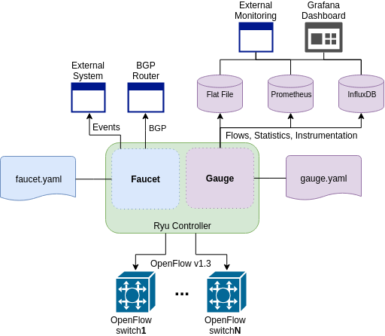
An Enterprise SDN Controller
Notes:
Connects users to services and Internet
Lots of copper ports , multiple speeds and many wireless APs
Hard to design a standard build-out
Too many special cases
Odd building layouts
Often have no control over devices at the access layer
BYOD
Network design has to scale to support all these edge-cases
Lots of security
Fine grained

Slide 4
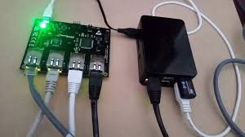
As Simple as Possible but No Simpler
Faucet is intentionally small
~10,000 lines of code
~10,000 lines of tests
Production networking
Feature set
Testing
Implements useful primitives that can be built on top of
Forwarding, VLANs, ACLs, L3 FIB
Implement some additional protocols for interop
BGP, Stacking, LACP, ARP & IPv6 ND
Protocols modular so they are only turned on when configured
Notes:
It aims to be as Simple as possible where simple means:
easy to deploy,
operate
support
understand and modify code base.
Lightweight - runs on a raspberry Pi. Easy to scale by running multiple Faucets to plumb a network
Nevertheless it aims to be fully featured. Layer 2 / 3 switching. Security, Multiple datapaths, basic interop. Aims at proactical usability rather than a laundry list of IEEE and RFC standards.

Slide 5
Easy to Install
$ echo "deb https://packagecloud.io/faucetsdn/faucet/ubuntu/bionic main" \
| sudo tee /etc/apt/sources.list.d/faucet.list
$ curl -L https://packagecloud.io/faucetsdn/faucet/gpgkey \
| sudo apt-key add -
$ sudo apt-get update
$ sudo apt-get install faucet gauge
or
$ docker run -d --name faucet \
-v /etc/ryu/faucet/:/etc/ryu/faucet/ \
-v /var/log/ryu/faucet/:/var/log/ryu/faucet/ \
-p 6653:6653 -p 9244:9244 \
faucet/faucet
Learn more https://docs.faucet.nz
Notes:
Faucet is easy to use.
It is packaged for Debian/Ubuntu and docker. Also there are Raspberry Pi images and you can install from Pip
It has good documentation including tutorials and a cookbook for configuration.

Slide 6
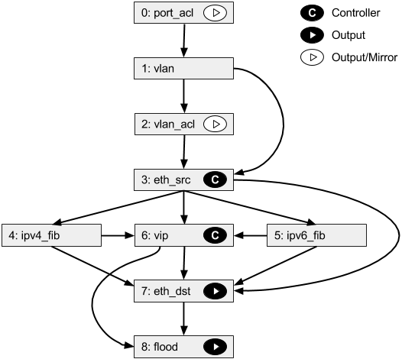
Faucet Pipeline
Notes:
Faucet has a pipeline.
Uses multi-table Openflow 1.3
Pipeline is designed to implement the core functionality of Faucet. It is not customised to the hardware.
Does not have any driver code
Enables true multi vendor networking - as long as vendors have support because we will not support their hardware

Slide 7
Production Quality - Tested
Unit Tests
>90% code coverage
Quick to write and to run
Integration Tests
Boot up many different network scenarios in parallel
30 - 60 minutes to complete
Ensure features work and checks performance
Runs against Open vSwitch and real hardware
Lets us prequalify devices for FAUCET support
Notes:
OpenVSwitch reference implementation.
Hardware switches will work if pass the test suite.
Compatible hardware requires no reading of specs or features.
Deployment of an automated process.
Four vendors have supplied hardware to pass the tests.
This means that buying compatible hardware requires no reading of specs or features but simple deployment of an automated process. To date four vendors have supplied hardware to pass the tests
Cyber-RFC - Stephen Stuart announced at Faucetcon and OVS Fall Conference. Now a requirement for selling OF switches to Google enterprise

Slide 8
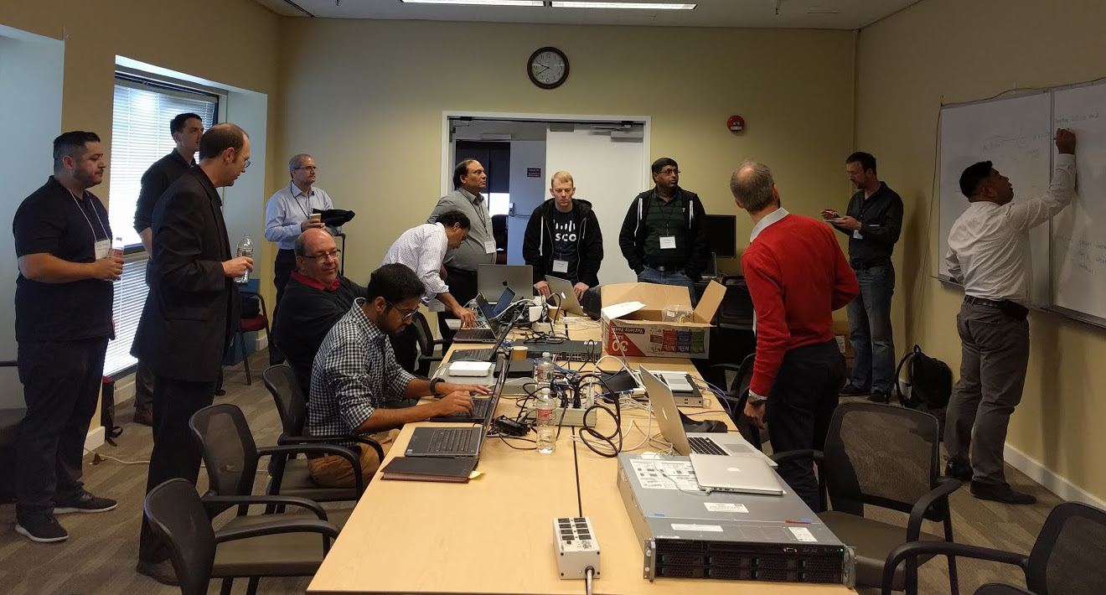
Plugfest Oct‘17
Notes:
LBNL 18 October 2017
Build a multi vendor distributed switch and pass the Faucet test suite with it.
Cisco, Allied Telesys, Noviflow, Ben Pfaff from OvS.

Slide 9
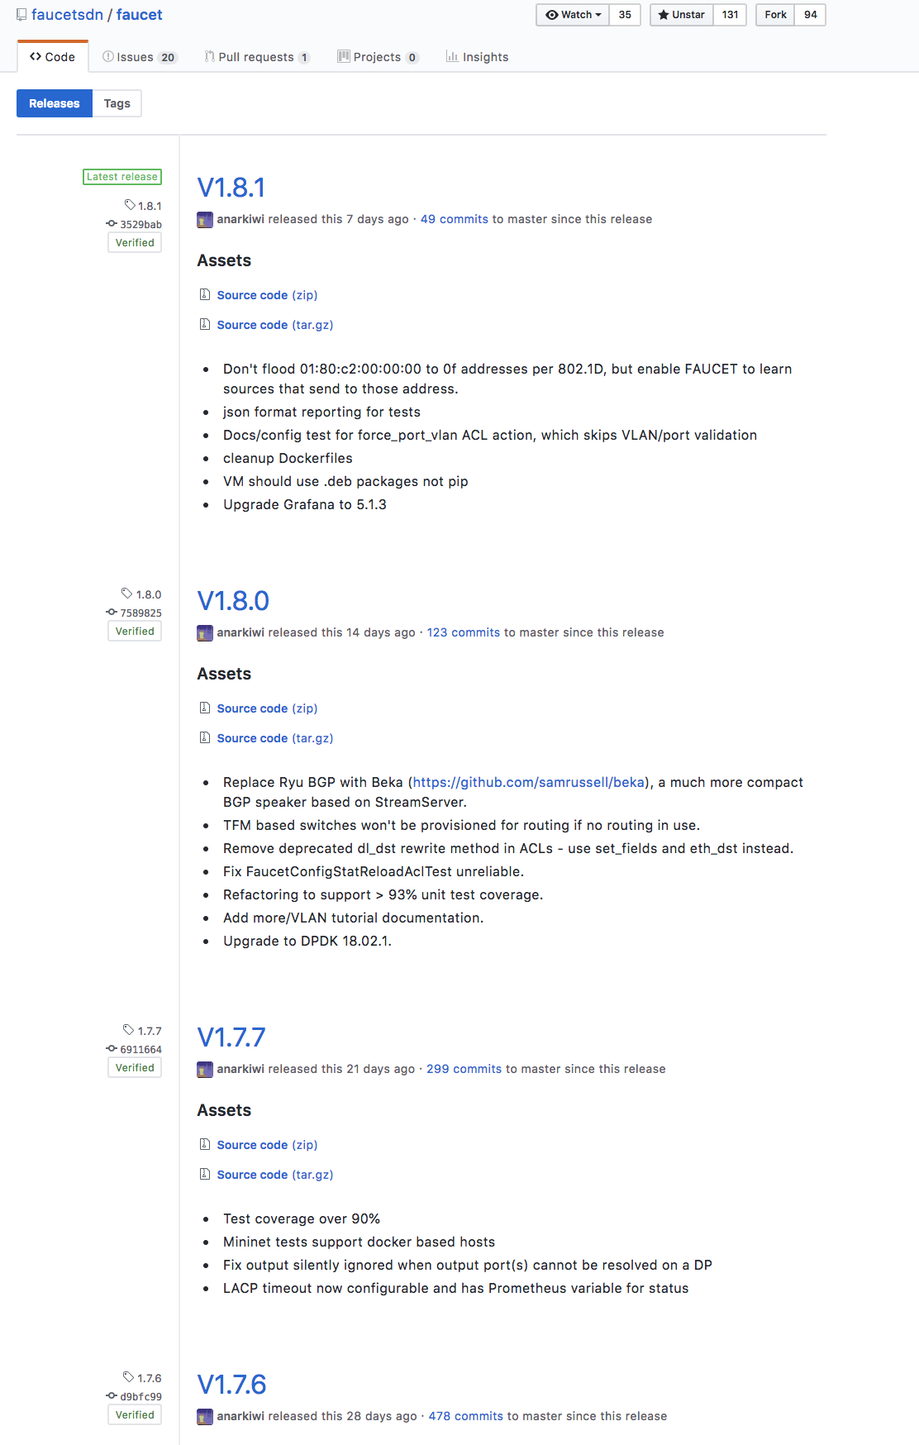
Release Often
Notes:
Keeping up to date with Faucet is important because new code is released often.
This is another advantage of Control plane separation - bug fixes, security updates and new features arrive at high velocity.

Slide 10
Policy and Security
Network policy is implemented with Faucet ACLs
A Faucet ACL has a match and action
Matches anything OpenFlow can,
Action can be DROP, ALLOW, OUTPUT, MODIFY
Can install at most places in the pipeline
Port-based
VLAN-based
Inter-VLAN / Routing
Policy-based Routing
Security Applications
IoT device control
Node behavior profiling - Poseidon
Notes:
Security and Policy is very important.
In the enterprise space, it needs to be very fine grained. This is a very good fit for OpenFlow.
Faucet ACLs are simply a wrapper round openflow rules.
Can be deployed at useful places in the pipeline and deployed or updated at any time.
Modifying and outputting allows integration with NFV style services or filtering and monitoring traffic
Various security projects will automate this process in response to alerts. Can use policy to limit IoT device behaviour.
Poseidon listens to Faucet events and samples traffic an uses ML to profile nodes then looks for nodes changing profile to detect insider threats.
It is well monitored using Gauge ­ Faucet's companion monitoring application or Prometheus to grab instrumented variables direct from Faucet.

Slide 11
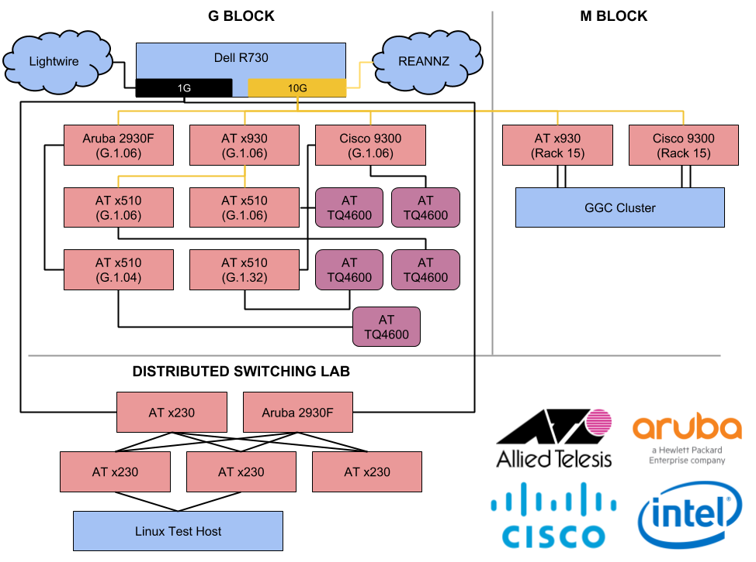
Multi-vendor Made Simple
WAND Network v2
https://redcables.wand.nz/
https://grafana.redcables.wand.nz/
https://github.com/wandsdn/redcables-ansible
Notes:
What does an automated SDN look like?
Can be multi­-vendor.
Equipment from Allied Telesis, HP Enterprise (Aruba), Cisco, OVS (DPDK)
Interoperates with the standard networks that use IP and Ethernet VLANs.
Explain diagram. NFV type services and routing at the top
Completely managed automated tools rather than SSH.
Ansible every network element.
Updates are Git commits. Review and rollback standard.
Different ansible inventories separate staging from production

Slide 12
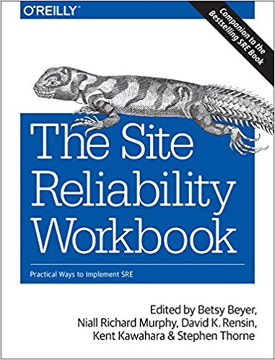
Simple to Configure
and Automate
YAML-based configuration file
Represents topology & features of network
Working on adding an abstraction layer on top for real time changes
Change configuration file then signal FAUCET to reload
FAUCET will compute diff between configuration and apply to network
Test that everything is working
Deploy on green
Notes:
Automate network behaviour Run network scenarios with automated test suite Continuous Integration Push on green
Zero Touch Networking (ZTN) gNMI

Slide 13
Simple to Upgrade

Slide 14
Faucet: More Information
https://faucet.nz/
https://github.com/faucetsdn/faucet
https://docs.faucet.nz/en/latest/
Notes:
Achieved with a small network for a research group
Network administrator who happens to be a Faucet developer.
So the next question……
How to scale this to a team and an enterprise?
Eventually a national backbone?

Slide 15
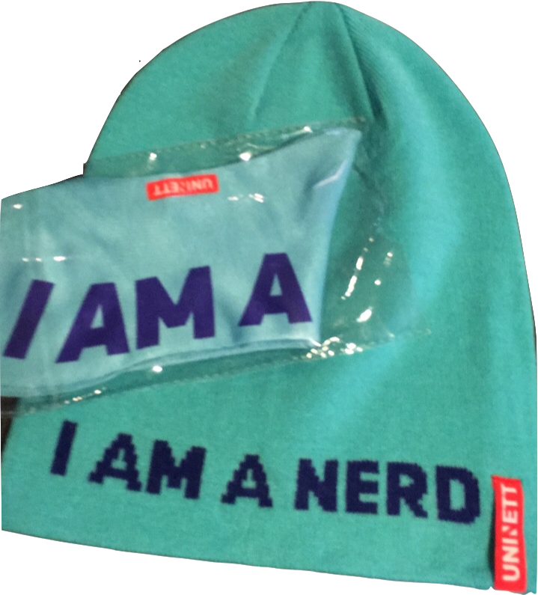
New breed of nerd
New technologies break tradition
Traditional teams won’t work
Need new skill sets
We need new nerds…..
Notes:
World is changing - how build & manage n/w’s is changing with it - in forums like this - focus on technological innovation that enables change
Also Need Think about our people & impact on day jobs
Advances such as Faucet make you re-think your team structure & skills
Unfortunately not all our staff are like the founders faucet - software developing network engineers
We need people with transferable skills who have an understanding of more than a core skill
What we need is a new breed of nerd

Slide 16
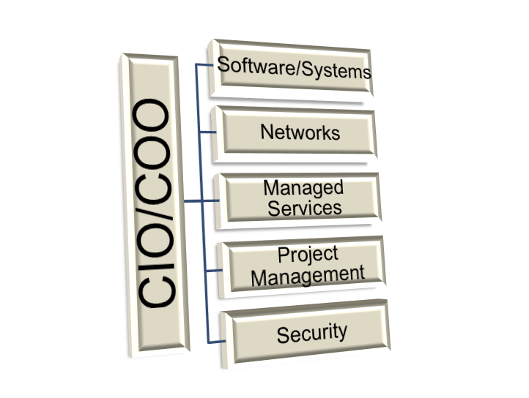
REANNZ – Little bit different
Old team structures were not working
Traditional silo’s deliver traditional outcomes
Need all the skills in the same place
Collaboration is vital
Mitigate conflicts of our own making
Notes:
Deploy Faucet internally - realised old team structure didn’t give us the skills we need
We were reinforcing traditional silo’s of networks / software / systems
READ SLIDE
Structure we came up with

Slide 17
Get your team ready
Software
Keep your experts
Encourage all-rounders
Make opportunities to work together
Strength is in the diversity of thought
Networks
Systems
Notes:
How build team cope with existing infrastructure but with new ways to manage it?
Need a different skill set & requires different thinking
Culley’s triangle - reflect actual work we do
Strength with this model is in all the skills we need are all in the same team
AND IT WORKS

Slide 18
Business Buy-In
Buy in from the board down on structure
Demonstrate the value to the business
Attract high calibre & Retain staff for longer
Our people get better more transferable skills
REANNZ gets the benefit of all the above
Notes:
Change to any traditional structure means you need to demonstrate the value of the change
READ SLIDE

Slide 19
Dynamic Resourcing
Business priorities not individual priorities
Traditional models pull resource No visibility of all the things that person is working on
Total visibility of actual workload across all the teams
Put the decision making in the right place
Notes:
Immediate change was to how we resource our teams
Blurred lines between systems - software - networks means assigning resource isn’t so easy anymore
READ SLIDE

Slide 20
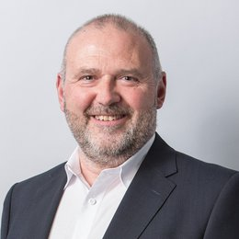
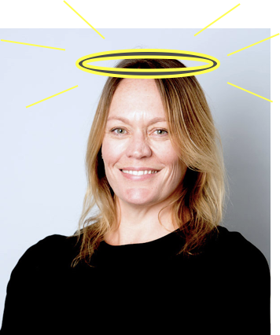
Instead of stressing out our teams trying to do the impossible…..
Stop asking for the impossible!
Notes:
As with any change - we inadvertently created a NEW PROBLEM
All the resource was in the one team BUT all the work was in the one team!
Talk to Slide
Single best thing we have changed so far

Slide 21
Training
What *new* things does your team need to know?
S/W Dev need to know networks?
N/W limits set by vendor OR can S/W dev change?
Collaboration across teams is now more important
Give people real opportunities to learn - eResearch
Short term pain with less experienced resource
Quickly outweighed by benefits
Notes:
Example of eResearch
No experience in deploying Faucet
Maybe take longer - need more support BUT fresh eyes on the software AND next time I have 2 people who can deploy

Slide 22
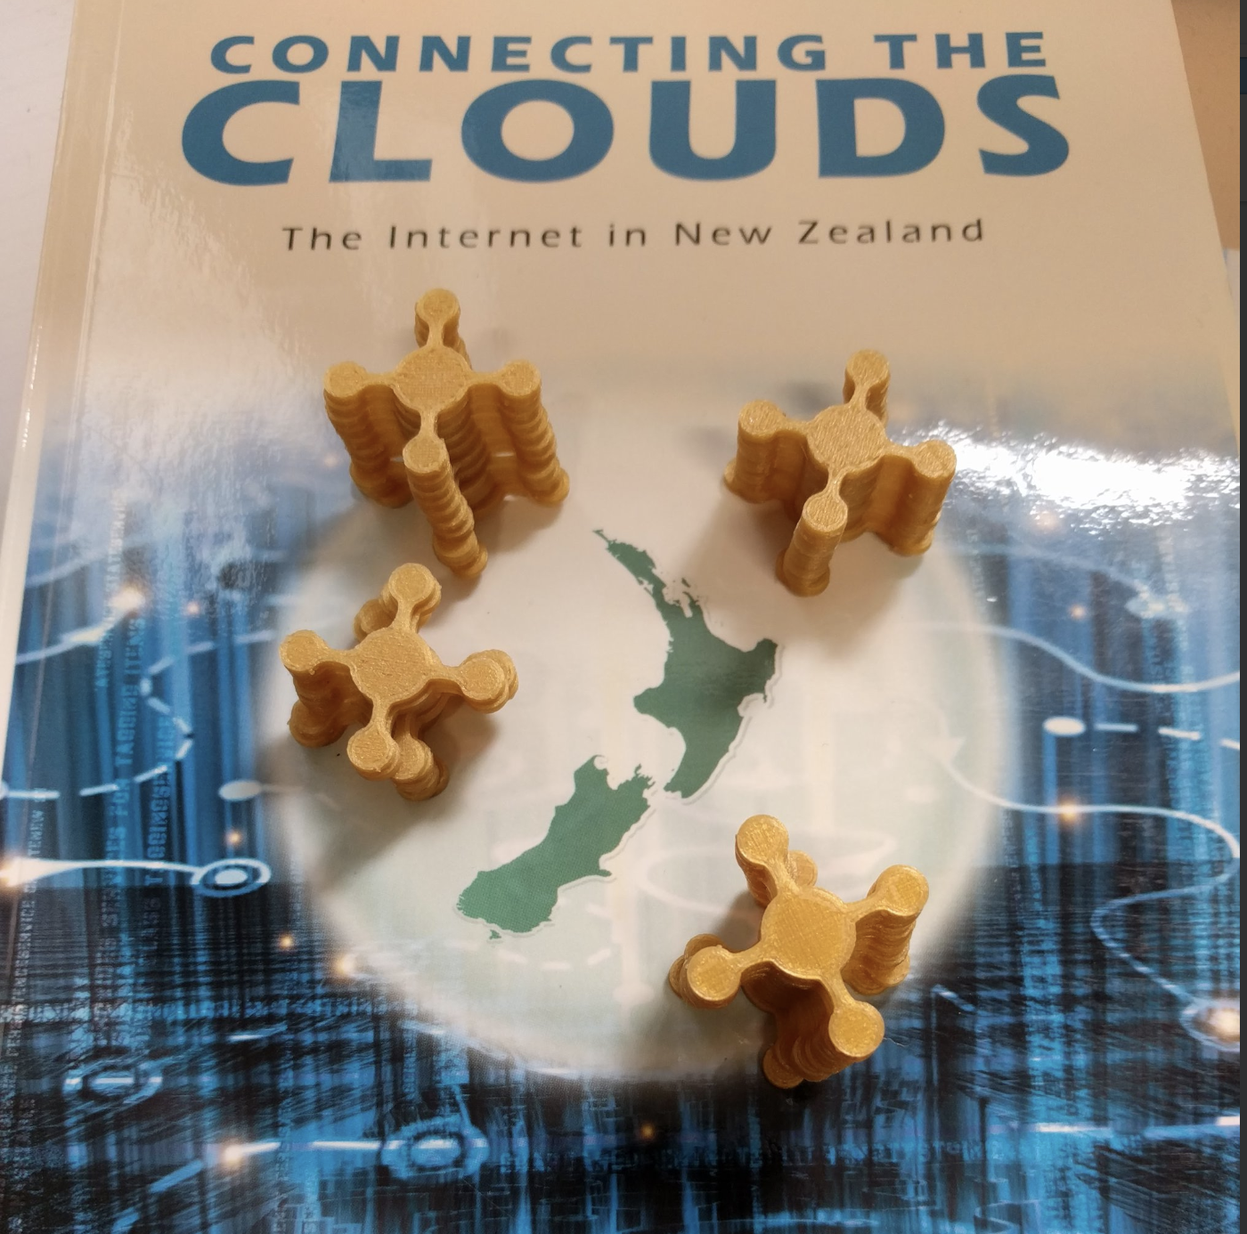
Community
Change is coming
Need to re-think how we do things
Change how we manage the network
Change how you manage the people
https://www.faucet.org.nz
Notes:
Best thing we can do for our community is share what we are all doing to meet these changes
And as with the very same Open Source approach utilised by Faucet
We all gain greater strength from each other in doing so
Questions?

