Slide 1
Automate all the thingS!
David Wilde
david.wilde@aarnet.edu.au

Slide 2
Disclaimer
Description of this talk, as seen on https://tnc18.geant.org/
Automate all the things!
AARNet is on a journey. In the beginning, network engineering was done by old-school artisans. Configurations were lovingly hand-crafted. Routers and switches petted and cared for. Loving attention was paid to each device under monitoring. This was fine…. until it wasn’t fine any more. We’re in 2018 now. It turns out that our CloudStor synch&share service got to the point where the number of users shot up from 500 to 50,000 over the course of a couple of years, and we ended up manually configuring hundreds of containers; that was really spreading the love too thin. Our systems have become cattle, not pets. AARNet network engineers are reluctantly handing in their CLI licences and learning to navigate Ansible + python + Git + Jenkins. Operator error is reduced, time to deployment is minimised, troubleshooting tools are improved, integration with applications is achieved. It all sounds wonderful. But - it’s still a journey. What have we achieved to date? What has turned out to be harder than expected? All shall be revealed…

Slide 3
Disclaimer
Description of this talk, as seen on https://tnc18.geant.org/
Automate all the things!
AARNet is on a journey. BLAH BLAH BLAH BLAH BLAH BLAH BLAH BLAH BLAH BLAH BLAH BLAH BLAH BLAH BLAH BLAH BLAH BLAH BLAH BLAH BLAH BLAH BLAH BLAH BLAH BLAH BLAH BLAH BLAH BLAH BLAH BLAH BLAH BLAH BLAH BLAH BLAH BLAH BLAH BLAH BLAH BLAH BLAH BLAH BLAH BLAH BLAH BLAH BLAH BLAH BLAH BLAH BLAH BLAH BLAH BLAH BLAH BLAH BLAH BLAH BLAH BLAH BLAH BLAH BLAH BLAH BLAH BLAH BLAH BLAH BLAH BLAH BLAH BLAH BLAH BLAH BLAH BLAH BLAH BLAH BLAH BLAH BLAH BLAH BLAH BLAH BLAH BLAH BLAH BLAH BLAH BLAH BLAH BLAH BLAH BLAH BLAH BLAH BLAH BLAH BLAH BLAH BLAH BLAH BLAH BLAH BLAH BLAH BLAH BLAH BLAH BLAH BLAH BLAH BLAH BLAH BLAH BLAH BLAH BLAH BLAH BLAH BLAH BLAH BLAH BLAH BLAH BLAH BLAH BLAH BLAH BLAH BLAH BLAH BLAH BLAH BLAH BLAH BLAH BLAH BLAH BLAH BLAH BLAH BLAH BLAH BLAH BLAH BLAH BLAH BLAH BLAH BLAH BLAH BLAH BLAH BLAH BLAH BLAH BLAH BLAH BLAH BLAH BLAH BLAH BLAH BLAH BLAH BLAH BLAH BLAH All shall be revealed…
I LIED: NOT ALL SHALL BE REVEALED

Slide 4
Why automate?

Slide 5
'cos your boss told you to?
https://www.cio.com/article/3124505/big-data/september-2016-big-data-on-campus.html

Slide 6
Really why?

Slide 7
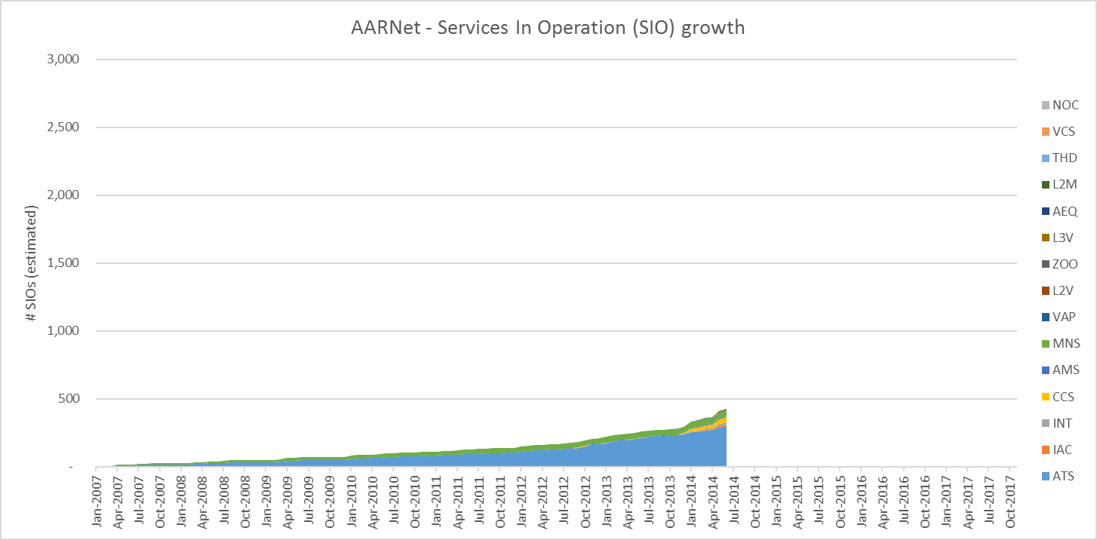
Why automate?
Number of services in 2014

Slide 8
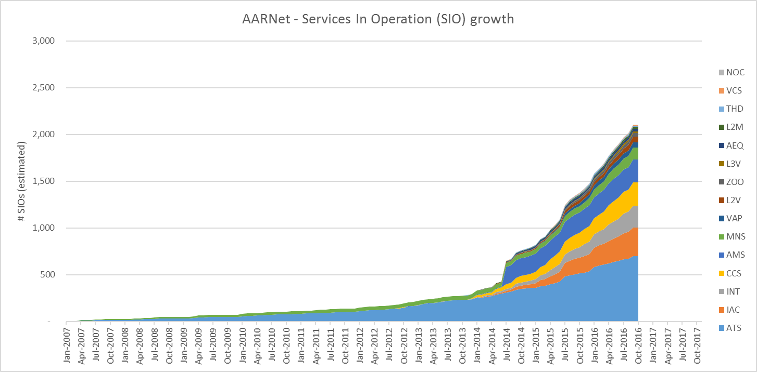
Why automate?
Number of services in 2016

Slide 9
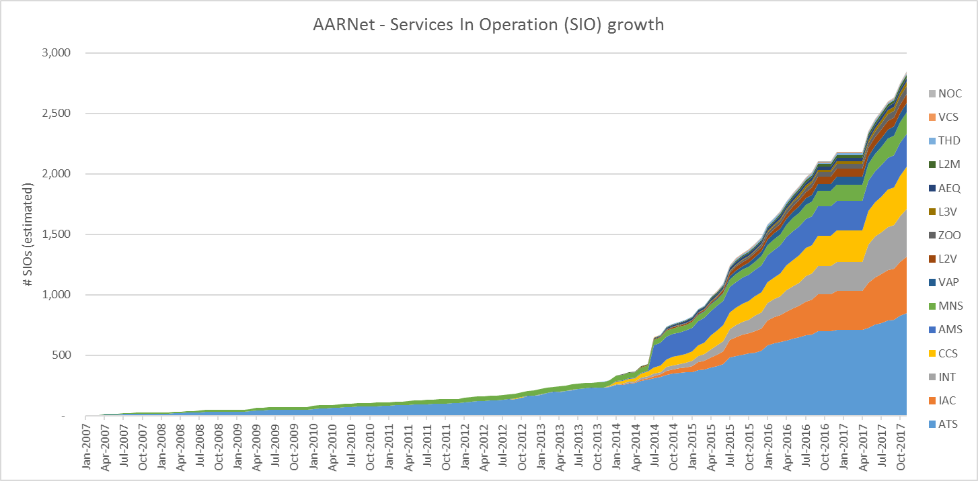
Why automate?
Number of services in 2017

Slide 10
So, why?

Slide 11
Why: really
Because we’re LAZY
Notes:
Don’t want to do anything twice
Don’t want to deal with the manual effort coming from operational inconsistencies
Don’t want to fix problems due to human error
(And because it’s fun)

Slide 12
How

Slide 13
How
Warning - unfortunate truth follows:
Automation is hard.
(Although not always technically hard.)
Notes:
Cultural change: no longer touching the router
Skills change: network engineer >> coder
Organisational change: agile, scrum, devops, SRE

Slide 14
Automation – Initial (non-destructive) steps
Document your procedures and business processes
Verify these processes.
Verify again.
Audit the network against your source of truth.
Start small.
Be willing to change
Grey Box Monitoring & Analysis
Is your source of truth valid?
Or is the network the source of truth?
Alarm in case of mismatch!
Start thinking like a coder.
Run regression checks.
Check pre- and post- maintenance windows
Notes:
Do you monitor DOM statistics on an interface today?
Do you know what type of Optic is in a port so you know if the DOM stats are within spec or not?
Do you know if your firewall rules for protecting your RE are what you expect?
Do you know if they are applied on the Lo0 interface?
Do you know if your CoS/QoS policy is applied correctly?
Do you know if your interface IPv4/IPv6 have correct forward and reverse entries in DNS?
Do you know when your box has produced a core-dump? Do you check daily or do you only look when there is a fault that you saw?

Slide 15
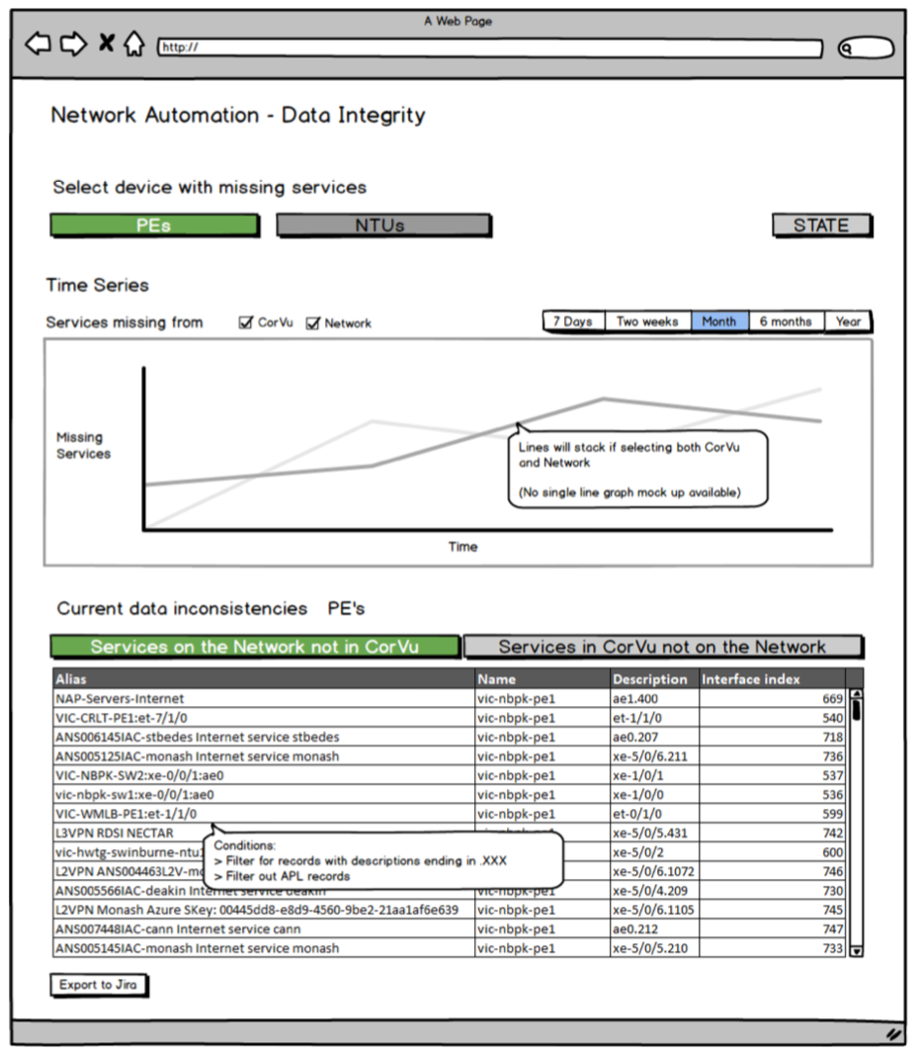
Smart Small
“Network services audit tool”
Notes:
Note – a network engineer would have produced a wall of ascii, fed by the command line…

Slide 16
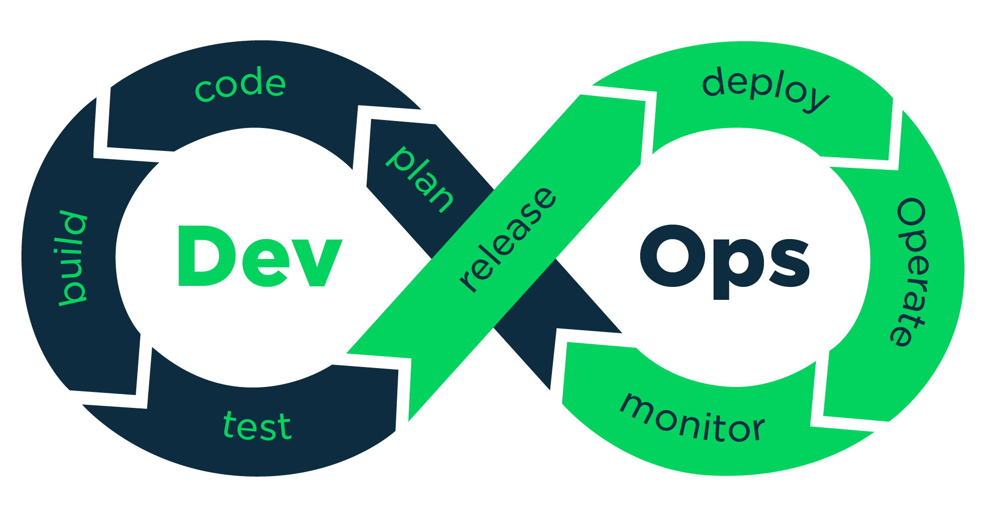
Next Level 31337
Grey Box Monitoring & Analysis

Slide 17
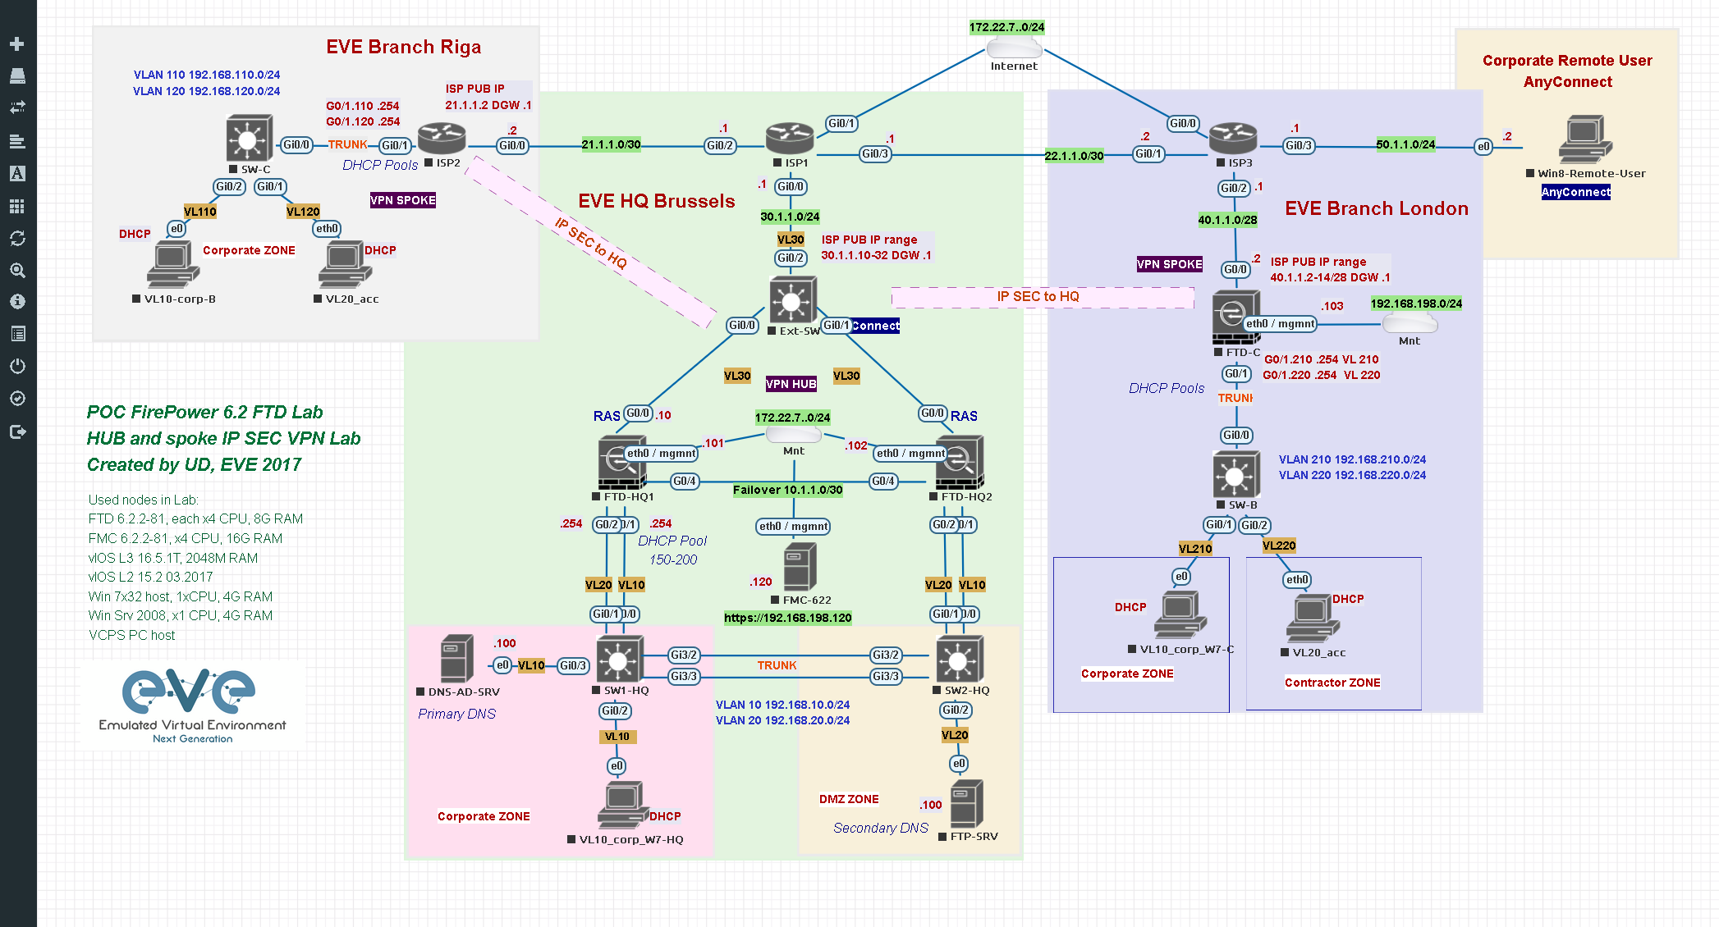
1. Build a Virtual model
Grey Box Monitoring & Analysis
http://www.eve-ng.net/

Slide 18
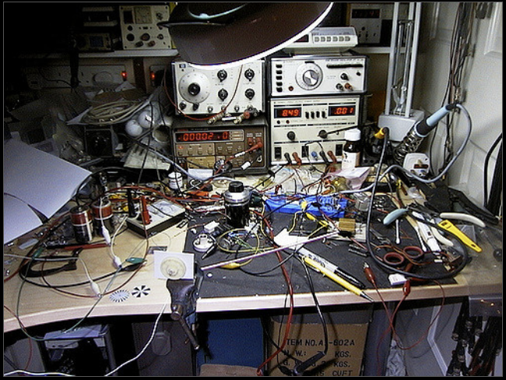
2. Build a physical lab
Grey Box Monitoring & Analysis
http://www.flickriver.com/photos/anachrocomputer/3080420597/

Slide 19
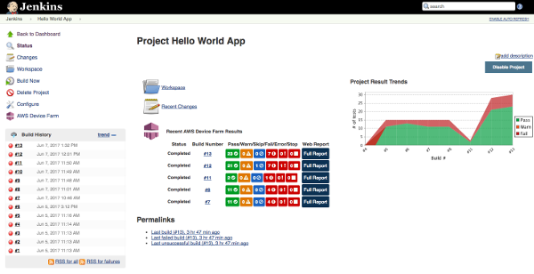
3. Build UNIT TESTS
Grey Box Monitoring & Analysis
https://aws.amazon.com/blogs/mobile/automated-device-testing-with-aws-device-farm-and-jenkins/

Slide 20
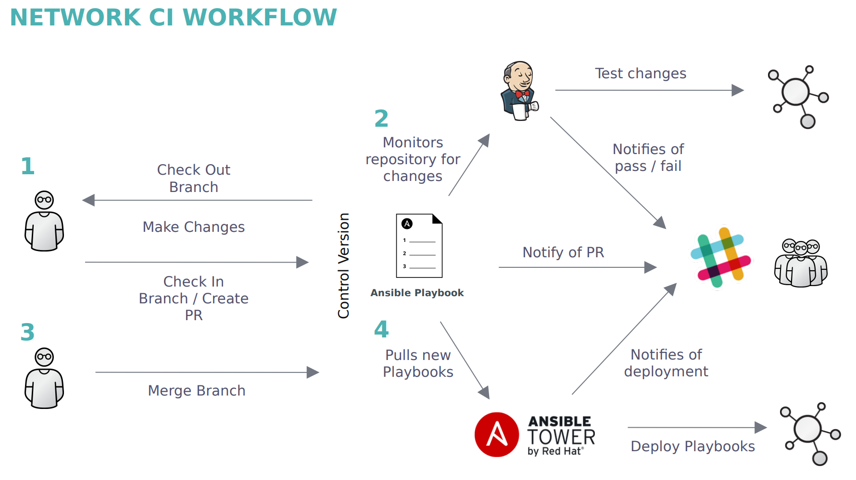
4. The holy grail: CI-CD

Slide 21
Useful links
Virtual testbed
EVE-NG (http://www.eve-ng.net)
VRNetLab (https://github.com/plajjan/vrnetlab)
VIRL (http://virl.cisco.com)
Wistar (https://github.com/Juniper/wistar)
GNS3 (http://www.gns3.com)
CI/CD
Jenkins (https://jenkins.io/)
Travis (https://travis-ci.org/)
TeamCity (http://www.jetbrains.com/teamcity/)
Automation
Ansible (https://www.ansible.com/)
SaltStack (https://saltstack.com/)
Puppet (https://puppet.com/)
Chef (https://www.chef.io/)
Juniper
PyEZ (https://github.com/Juniper/py-junos-eznc)
VMX (https://www.juniper.net/us/en/products-services/routing/mx-series/vmx/)
Grey Box Monitoring & Analysis

Slide 22
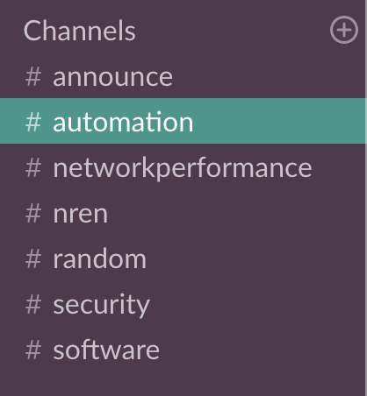
Join the conversation
Slack channel for NRENs:
Grey Box Monitoring & Analysis
https://nren.slack.com/

Slide 23
Thank you
David Wilde
david.wilde@aarnet.edu.au

