Slide 1
Cloudstor: Glamming up the ecosystem
Guido Aben, Peter Elford, AARNet
TNC 2018
13 June, 2018

Slide 2
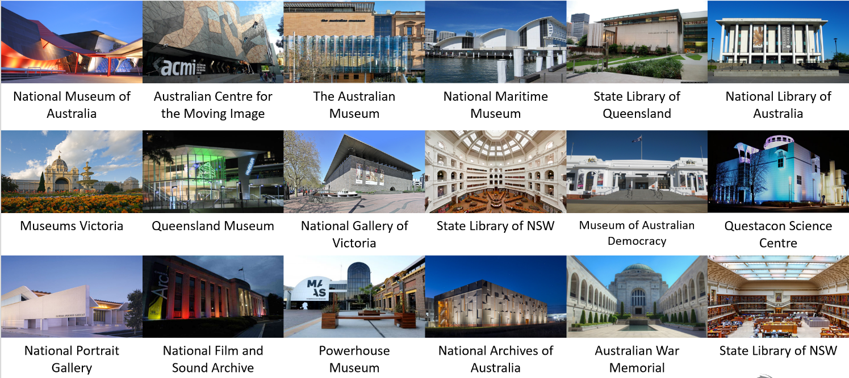
GLAMs – Galleries, libraries, archives and museums

Slide 3
Aarnet CLOUDSTOR – storage service
Users 51,409
Domains 343
Storage Used* 369 TB
*By users – 2 copies of all data is kept (one on disk, one on tape) Data updated 2 June 2018
© AARNet Pty Ltd |
Notes:
Zero-barrier to entry
Free (and on-net)
Pre-approved 100GB
Familiar
Fast
Australian
Cross-institution collaboration
Local “real” support
AARNet brand
Strong Institutional Interest

Slide 4
Glam sector – by the numbers
ABS Cat 8560.0 Museums, Aust 2007/08

Slide 5
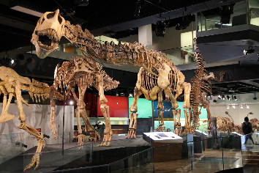
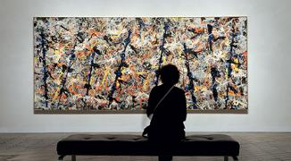
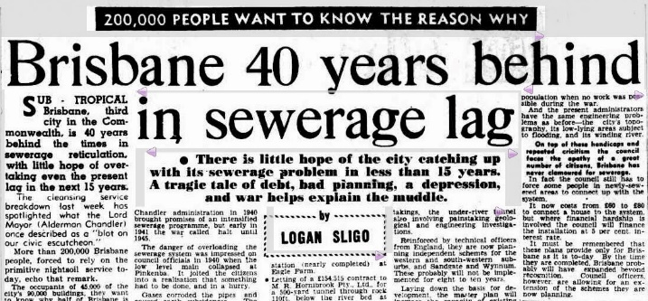
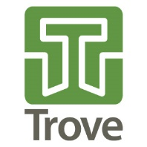
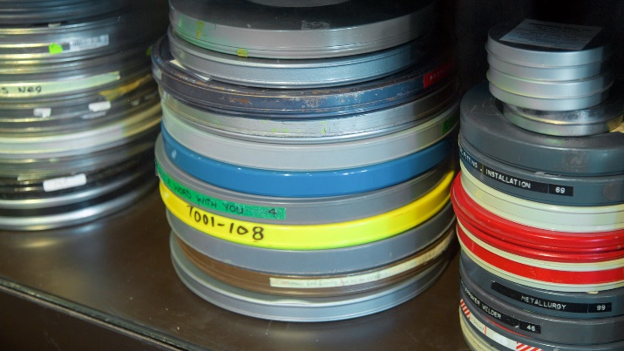
Glam sector CHARACTERISTICS
Strong, close and vibrant community
Conferences, peak bodies
Different language, different drivers, need to build trust/value
Strong preserving and sharing culture
Institutions are all in a different place on their digital journeys
Digital preservation
Digitisation and Access
Decisions driven by requirements/experience more than technology
Need to Validate Assumptions
Not like universities
May not have access to same resources (eg. federated identity)

Slide 6
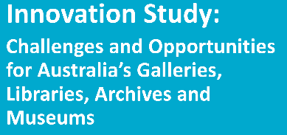
GLAM INNOVATION STUDY
Making the public part of what we do
Becoming central to community wellbeing
Beyond digitisation – creative reuse
Developing funding for strategic initiatives
Digitisation and Access
Digital Preservation
Skills and organisational change
Shared infrastructure
Trans-disciplinary collaboration and research partnerships
Four Strategies
National Leadership & Collaboration Forum
A National Framework for Collaboration
http://apo.org.au/node/42371 (2014)

Slide 7
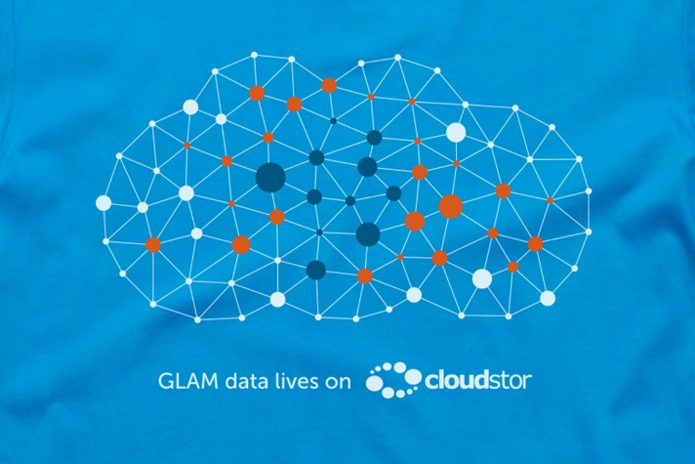
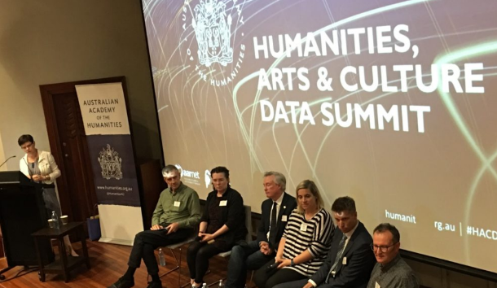
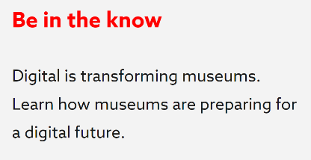
GLAM opportunity
https://www.nfsa.gov.au/about/corporate-information/publications/strategic-plan-2016-2020 https://www.humanities.org.au/2018/04/27/next-steps-in-unlocking-australias-social-and-cultural-data/
Digitally driven change agenda, , common technology issues, aligned to our stakeholders
https://www.nfsa.gov.au/about/corporate-information/publications/strategic-plan-2016-2020 https://www.humanities.org.au/2018/04/27/next-steps-in-unlocking-australias-social-and-cultural-data/

Slide 8
HUMANITIES, ARTS AND SOCIAL SCIENCE (HASS) & GLAMS
HASS Research
GLAM Collecting
Accessibility of digital collections for research
Restocking of digital collections through research
Notes:
This is a simplistic representation of many and various interrelationships between these two complex and diverse communities and we’re at the most simple, delivering the network into universities, that have many HASS researchers working in them, and into many of the large cultural institutions that hold significant collections of Australia’s cultural heritage, and in some cases, deliver services that are used heavily by HASS researchers.

Slide 9
CLOUDSTOR
Users 51,409
Easy, Familiar
Minimum Intervention
Cross Institutional
Free(mium)
Fast
Flexible Integration
Domestic
Local Support
Domains 343
Why ?
Storage Used* 369 TB
*By users – 2 copies of all data is kept (one on disk, one on tape) Data updated 2 June 2018
© AARNet Pty Ltd |
Notes:
Zero-barrier to entry
Free (and on-net)
Pre-approved 100GB
Familiar
Fast
Australian
Cross-institution collaboration
Local “real” support
AARNet brand
Strong Institutional Interest

Slide 10
What do RESEARCHERs want ?
Research
Data
Analysis
Application
Results

Slide 11
Regular researchers
Big Data – Big Computer – Big Network
High Performance Computing (HPC) facilities
Well organised science disciplines
Data Volume
Medium, Small Data
Few standards, diverse sources, non-digital
Lower adoption of digital tools, methods
Humanities, Arts, Social Science (HASS)
# Researchers

Slide 12
Cloudstor – not just storage – new partnerships
Send
Store and Sync
Collaborate
Scale Out
Reliability
Storage
Integration
Application
Platform
Application Integration
FigShare, OSF Kaltura, archives
S3
Jupyter Notebooks
R, Python
Office in Cloud
Collections RaID, ORCID
OpenStack, Institutional Storage Rocket upload
HPC access/upload Commercial Cloud ?
S3
… and more …

Slide 13
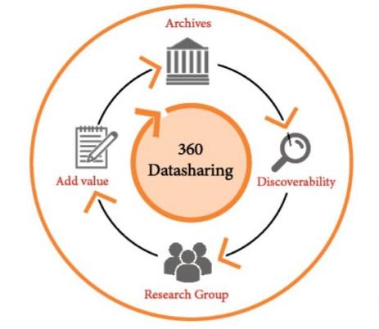
takeaways
NRENs are natural parts of the R&E and GLAM ecosystems
Shared digital agenda
Technical platforms can be shared with appropriate adoption and translation
But it’s not about the technology
NRENs need to form relationships above the network to build relevance
Differentiated offerings are crucial
Ease of use, coherence and integration and relevance drive service adoption
e-Infrastucture needs to work better-together to increase adoption in HASS and GLAM communities

Slide 14
Thank you

