Slide 1
The Age of Real-time Big Science
GÉANT and the R&E community
Chris Atherton
Research Engagement Officer - GÉANT
11th June 2018

Slide 2
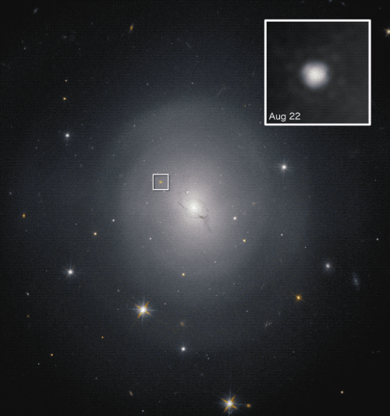
The 17th August 2017
A fortuitous event
Pre 2015 all discoveries electro-magnetic
Credit: Hubble Space Telescope, NASA and ESA

Slide 3
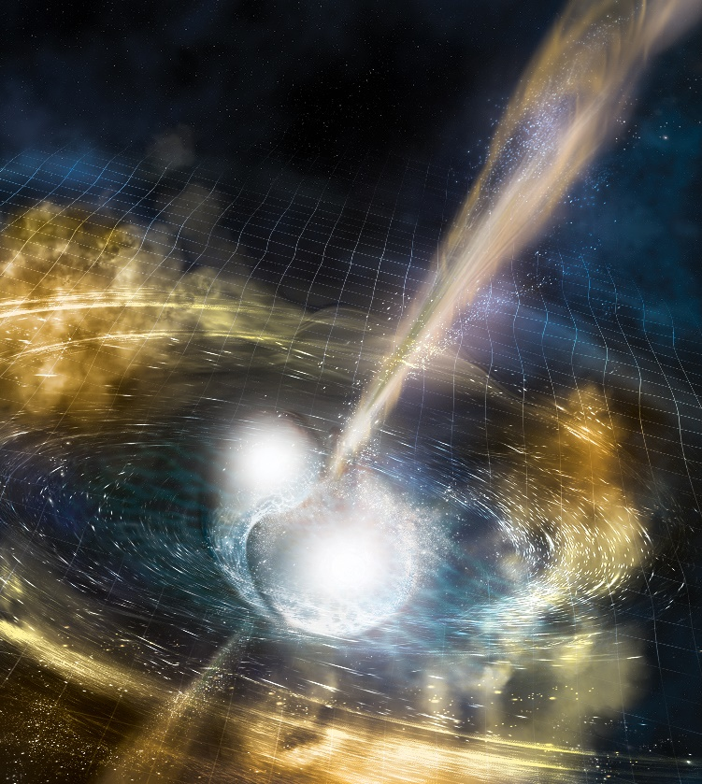
The Kilonova
Not the first observed but difficult to spot
Two neutron stars colliding
100 times brighter than the biggest supernova
Credit: NSF/LIGO/Sonoma State University/A. Simonnet

Slide 4
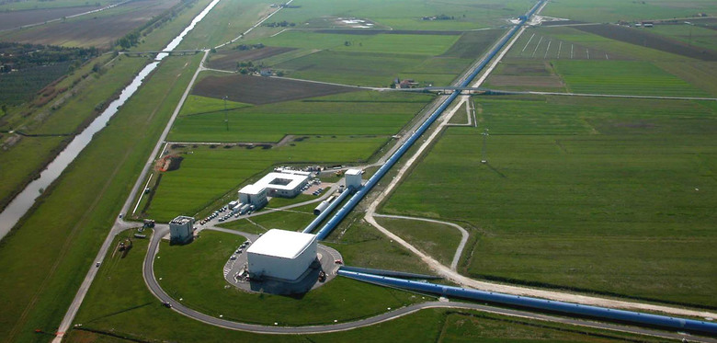
The Background
Gravitational wave detectors
EduGain and the R&E network
Upgrades and maintenance

Slide 5
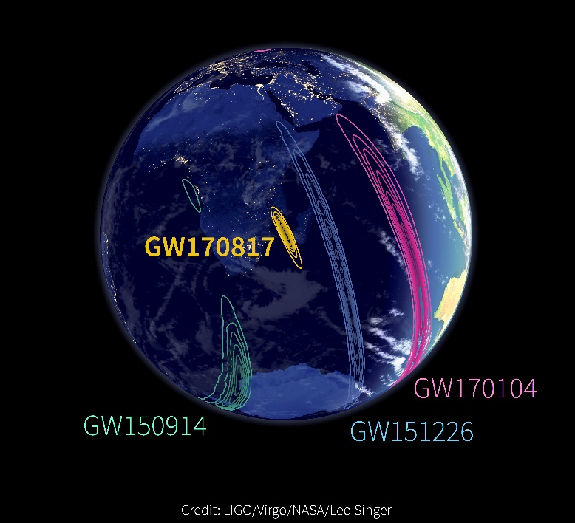
The Event
0.04 seconds
Cross checking with Virgo
Gravitational wave discovery

Slide 6
NASA/ESA Observation
Credit: NASA GSFC & Caltech/MIT/LIGO Lab

Slide 7
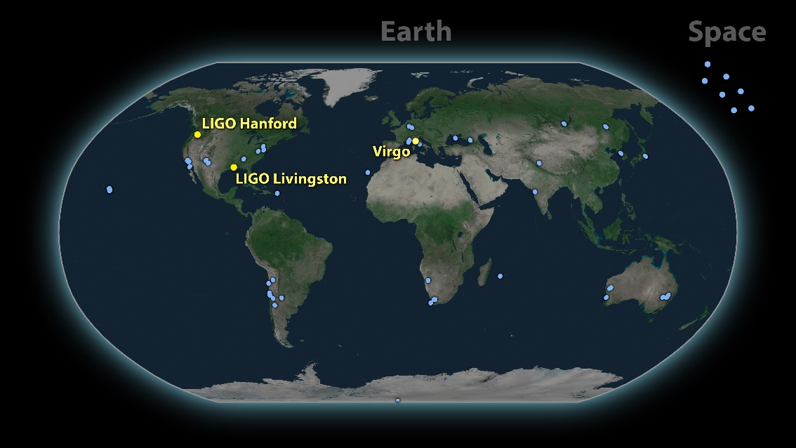
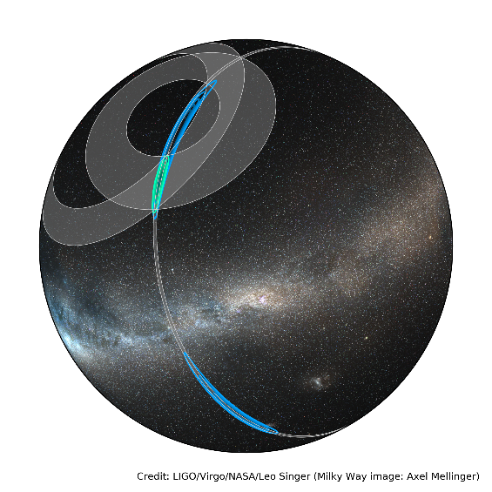
The Search Begins
A 1 hour Window
SWOPE
ESO
Credit: LIGO-Virgo

Slide 8
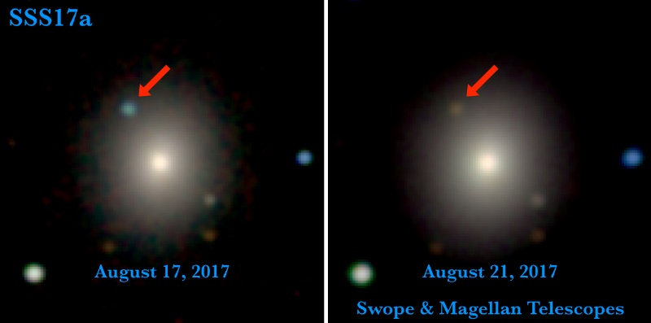
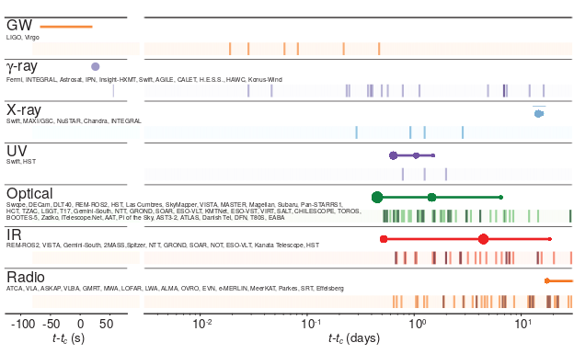
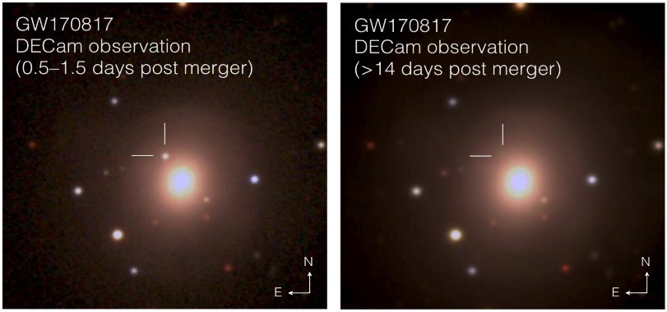
The 9 day explosion
The value of the community
Proven heavy elements
The different astronomical fields observing
Credit: 1M2H/UC Santa Cruz and Carnegie Observatories/Ryan Foley
Credit: Abbott et al. And Ligo-Virgo Scientific Collaboration
Credit: Soares-Santos et al. and DES Collaboration

Slide 9
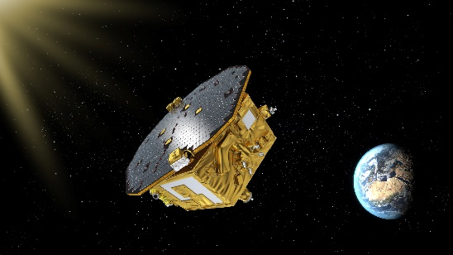
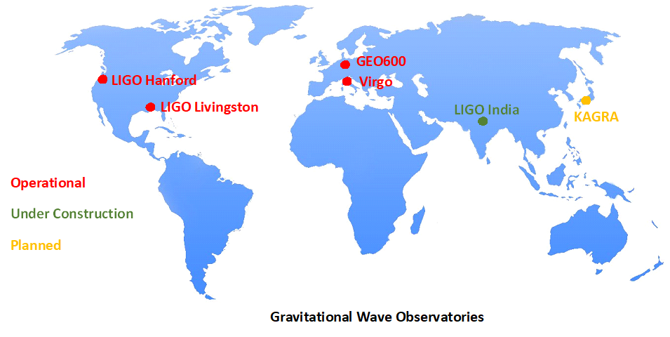
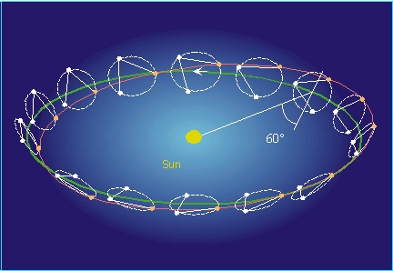
A glimpse at the future
Multi-messenger transient event astronomy
Gravitational wave / time series astronomy
What is next?
LISA
LIGO India / KARAGA
European Pulsar timing array
Credit: ESA
Credit: ESA

Slide 10
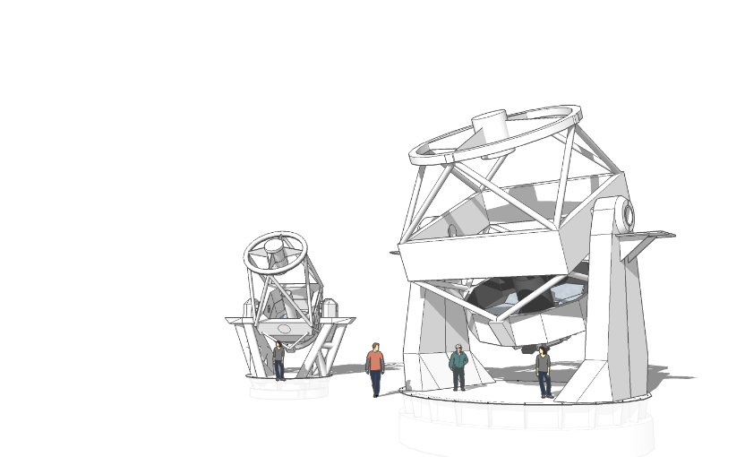
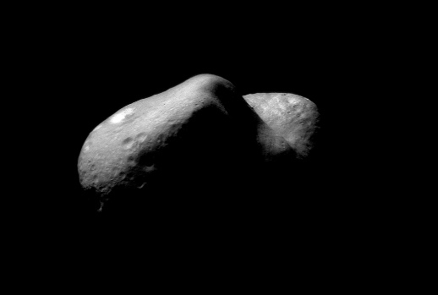
Future Advances
Asteroid mining
Automated telescopes
AI
Credit: LJMU Liverpool 2 Telescope
Credit: NASA

Slide 11
researchengagement@geant.org

