Slide 1
Phaethon: a lightpath provisioning adapter for LightSoft
Charalampos Andreou
June 2018

Slide 2
OCh and LightPath
OTN
Reconfigurable Optical Add-Drop Multiplexer
Transponder
Filter

Slide 3
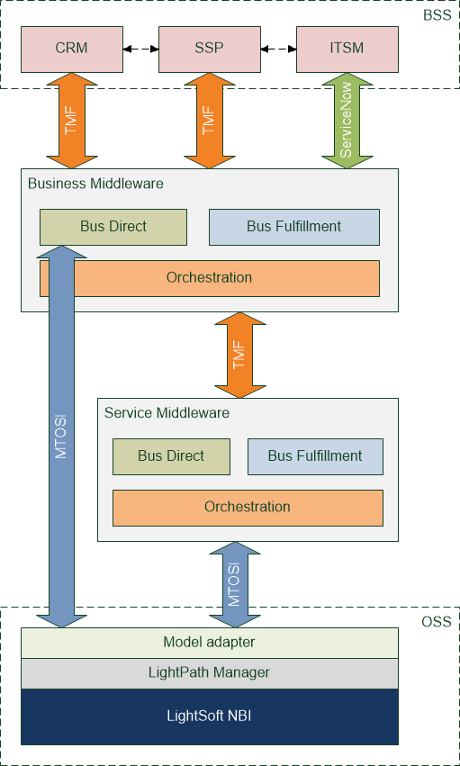
Lightpaths in the GRNET OSS/BSS stack

Slide 4
Lightpaths in the GRNET OSS/BSS stack
Phaethon

Slide 5
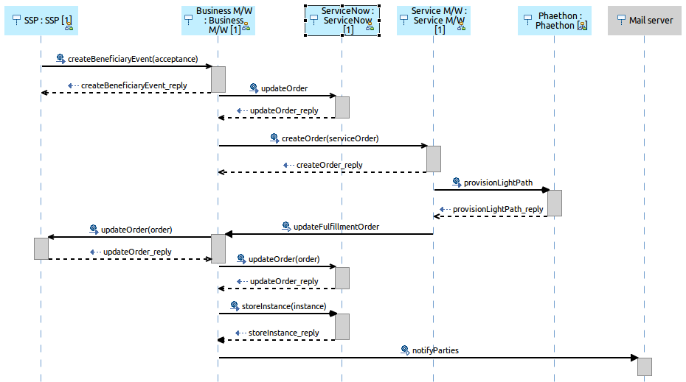
Provisioning sequence diagram

Slide 6
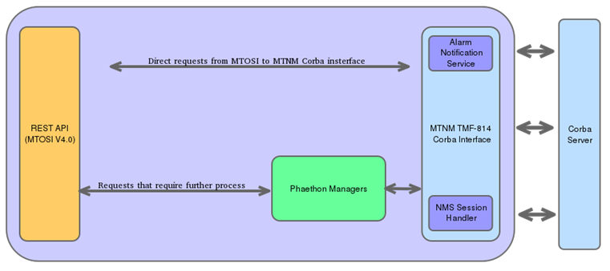
Phaethon
Adapter of the MTNM TMF-814 (NorthBound Interface) for LightSoft
Direct transformation of CORBA calls to HTTP Rest calls (JSON payload)
Complex requests - Operations extension (Phaethon manager)
Notification service

Slide 7
API Direct Requests (MTOSI v4.0)
Connection Retrieval
Equipment Retrieval
getAllSubnetworkConnections: Retrieval of all SNCs of all subnetworks
getAllSubnetworkConnectionsWithTp: Retrieval of all SNCs that use specific termination points
getRoute: Retrieval routes for a specific SNC
getSubnetworkConnection: Retrieval of SNC with all associated details)
getAllEquipment: Retrieval of the equipment included in a managed element
getAllSupportingEquipment: Retrieval of equipment with PTP/FTP ή Matrix Flow Domain
getEquipment: Retrieval of details of equipment
Managed Element
Termination Point Control
Multilayer Subnetwork Retrieval
getAllManagedElements: Retrieval of all managed Managed Elements under control of a specific ManagedElementMgr
getManagedElement: Retrieval of Managed Element with details
setTerminationPointData: Modify the parameters of a termination point (Termination Point, CTP, PTP or FTP). Best effort process.
getContainingMultiLayerSubnetworkNames: Retrieve all names of MultiLayerSubnetwork
getContainingMultiLayerSubnetwork: Retrieve all MultiLayerSubnetworks
getAllTopLevelMultiLayerSubnetworks: - Retrieve all top level MultiLayerSubnetworks
Termination Point Retrieval
getAllEdgePoints: Retrieve all Edge points – Termination points that are able to undertake a connection
getTerminationPoint: Retrieve a Termination point in detail.
getContainedCurrentTPNames: Created to managed produced exceptions (not served by the Corba server)
getContainedPotentialTPNames: Created to managed produced exceptions (not served by the Corba server)
Topological Link Retrieval
getAllTopLevelTopologicalLinks
getAllTopologicalLinks: Retrieve all topological links in the NMS.
getTopLevelTopologicalLink: Retrieve details of Topological Link

Slide 8
API Update Delete (MTOSI v4.0)
Termination Point Control
setTerminationPointData: Modify the parameters of a termination point (Termination Point, CTP, PTP or FTP). Best effort process.
Topological Link Control
createTopologicalLink: Creation of a Topological Link
deleteTopologicalLink: Deletion of a Topological Link

Slide 9
API Ph_Managers calls
LSNExt_SpeificClientType is
ODU2, ODU2E,
10GbE, 100GbE
LSNExt_LEUnit contains TR (Transponder)
Termination Point name contains UME
All Termination Points
Managed Elements
All TPs
Termination Point Retrieval
getAllConnectionlessPortTerminationPoints
getAllConnectionlessPortTerminationPointsForME
Used Termination Points
All Subnetwork Connections
Route
Route Endpoints
CrossConnections (aEnds-zEnds)

Slide 10
API Ph_Managers calls
Endpoint Compatibility Check (TunedFrequency, LSNExt_TunedFrequencyRx, LSNExt_FECOverhead, LSNExt_SpecificClientType)
checkValidSNC
Connection Control
checkValidSubnetworkConnection
createAndActivateSubnetworkConnection
deactivateAndDeleteSubnetworkConnection
createAndActivateSubnetworkConnectionAtOnce
deactivateAndDeleteSubnetworkConnectionAtOnce
Endpoint Compatibility Check
Endpoint Correction
createAndActivateSNC

Slide 11
Exception handling
String message
NOT IMPLEMENTED | 0
INTERNAL ERROR | 1
INVALID INPUT | 2
OBJECT IN USE | 3
INVALID ENDPOINT | 4
ENTITY NOT FOUND | 5
TIMESLOT IN USE | 6
PROTECTION EFFORT NOT MET | 7
NOT IN VALID STATE | 8
UNABLE TO COMPLY | 9
NE COMMUNICATION LOSS | 10
CAPACITY EXCEEDED | 11
ACCESS DENIED | 12
TOO MANY OPEN ITERATORS | 13
UNSUPPORTED ROUTING CONSTRAINTS | 14
USER LABEL IN USE | 15
DEFAULT UNMAPPED EXCEPTION | 16
CORBA server exceptions
ProcessingFailureException (TMF 814)
Ph_ProcessingFailureException to analyze the exception towards Phaethon
IOEcxeption and UserException

Slide 12
Exception handling
String message
TunedFrequency | 0
LSNExt_TunedFrequencyRx | 1
LSNExt_SpecificClientType | 2
LSNExt_PortType | 3
DifferentProvisioning | 4
LSNExt_FECOverhead | 5
Unknown Exception | 6
Internal Phaethon exceptions
TPCompatibilityException as a results of checkValidSNC or createAndActivateSNC
Ph_MultiLayerSubnetworkException during the retrieval or creation of the SNC
RestExceptionHandler (towards BSS)
String message
OCh Trail Not Found | 0
LP Trail Not Found | 1
Failed Deactivate And Delete SNC for LP | 2
Failed Deactivate And Delete SNC for OCh | 3
Subnewtwork Connection Retrival Failure | 4
Unknown Exception | 5

Slide 13
Notifications
NOTIFICATION_MODE
MANUAL_MODE, based on logical expressions
Configuration based on “alarming.properties”
Example
$type_name == 'NT_ALARM' and $filterable_data(perceivedSeverity) == 5
PS_INDETERMINATE = 0 , PS_CRITICAL = 1, PS_MAJOR = 2, PS_MINOR = 3, PS_WARNING = 4, PS_CLEARED = 5;
$filterable_data(perceivedSeverity) <= 3

Slide 14
LightApp example: OCh related End points
How to get OCH related End points for some NE identified by its DN
HTTP command: GET
Type of service execution: Asynchronous
URI example of synchronous execution
http://pogs:7001/LightApp/resources/topology/v1/OCH/endpoints?servicecategory=ECI_OCH&portrate=all&endpointstatus=available&neid=EMS~~ECI/EMS_STMS_9@@ManagedElement~~151
Main query parameters description: portrate, serviceType, directionality, endpointstatus
Example of operation execution output:
{"EMS~~ECI/EMS_STMS_9@@ManagedElement~~151": [2]
0:{
"element": "OTU2e-u2/3"
"slot": "Slot u2 (TR10_4)"
"port": "OTU2e-u2/3"
"numberOfTunableFrequencies": 88
"frequencySpacing": "DWDM_50"
"wdmMode": "DWDM"
"txChannelFrequency": 192.2
"rxChannelFrequency": 192.2
"supportedFEC": "FEC"
"tunable": true
"dn": "EMS~~ECI/EMS_STMS_9@@ManagedElement~~151@@PTP~~port-u2/3"
"rate": "OTU2"
}
Possible values of frequencySpacing
CWDM
DWDM_50
DWDM_100
DWDM_1000
Possible values of wdmMode
CWDM
DWDM

Slide 15
Thank you
bcand@di.uoa.gr

Slide 16
Automated Service creation between NREN Domains
Jonathan Homa
Director, Portfolio Marketing
TNC18, Trondheim, June 2018

Slide 17
Local service orchestration
Business and Service Orchestration
Starting point:
You have successfully implemented SDN+NFV service orchestration within your NREN domain
You can now bring up new services in minutes, like E-line service shown
E-line service

Slide 18
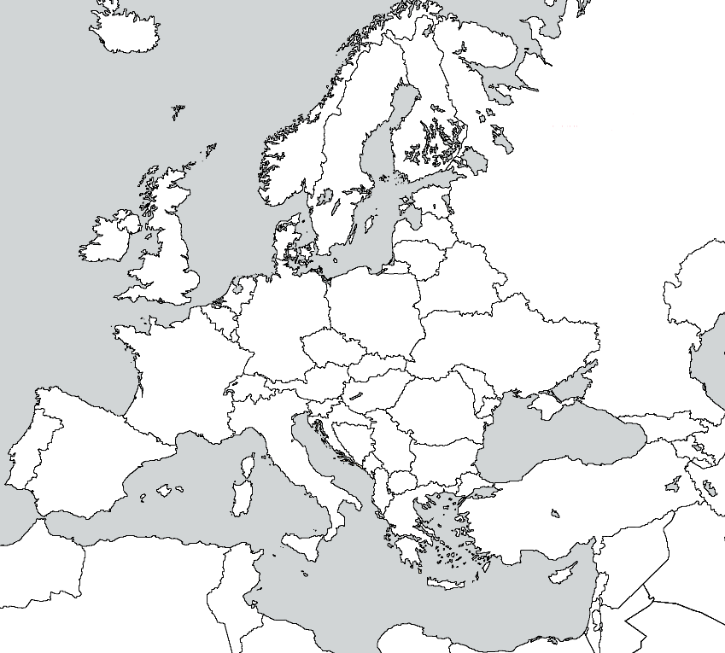
challenge
How do you extend this service creation agility between NREN domains
Any-to-any connectivity
Rapidly
Even for short duration use

Slide 19
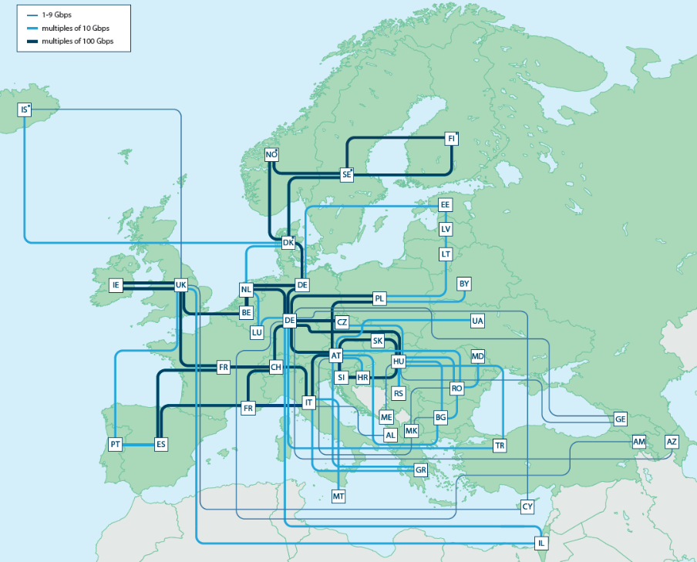
Physical Connectivity not an issue
Leveraging GEANT’s network (in Europe at least)
But still need to orchestrate services between NREN domains

Slide 20
Inter-NREN Service orchestration
Business and Service Orchestration
Business and Service Orchestration
Business and Service Orchestration
NREN 1
NREN 2
UNI
ENNI
ENNI
UNI
Orchestrated E2E E-Line Service

Slide 21
MEF 3.0 solution framework
Was launched in November 2017
The MEF 3.0 Services Framework
A traditional services framework
Defining, delivering, and certifying agile, assured, and orchestrated services
Across a global ecosystem of automated networks
Services
LSO APIs
Certification
Community

Slide 22
MEF 3.0 Lifecycle service orchestration (LSO) Reference Architecture
Customer Domain
SP #1 Domain
SP #2 Domain
CANTATA
(CUS:BUS)
Business Applications
SONATA
(BUS:BUS)
Business Applications
Customer
Application
Coordinator
LEGATO
(BUS:SOF)
LEGATO
(BUS:SOF)
ALEGRO
(CUS:SOF)
Service Orchestration Functionality
INTERLUDE
(SOF:SOF)
Service Orchestration Functionality
PRESTO
(SOF:ICM)
PRESTO
(SOF:ICM)
Infrastructure Control and Management
Infrastructure Control and Management
CUS: Customer Application Coordinator
BUS: Business Application
SOF: Service Orchestration Functionality
ICM: Infrastructure Control and Management
ECM: Element Control and Management
ADAGIO
(ICM:ECM)
ADAGIO
(ICM:ECM)
Element Control and Management
Element Control and Management
Network Infrastructure
Network Infrastructure
ENNI

Slide 23
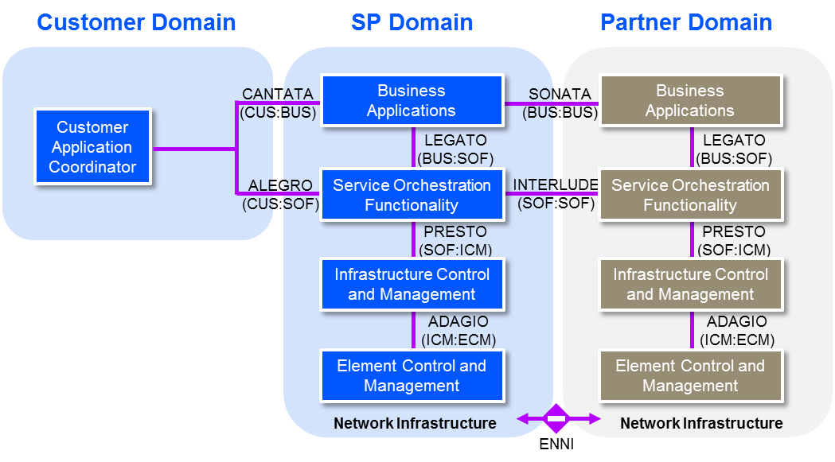
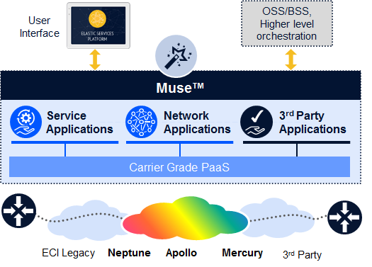
ECI LSO Innovation platform
A subset of ECI’s Muse commercial PaaS, which provides a distributed cloud-native development and deployment environment for microservices applications
Plus microservices for the Sonata, Interlude and Presto interfaces

Slide 24
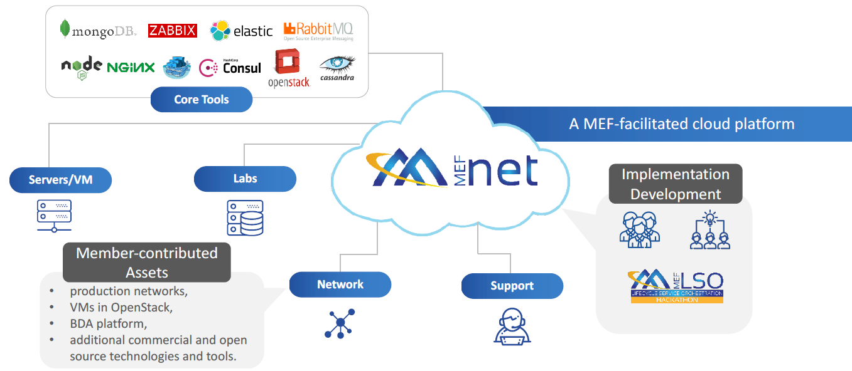
MEFNET: building “LSO use cases”
ECI
LSO Innovation Platform

Slide 25
MEF 3.0 service fulfilment & activation (SF&A) implementation project
Reduce fulfilment and activation of a MEF 3.0 service spanning multiple operator domains
from
months
to
minutes

Slide 26
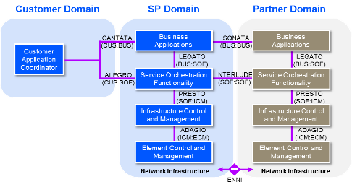
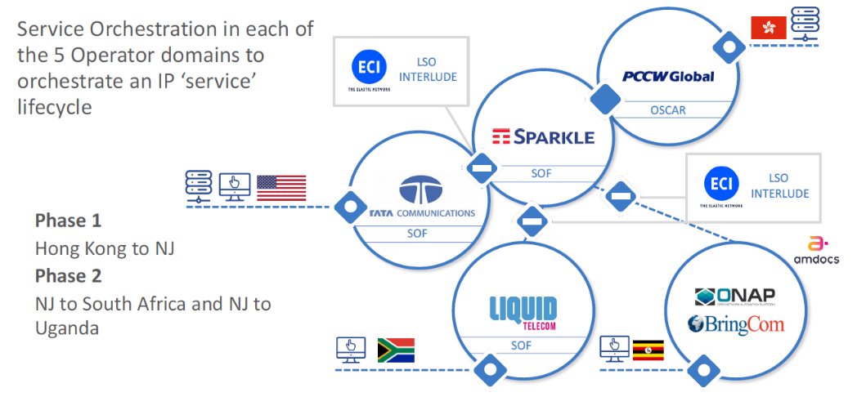
WHERE ECI FITS
SF&A project
Service Orchestration in each of the 5 operator domains to orchestrate an IP ‘service’ lifecycle
Phase 1
Hong Kong to NJ
Phase 2
NJ to South Africa and NJ to Uganda

Slide 27
Can also be used to connect NRENS
ECI’s LSO Innovation Platform, working through MEF, provides an ideal tool to explore automated service connectivity between NREN domains
ECI
LSO Innovation Platform
Business and Service Orchestration
Business and Service Orchestration
Business and Service Orchestration
NREN 1
NREN 2
UNI
ENNI
ENNI
UNI
Orchestrated E2E E-Line Service

Slide 28
Thank YOU!
Please be sure to stop by booth #14 for further discussion.

