Slide 1
AmLight’s SDN Looking Glass – An SDN centralized monitoring system
TNC, June 12th 2018
Jeronimo Bezerra <jab@amlight.net> Florida International University
Antonio Francisco <antonio@amlight.net>
Academic Network at São Paulo

Slide 2
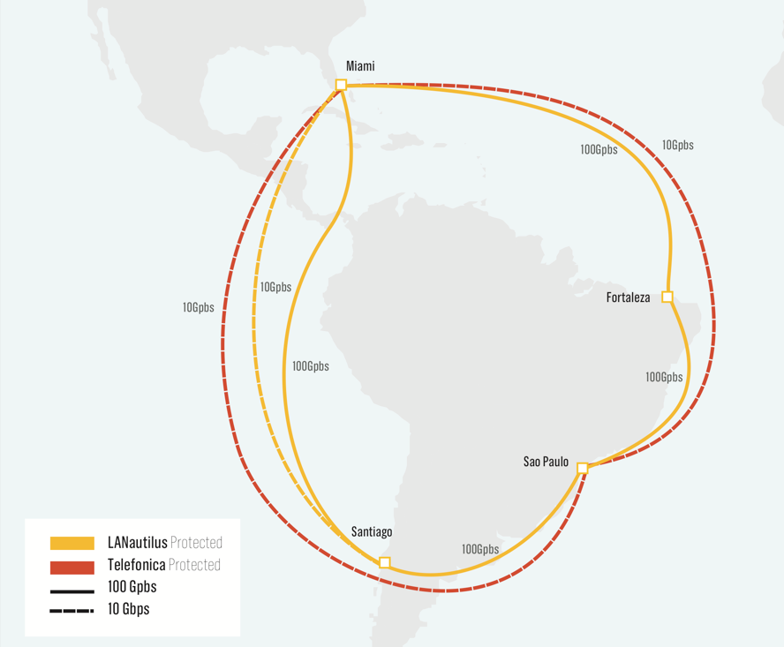
AmLight: a Distributed Academic Exchange Point
Production SDN Infrastructure since Aug-2014
NAPs: Miami, Brazil(2), Chile, and Panama
Multiple 10G and 100G links
Carries Academic and Commercial traffic
Control Plane: OpenFlow 1.0 and 1.3
Network Programmability/Slicing
Inter-domain Provisioning with NSI
2000+ R&E institutions connected
AmLight’s SDN Looking Glass - An SDN centralized monitoring system – TNC 2018

Slide 3
SDN vs. Troubleshooting
Why troubleshooting a SDN network is so complex?
OpenFlow has minimum support for troubleshooting
For instance, there are no special/reserved flow cookies
Current SDN applications only consider network provisioning
Need for troubleshooting features only appears once things start falling apart
Many academic papers suggesting solutions that do not fit in production
Highly dependent on the controller for actions
Heuristic and Machine Learning per unknown packet do not scale
AmLight’s SDN Looking Glass - An SDN centralized monitoring system – TNC 2018

Slide 4
SDN vs. Troubleshooting (2)
SDN concept itself makes things harder sometimes
Because datapaths have no intelligence at all, controllers always have to be involved
Creating scalability and timing issues
Making controllers more complex to operate and maintain
Lack of support from vendors for useful OpenFlow features
Counters are not trustworthy, action OFPP_Table is not supported, ...
AmLight’s SDN Looking Glass - An SDN centralized monitoring system – TNC 2018

Slide 5
Our 2016/2017 Vision
A single side-application for troubleshooting made sense:
Pros:
Frees the provisioning developers to focus on provisioning
Avoids duplicated data when multiple SDN applications are running in production
Eases auditing
Centralizes all troubleshooting data, making it easier to correlate events
OpenFlow agent, NMS, SDN app, slicer and sniffer’s data are processed by just one entity
Cons:
Running OpenFlow applications in parallel is still a challenge:
ONOS deletes unrecognized flows, which makes design with other third parties controllers inviable.
OpenFlow roles and multiple Masters: multiple masters ack as standalone controllers and just a few controllers actually support all role modes (SLAVE, MASTER, NONE)
No East-West protocol standardized
Each SDN app will have to be customized to gather status and counters from a remote app
AmLight’s SDN Looking Glass - An SDN centralized monitoring system – TNC 2018

Slide 6
Our 2017/2018 Vision
A set of single micro-applications over the same framework makes more sense:
Pros:
Frees the provisioning developers to focus on provisioning
Avoids duplicated data when multiple SDN applications are running in production
Eases auditing
Centralizes all troubleshooting data, making it easier to correlate events
OpenFlow agent, NMS, SDN app, slicer and sniffer’s data are processed by just one entity
No conflicts when running OpenFlow controllers in parallel
Easy integration with production applications in the same framework (Kytos, ONOS, ODL, etc.)
Cons:
OpenFlow controller-dependent solution:
Kytos Napps only work with Kytos SDN controller, and ONOS apps only work with ONOS SDN controller
AmLight’s SDN Looking Glass - An SDN centralized monitoring system – TNC 2018

Slide 7
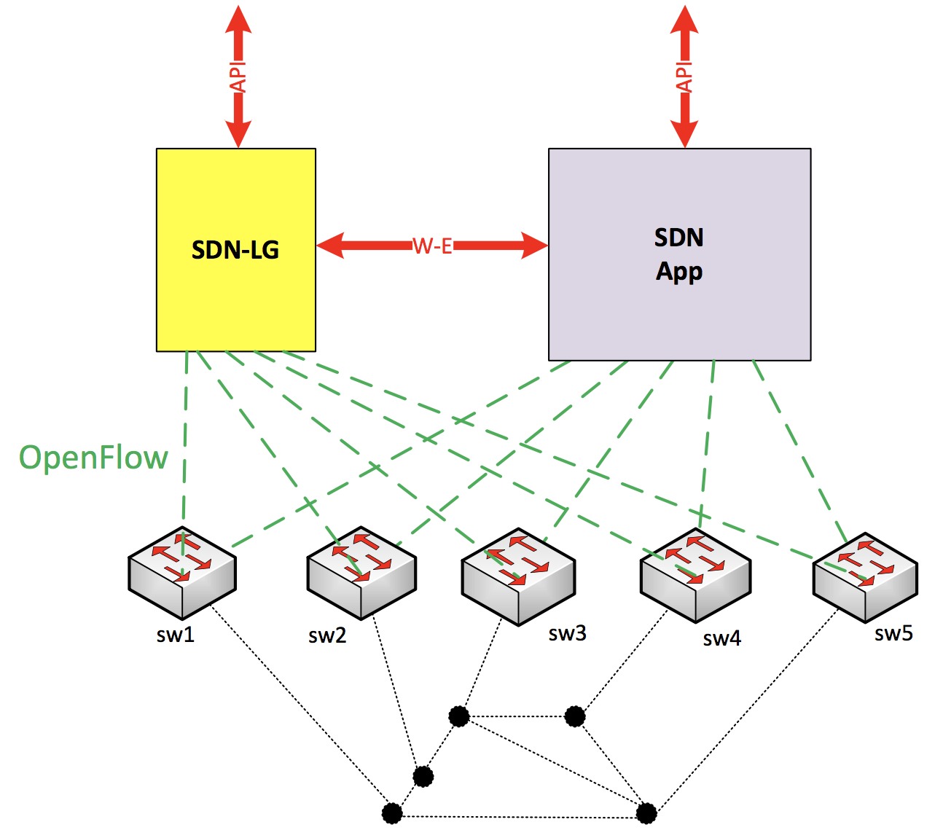
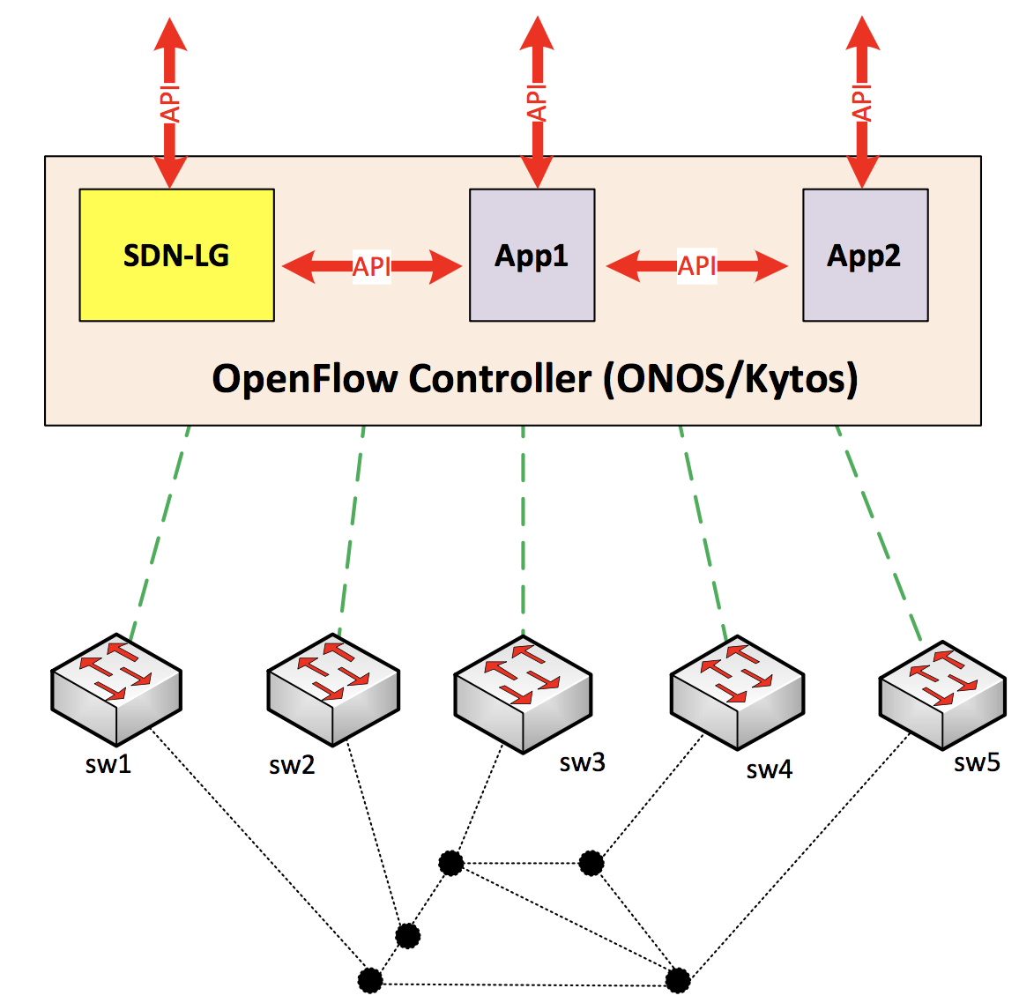
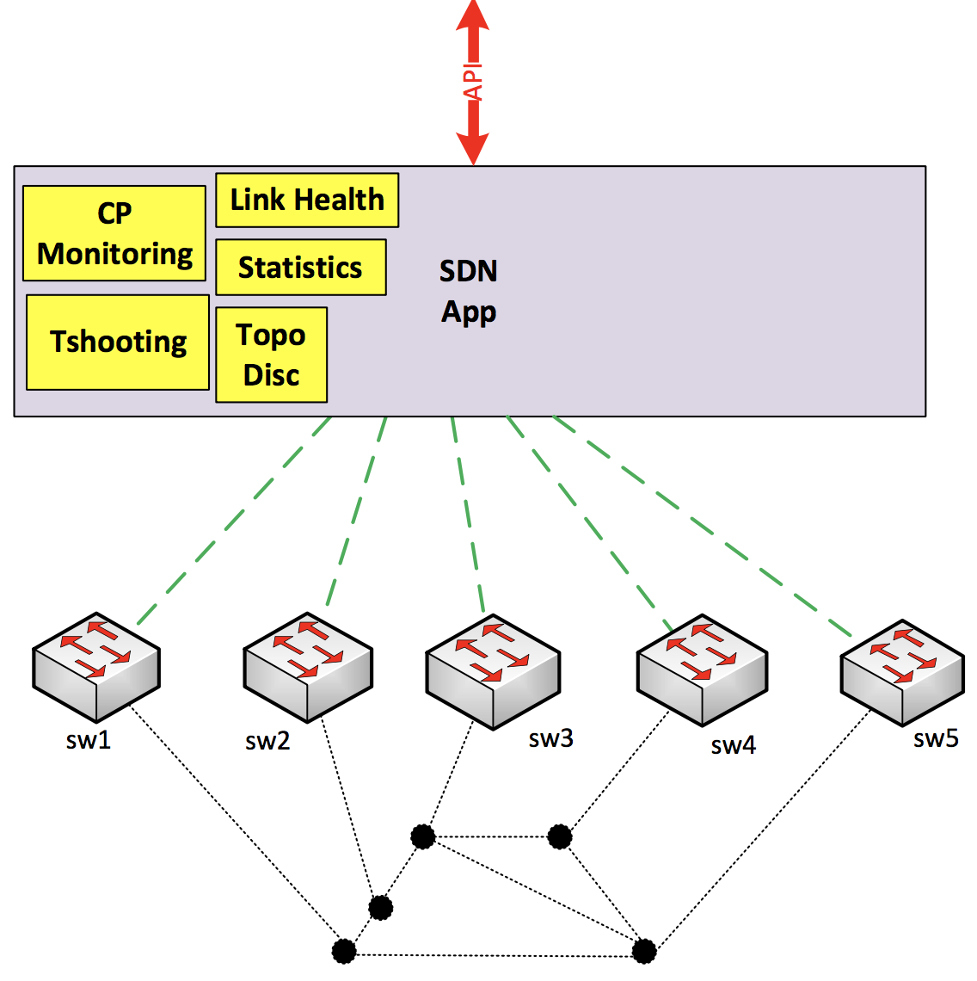
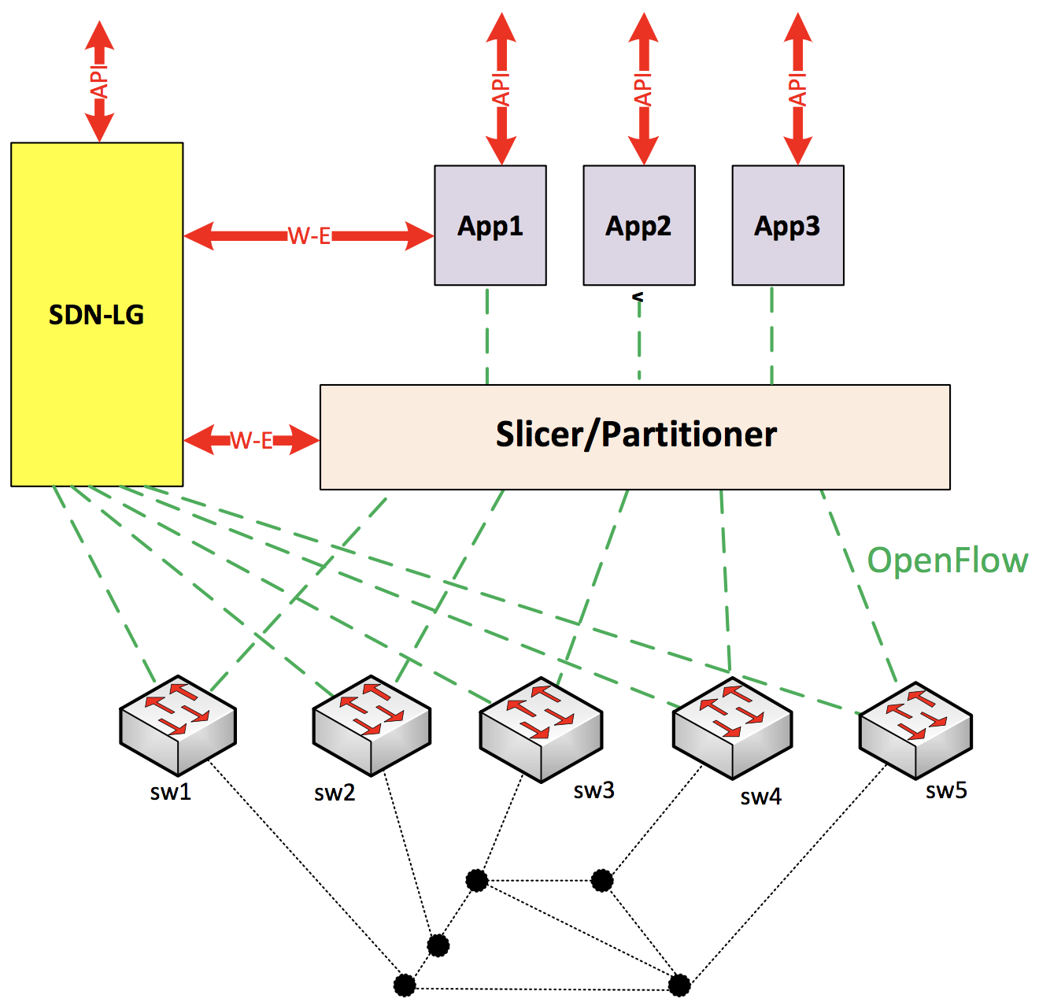
Original
Previous
Current

Slide 8
AmLight SDN Looking Glass
Central point for SDN monitoring:
Centralizes all monitoring and troubleshooting information being slice/app-independent
Stores all statistical data (flow, ports, etc.) and OpenFlow messages into a persistent backend
Tracks real time OpenFlow control plane messages
Takes network snapshots: save the network state for future troubleshooting and capacity planning
Central point for SDN troubleshooting:
Runs trace paths (”traceroute”) in both Data Plane and Control Plane
Sends alerts via e-mail and Slack
Provide REST to be used by external SDN apps, auditing tools, and external NMS
AmLight’s SDN Looking Glass - An SDN centralized monitoring system – TNC 2018

Slide 9
AmLight SDN Looking Glass - Components
The AmLight SDN Looking Glass is composed of the following Napps:
Stats: Gets flow stats from switches and store them.
Sniffer: Monitors the Control Plane
SDNTrace CP: Traces a path using flows acquired by the Stats app
SDNTrace DP: Data Plane path tracing
Notifications: Sends notifications when problems occur
Topology: Discovers topology
Web UI for network visualization
AmLight’s SDN Looking Glass - An SDN centralized monitoring system – TNC 2018

Slide 10
AmLight SDN Looking Glass
Developed in Python 3.6
Built as a series of Napps on top of Kytos SDN framework
Uses Influxdb and Kytos/StoreHouse for persistence
Uses Grafana and JavaScript D3 for visualization
Supports both OpenFlow 1.0 and OpenFlow 1.3
Integrates with the AmLight OpenFlow Sniffer
Open Source/GPL
AmLight’s SDN Looking Glass - An SDN centralized monitoring system – TNC 2018

Slide 11
AmLight SDN Looking Glass Software Stacks
Controller:
Web:
DB:
Messaging:
{RESTful API}
AmLight’s SDN Looking Glass - An SDN centralized monitoring system – TNC 2018

Slide 12
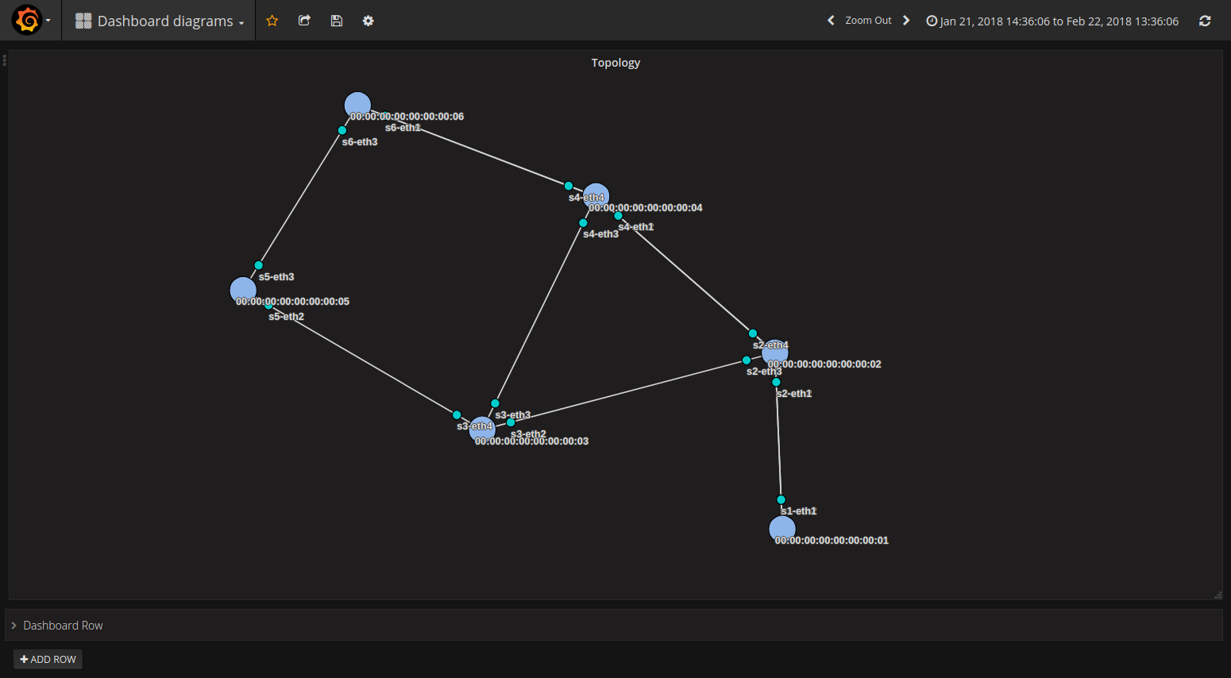
Topology Discovery
AmLight’s SDN Looking Glass - An SDN centralized monitoring system – TNC 2018

Slide 13
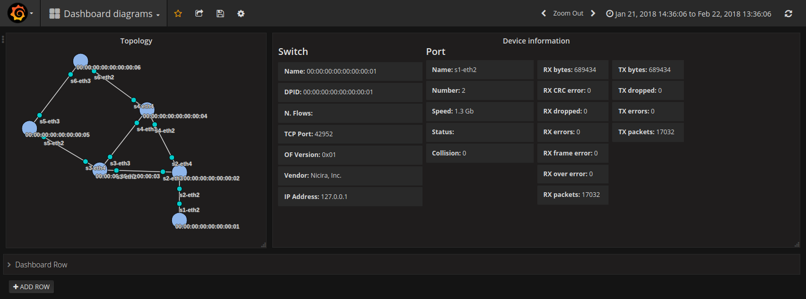
Switch info
AmLight’s SDN Looking Glass - An SDN centralized monitoring system – TNC 2018
Notes:
update screenshots

Slide 14
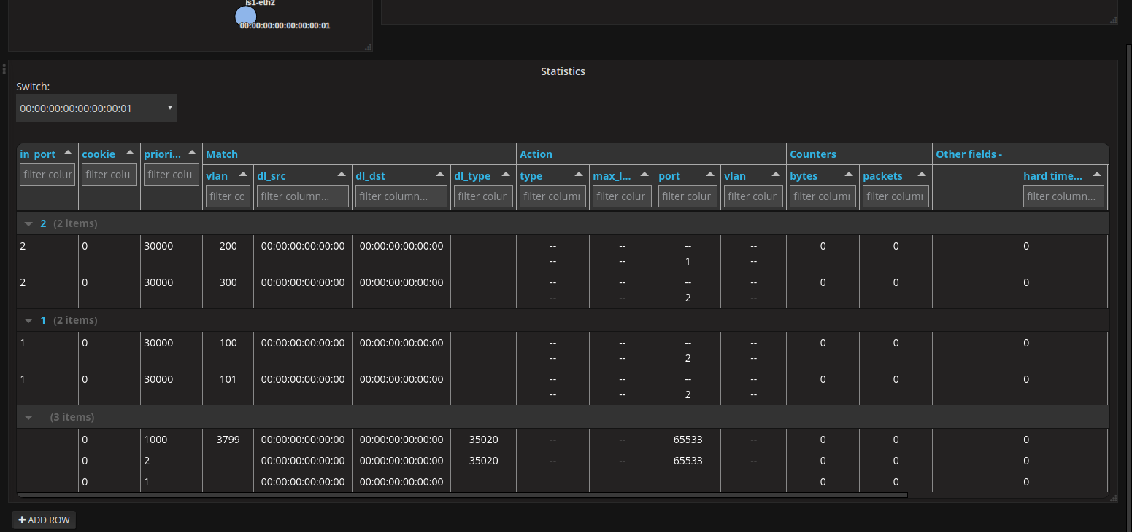
Flow Table
AmLight’s SDN Looking Glass - An SDN centralized monitoring system – TNC 2018
Notes:
We have a REST endpoint returning the flows installed in a switch at a certain datetime. The web view is not ready yet, but the look will be similar to this.

Slide 15
Tracing Paths
Control Plane: uses flow entries collected through OFP_STATS_REQUEST
Data Plane: sends Ethernet probes to match user flow entries (via OFPP_TABLE action)
Manual tests are supported:
The SDN LG always compares the Control Plane results ("correct" path) with the Data Plane results ("actual" path detected).
In case CP and DP results are different, a notification is send to Admins
Scheduled routine run CP path traces at every interval and randomly sample some circuits to test in the Data Plane:
Reason is to avoid overloading the switches' CPU
AmLight’s SDN Looking Glass - An SDN centralized monitoring system – TNC 2018

Slide 16
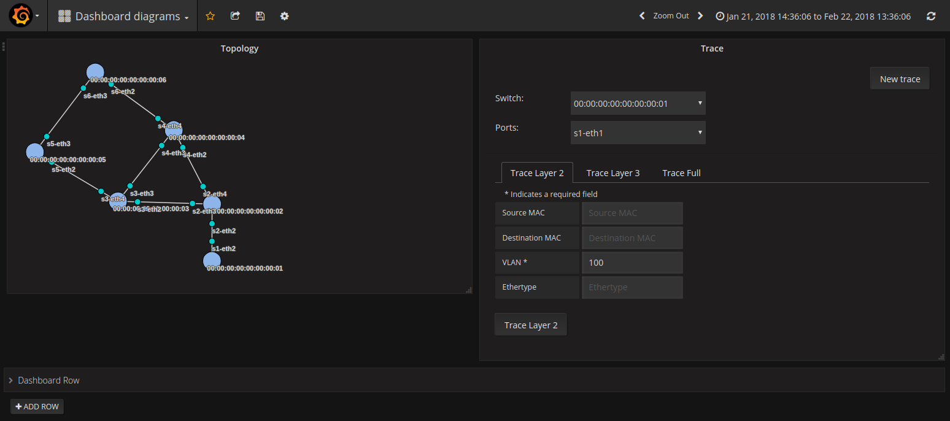
Trace Path Form
AmLight’s SDN Looking Glass - An SDN centralized monitoring system – TNC 2018

Slide 17
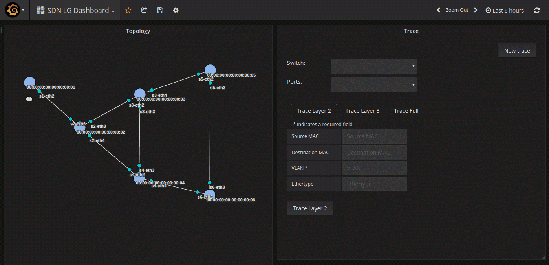
Trace Path
AmLight’s SDN Looking Glass - An SDN centralized monitoring system – TNC 2018

Slide 18
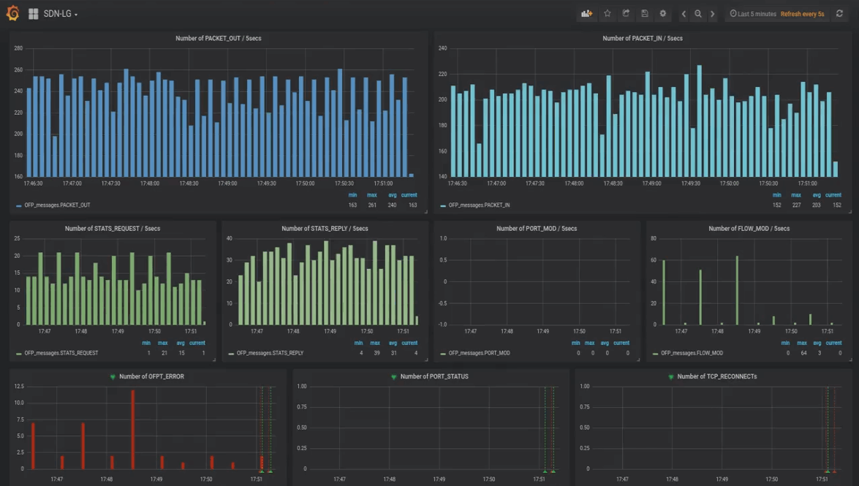
Notes:
Error: Flow Space Firewall rejecting FLOW MODs

Slide 19
SDN Looking Glass Compatibility
Evaluated OpenFlow Switches:
Switch Platform | Firmware Version | OpenFlow version | Control Plane Tracing | Data Plane Tracing | Topology Discovery | Flow Stats
OvS | 2.9.0 | 1.3 | SUPPORTED | SUPPORTED | SUPPORTED | SUPPORTED
Dell Z9100-ON | 9.11(0.0P6) | 1.3 | SUPPORTED | NOT SUPPORTED | SUPPORTED | SUPPORTED
Corsa DP 2400 | 3.0.2 build 12 | 1.3 | SUPPORTED | NOT SUPPORTED | SUPPORTED | SUPPORTED
Brocade MLXe | 6.2.0b T177 | 1.3 | SUPPORTED | NOT SUPPORTED | SUPPORTED | SUPPORTED
AmLight’s SDN Looking Glass - An SDN centralized monitoring system – TNC 2018

Slide 20
SDN Looking Glass Deployment
Two installation methods:
Single server with all components (complex how-to)
Docker containers:
Kytos
InfluxDB
Grafana
ofp_sniffer
GitHub: https://github.com/amlight/sdn-lg
AmLight’s SDN Looking Glass - An SDN centralized monitoring system – TNC 2018

Slide 21
Future
Next Steps:
Monitoring OpenFlow Meters
Monitor Interface Queue utilization
Use SNMP to monitor CPU and memory utilization
Network configuration snapshots
Save the network state (flows, CPU/memory, topology, link status, last OF messages exchanged, etc.) for future troubleshooting
Small functionalities:
Work in fully passive mode (for parallel OF controller scenarios)
"Discover" topology through other approaches (file, API, etc.)
AmLight’s SDN Looking Glass - An SDN centralized monitoring system – TNC 2018

Slide 22
THANK YOU!
Jeronimo Bezerra <jab@amlight.net> Florida International University
Antonio Francisco <antonio@amlight.net>
Academic Network at São Paulo
Vinicius Arcanjo
<vinicius@amlight.net>
Rede Nacional de Ensino e Pesquisa
Rogerio Motitsuki
<rogerio@amlight.net>
Academic Network at São Paulo
AmLight’s SDN Looking Glass - Central monitoring system for SDN
TNC 2018

