Slide 1
Transferring Earth observation data around the globe
Christos Argyropoulos
cargious@noc.grnet.gr
June 13, 2018, TNC18: Trondheim

Slide 2
Copernicus, Europe's eyes on Earth
The European Union's Earth Observation Programme
Looking at our planet and its environment for the benefit of all European citizens
It offers information services based on satellite Earth Observation and in situ (non-space) data.

Slide 3
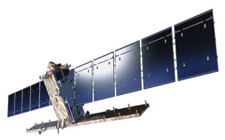
Copernicus, Europe's eyes on Earth
Sentinel-1
All weather, day-n-night
Radar imaging for land & ocean services
Able to see through clouds and rain
Main instrument: C-band synthetic aperture radar

Slide 4
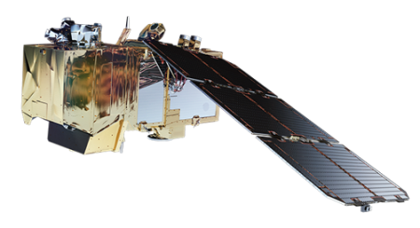
Copernicus, Europe's eyes on Earth
Sentinel-2
Medium resolution multispectral optical satellite for the observation of land, vegetation and water
13 spectral bands with 10, 20 or 60m resolution and 290km swath width
Main instrument: Multispectral instrument (MSI)

Slide 5
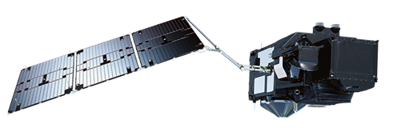
Copernicus, Europe's eyes on Earth
Sentinel-3
Measures sea-surface topography (300m resolution)
Sea & Land surface temperature (0.3K accuracy)
Colour with a resolution of 1km
Measures water vapour, cloud water content & thermal radiation emitted by the Earth
Global sea surface temperatures (0.3K accuracy)
Main Instruments:
Ocean and Land Colour Instrument (OLCI)
Sea and Land Surface Temperature Radiometer (SLSTR)
SAR Radar ALtimeter (SRAL)

Slide 6
Copernicus, Europe's eyes on Earth
Sentinel-5P
Observation of key atmospheric constituents including ozone, nitrogen dioxide, sulphur dioxide
Improves climate models and weather forecasts
Provides data continuity during the five-year gap between the retirement of Envisat and the launch of Sentinel-5
Main Instrument: TROPOspheric Monitoring Instrument (TROPOMI)

Slide 7
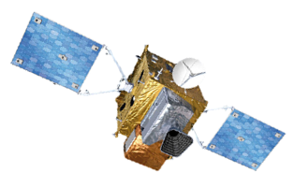
Copernicus, Europe's eyes on Earth
Sentinel-4 (launch in 2021)
Provides air quality with data on trace gas concentrations and aerosols in the atmosphere
Main Instruments:
UVN Multispectral Spectrometer
Infra-Red Sounder (IRS)

Slide 8
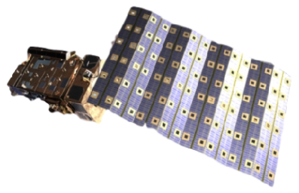
Copernicus, Europe's eyes on Earth
Sentinel-5 (launch in 2021)
Measures air quality and solar radiation, monitors stratospheric ozone and the climate
Global coverage of Earth’s atmosphere with an unprecedented spatial resolution
Carried aboard EUMETSAT’s MetOp Second Generation satellites
Main Instrument: Passive Grating Imaging Spectrometer

Slide 9
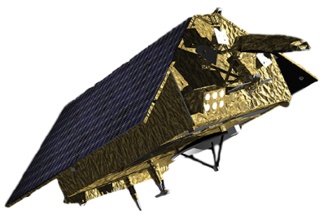
Copernicus, Europe's eyes on Earth
Sentinel-6 (launch in 2020)
Observes changes in sea surface height with an accuracy of a few centimeters
Global mapping of the sea surface topography every 10 days
Enables precise observation of ocean currents and ocean heat storage; vital for predicting rises in sea levels
Main Instruments:
Synthetic Aperture Radar Altimeter (POSEIDON-4)
Microwave Radiometer (AMR-C)

Slide 10
Copernicus operations
ESA developed a dedicated ground segment which includes
Sentinel Flight Operations Segment (FOS) The brain of the control-plane
Sentinel Payload Data Ground Segments (PDGS) comprising The brain of the data-plane
Core Ground Stations (CGS) for Data Acquisition and product generation in Near Real Time
Matera (eGeos, IT)
Svalbard (K-Sat, NO)
Maspalomas (Inta, SP)
Alaska (K-Sat, USA)
Sentinel Processing and Archiving Centers (PAC)
S1 (Astrium/UK, DLR/DE)
S2 (Astrium/UK, Indra/SP)
S3 (OLCI Land DLR/DE, SRAL CLS/FR, SLSTR-SYN ACRI/FR)
S3 (OLCI Marine EUMETSAT/DE)
Sentinel Missions Performance Centers (MPC)
S1 (CLS/FR)
S2 (CS/FR)
S3 (ACRI/FR)
Sentinel Precise Orbit Determination (POD) operated by GMV-led (Tres Cantos, Spain)
Payload Data Management Centre (PDMC) (European Space Research Institute – ESRIN, Frascati/IT)

Slide 11
Space-to-Earth data delivery
Orbiting from pole to pole about 700 km up, Sentinel-1A transmits data to Earth routinely, but only when it passes over its ground stations in Europe. However, geostationary satellites, hovering 36 000 km above Earth, have their ground stations in permanent view so they can stream data to Earth all the time
Marking a first in space, Sentinel-1A and Alphasat (telco sat) have linked up by laser stretching almost 36 000 km
Large volumes relay of data very quickly so that information from Earth-observing missions can be even more readily available (used maritime safety and helping to respond to natural disasters)

Slide 12
Copernicus Data Hubs
Copernicus Services Hub
Over 200 users
No rolling policy
Data on demand service is available
Service Level Agreement
International Hub (hosted by GRNET, operated by National Observatory of Athens)
4 users (National Aeronautics and Space Administration/USA, National Oceanic & Atmospheric Administration/USA, U.S. Geological Survey/USA, Geoscience/AUSTRALIA)
3-week rolling policy
Service Level Agreement
Collaborative Hub (hosted by GRNET, operated by NOA)
Over 25 users (including hub relays)
2-4 weeks rolling policy
Service Level Agreement
Copernicus OpenAccess Hub
150.000 users
No rolling policy
Hub Relays, national mirror sites etc.
Increase the overall capacity
Different flavors of data/metadata

Slide 13
Copernicus added-value services
The Copernicus Land Monitoring Service (CLMS)
provides access to information on land-use and land-cover products (e.g. vegetation state or the water cycle)
The Copernicus Atmosphere Monitoring Service (CAMS)
provides data and information on atmospheric composition (current situation, few days forecasts)
The Copernicus Marine Environment Monitoring Service (CMEMS)
one-stop-shop for marine data
The Emergency Management Service (EMS)
supports crisis management (disasters caused by natural hazards, man-made hazards and humanitarian crisis)
The Copernicus Climate Change Service (C3S)
provides high quality data and graphics for climate change
Security service aims to support EU policies
information in response to Europe’s security challenges (crisis prevention, border surveillance, maritime surveillance)

Slide 14
Copernicus Data Metrics
ESA (all hubs) 8 Million published products
60 PB downloads from users Sentinel-1 delivery: 1h (Near Real Time), 24h (Non Time Critical)
Sentinel-3 delivery: <3h (Near Real Time), <1month (Non Time Critical)
GRNET/NOA Consumes
~20k products /day
~13 TiB /day
Data downloaded from the distribution DC
For Sentinel-5P GRNET will be the seeder
GRNET/NOA Provides
36k products = 13 TiB / day downloads (IntHub)
51k products = 17 TiB / day downloads (ColHub)
61k products = 15 TiB / day downloads (DIASHub)
Overall avg product size: 700 MB (min: 15 MiB, max: 1.7GiB)

Slide 15
The Mission
“Transfer satellite products from the main service distribution DC (central Europe), to our DC in Greece”
OR
“A constant flow of large files should be delivered daily from DC alpha to DC beta residing thousands miles away, over Long Fat Networks (LFNs)”
Datasets should be transferred asap to the scientific community and authorities
The software handling the file download is using TCP connections for data transferring and resides on multiple Virtual Machines on multiple servers across the DC.
Notes:
The path for the Earth observation data, from the ESA Sentinel satellites all the way down to the end-user is a complex one, starting from the satellite, involving receiving stations as far away as Svalbard, including distributed processing centres for data calibration and geo-coding, especially considering the data should be delivered as fast as possible to the user communities in order to run models and make predictions for environmental effects and emergency incidents. GRNET is participating to this effort as one of the service/content distribution points for ESA’s Earth observation data, contributing to the European Union’s flagship Copernicus programme

Slide 16
The Problem Products Backlog
GRNET/GÉANT networks can achieve speeds of many Gbps
but
The transfer speed was not adequate
The number of the datasets (files) per day, with a total size of many Terabytes, that were in the queue waiting to be transferred to our DC was increasing
One of our first thoughts →distance (a.k.a propagation delay in networking) leading to TCP throttling
Notes:
Data are distributed from the main DC of the ESA, in central Europe, to other DCs across Europe. One of these DCs is a newly-built GRNET DC connected to our WAN network with multiple 10Gbit links. The software handling the file download is using TCP connections for data transferring and resides on multiple Virtual Machines on multiple servers across the DC.
After setting up the entire DC infrastructure we started to download datasets. The operation team noticed that the backlog of the files that were waiting to be downloaded was large. Even worse, new datasets were becoming available with fresh data from the satellites to the main DC. The total bandwidth consumed by the TCP connections between the two DCs was under 1Gbit/s.
Such a rate, taking into consideration the data volumes we had to handle, was like trying to download an HD movie 15 years ago via a home connection.
One of our first thoughts →distance (a.k.a propagation delay in networking) leading to TCP throttling

Slide 17
Ecosystem to deal with
Newly-built DC with spine-leaf collapsed CLOS topology
EVPN-VXLAN for L2 connectivity (between servers & DC-routers)
Spine switches act as DC-routers
Carrier routers running MPLS/IS-IS provides L2VPNs to connect DC-to-IP
Carrier routers links over optical services (DWDM optical network)
Each layer of the aforementioned WAN/DC Fabric are redundant to node, link and routing engine level
The overall number of the paths between end-hosts located to different GRNET’s DCs is at least 128
Servers running the service VMs also multi-homed to TOR leaf switches
Ganetti/KVM for IaaS deployment
Service specific software is running to download the datasets
The main DC is located in central Europe and our capacity view is limited to the GRNET/GEANT network, two of the multiple pieces of the network topology puzzle. No view to the rest of the network links
Notes:
Our newly-built DC is using a spine-leaf collapsed CLOS topology with EVPN-VXLAN implementation as main pillars for the network fabric. The spine switches that also act as DC routers are connected to carrier routers that are running MPLS/IS-IS and provides L2 services in order to connect the DC routers to our main IP routers . The links among the carrier routers are implemented as optical services from our DWDM optical network. Each layer of the aforementioned WAN and DC Fabric are redundant to node, link and routing engine level. Some optical links are also protected. The overall number of the paths between end-hosts located to two different GRNET’s DCs is at least 128.
Servers that host the service VMs are also multihomed to Top-Of-the-Rack (TOR) leaf switches. Ganetti/KVM is the Infrastructure-as-a-Service (IaaS) platform we are using. And on top of that the service specific software is running
The main DC is located in central Europe and our capacity view is limited to the GRNET/GEANT network, two of the multiple pieces of the network topology puzzle. No view to the rest of the network links
in order to download the file and make smart things that are beyond the scope of this text.

Slide 18
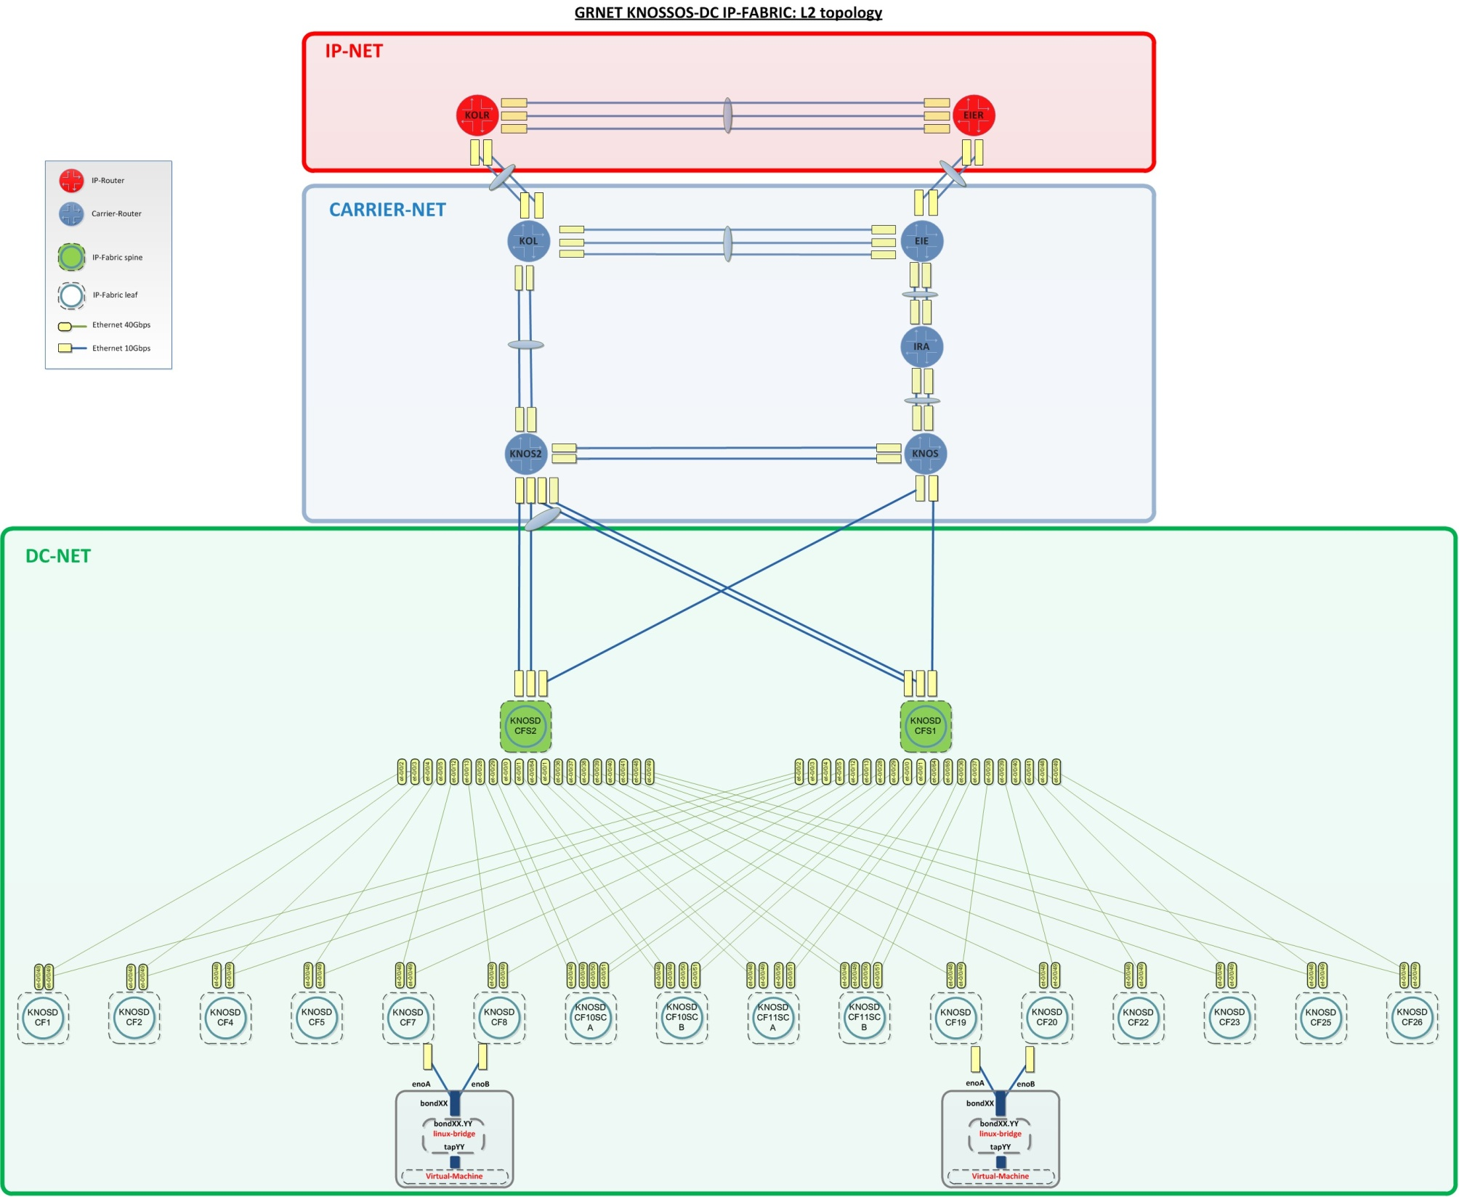

Slide 19
Troubleshooting Approach
Many software/hardware components taking part to the service provisioning there was no other path rather than..
Trying to make an educated guess as a starting point and adopt a top-down approach for our troubleshooting.

Slide 20
The educated guess
taking into consideration the report that another DC somewhere in central Europe is downloading with higher speeds from the main DC
not knowing exactly what the numbers behind this vague description are
having assured there is no congestion inside our DC and WAN topology, we start thinking the TCP characteristics.
the bandwidth-delay (BD) product effect is throttling the TCP bandwidth of each connection
BUT
With so many domains/operation teams between the host and not controlling both ends we had to prove it and suggest proper tuning
Notes:
The main DC is located in central Europe and our capacity view is limited to the GRNET and GEANT network, which are the two of the multiple pieces of the network topology puzzle. We had no view to the rest of the network links. Nonetheless, (1) taking into consideration the report that another DC somewhere in central Europe is downloading with higher speeds from the main DC, (2) not knowing exactly what the numbers behind this vague description are, (3) having assured there is no congestion inside our DC and WAN topology, we start thinking the TCP characteristics. After consideration our educated guess was that the bandwidth-delay product effect is throttling the TCP bandwidth of each connection.
BUT
With so main domains/operation teams between the host and not controlling both ends we had to prove it and suggest proper tuning

Slide 21
Fast work-around
Each satellite has its own datasets, handled separately: one FIFO queue of datasets per satellite waiting to the main DC to be downloaded to our DC
Multiple TCP connections are used in order to transfer datasets in parallel
The immediate work-around we decided to test if it really works was to increase the number of parallel TCP connections
IF the BD product the only cause of the “low speeds”
IF no packet loss (buffer overflow, link congestion etc.)
THEN the congestion window would not be activated, letting each TCP connection to carry as many bits as the BD product would let to fly on wire
This was the obvious way to increase the aggregated bitrate

Slide 22
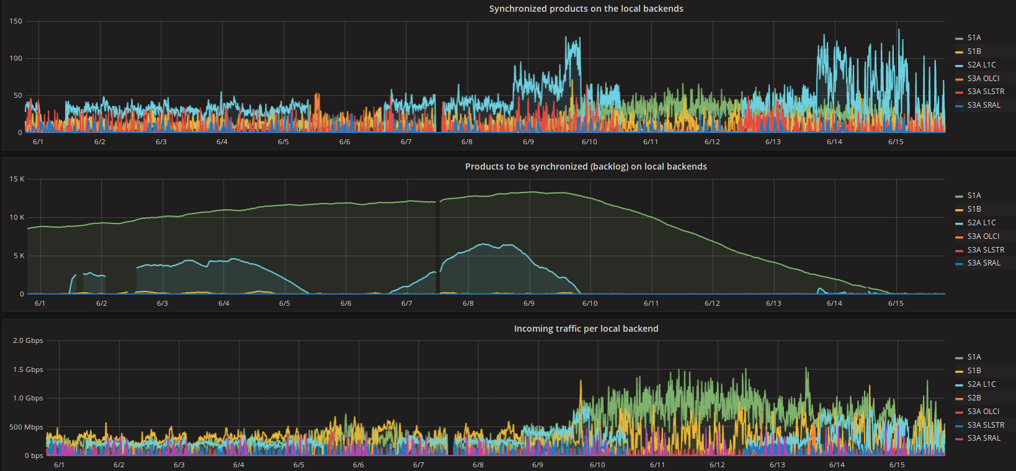
Work-around impact
Notes:
We started to monitor the bandwidth consumed by each queue and the backlog for each queue of datasets that we had to download to our DC.
These were the reasonable metrics in order to understand if we were tackling the problem with our work-around.
In the same time these metrics were proper indicators for the backlog that would be going to be created during a possible outage.
As it is clearly depicted in Figure after 10th of June we doubled the parallel downloads, the aggregated incoming traffic for all TCP connections of each dataset queue (different color-line) increased and the queue lengths were steadily decreasing. The synchronized datasets per 10 minutes time window also increased, as a result of the higher overall bitrates per queue. Hence, we had found a solution to download datasets faster than they have being created and a mechanism to decrease the synch up time.
The remaining part and the more interesting was to verify the bandwidth delay product as the root cause for slow speeds and try to tune the related kernel buffers and parameters for speed optimization per TCP connection.
This way we would be able to keep the queues as small as we could, under normal operation, and have the ability to eliminate larger queues after outages to our DC or the networks that connects the two DCs.

Slide 23
Assumptions
Argument: “The BD product was the root cause”
Baseline: RTT= propagation + transmission + processing + queuing buffer(size) = bandwidth * RTT
1st assumption:
The propagation delay → the dominant type of delay for long-distance paths → estimate the buffer size using the equation → buffer size = bandwidth * propagation delay
2nd assumption:
No throttling/bottleneck (e.g. congestion back-off algorithm)
Hypothesis: With constant RTT the bandwidth is proportional to the buffer size.

Slide 24
Fully(?)-controlled Environment
Small testbed deployment inside our premises between hosts located to GRNET’s distant DCs (200 miles away)
Iperf consecutive tests with 1 TCP connection
No congestion/packet loss to our WAN/DC networks
Results between 2 hosts with the default kernel parameters:
HOST A, DC A –> HOST B, DC B
1st trial: 0.0-10.0 sec 1.58 Gbits/sec
2nd trial: 0.0-10.0 sec 2.00 Gbits/sec
3rd trial: 0.0-10.0 sec 3.11 Gbits/sec
>> 1Gbit/s vs. GRNET-Central_EU DC
First conclusions:
In LFNs the propagation delay is the dominant type of delay
buffer size = bandwidth * propagation delay
longer connections suffer more (200Mbit/s vs. 2Gbit/s)

Slide 25
Fully(?)-controlled Environment
Kernel rx (max) buffer size → 6Mbyte
Extra space for internal kernel structures
The rx buffer size in linux kernel is the upper bound of the window size but is not equivalent to the window size
The % of the receive buffer used for “administrative purposes”, not allocable for the tcp window was stated wrong to the man-page → dig to the kernel code
With window size scaling & auto-tuning on the correct upper bound for the default window size is (only) 3072 Kbyte

Slide 26
Fully(?)-controlled Environment
Calculating the throughput for 8ms RTT the default window size value of 3072 Kbyte → <3.1 Gbit/sec, close to the max value we achieved
, but not enough, because the 1st trial has achieved only 1.58 Gbit/s, almost the 1/2 of the max achieved value of the 3rd trial
The iperf set of results, each time, had fluctuations, but there were no packet retransmissions, so the congestion algorithm was not kicked in
RTT was changing ? After several ping checks → RTT ~ [8, 12]ms The alternative paths were above 128
The maths for the 12ms RTT results to an upper bound of 2.1 Gbit/sec
Understand why the ping results were steadily 7.8ms or in rare cases steadily 11.9ms was a nightmare (multiple links between DC/Carrier/IP network)
The reason for such a RTT difference was eventually found to a DWDM optical service that was following a much longer path, inserting propagation delay

Slide 27
Fully(?)-controlled Environment
The results between those 2 hosts when we increased the rmem buffer (receiver buffer that defines the announced window size of the end-host) were better
Good news, but something unexpected derived from this tests, except the large deviation between the trials we made in both directions. On this round of measurements the results were not even approaching the theoretical value of the maximum throughput → 16Mbytes gives <= 8.4 Gbit/sec for 8ms RTT
We thought that there may be another bottleneck, starting looking again to other system parameters

Slide 28
Fully(?)-controlled Environment
We noticed that the throughput had been throttled many times per second, it was like the sender was slowing down again and again
The sender was never sending packets with a rate that could reach the maximum window size value that the receiver was announcing through its acks.
We also noticed that the “bytes in flight” (a.k.a bytes of TCP packets that has not been yet acked from the receiver) were not exceeding the sender buffer size (net.ipv4.tcp_wmem).
Hence, the sender’s buffer should be large enough in order to support a large number of bytes in flight

Slide 29
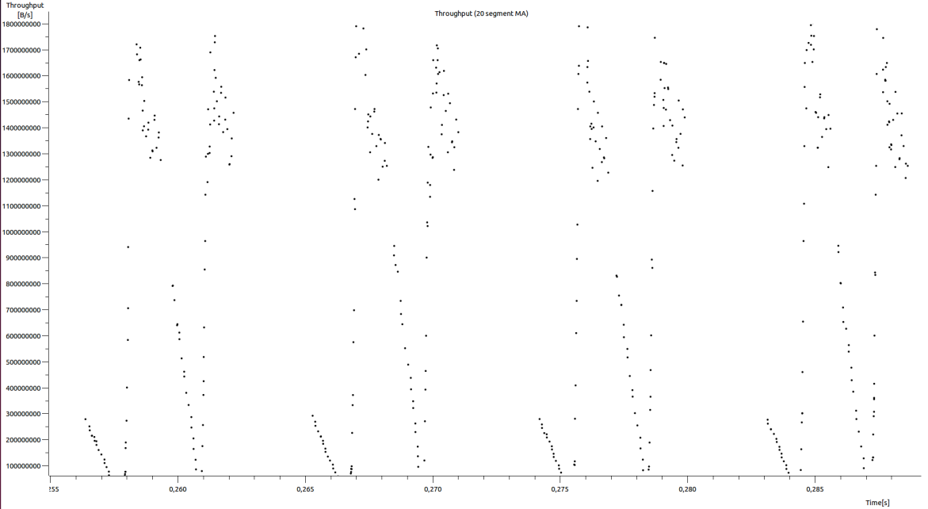
Fully(?)-controlled Environment
The sender’s buffer should be large enough in order to support a large number of bytes in flight
Notes:
Eventually, analyzing the throughput results using Wireshark we noticed that the throughput had been throttled many times per second and it was like the sender was slowing down many times per second.
We identified that the sender was never sending packets with a rate that could reach the maximum window size value that the receiver was announcing through its acks.
We also noticed that the “bytes in flight” (a.k.a bytes of TCP packets that has not been yet acked from the receiver) were not exceeding the sender buffer size (net.ipv4.tcp_wmem).
Hence, the sender’s buffer should be large enough in order to support a large number of bytes in flight.

Slide 30
Fully(?)-controlled Environment
First priority requirement to optimize the bitrate: tune the rx/tx buffers
We run the tests again setting the write buffers to the same values with the receive buffers, in both end-host (rx/tx buffer size 16Mbyte)
The results were much better:
HOST A, DC A –> HOST B, DC B
0.0-10.0 sec, 5.95 Gbytes, 5.11 Gbits/sec
We were feeling that we could proceed with a longer step
Throughput tests with hosts outside GRNET’s network, residing worldwide, tuning the relevant receive/transmit buffers.

Slide 31
Production environment
Real-life conditions which define the environment we made the measurements/observations:
Use of perfSONAR monitoring suite for measurements
Use of ESnet servers (256 Mbyte buffers & 10Gbit NICs), capable of supporting high throughputs even in high-RTT links We could throttle the TCP connection from our end-host which was acting as the sender, tuning the write buffer
The intermediate links were not congested as they were belonging to overprovisioned research networks such as GEANT & ESnet
We estimated that the background traffic the moment of the tests was between 1-1,5Gbps out of 10Gbps that a single TCP connection could theoretically consume due to link speed constraints and hashing (Layer3-Layer4 hashing to nx10Gbit aggregated Ethernet bundles)

Slide 32
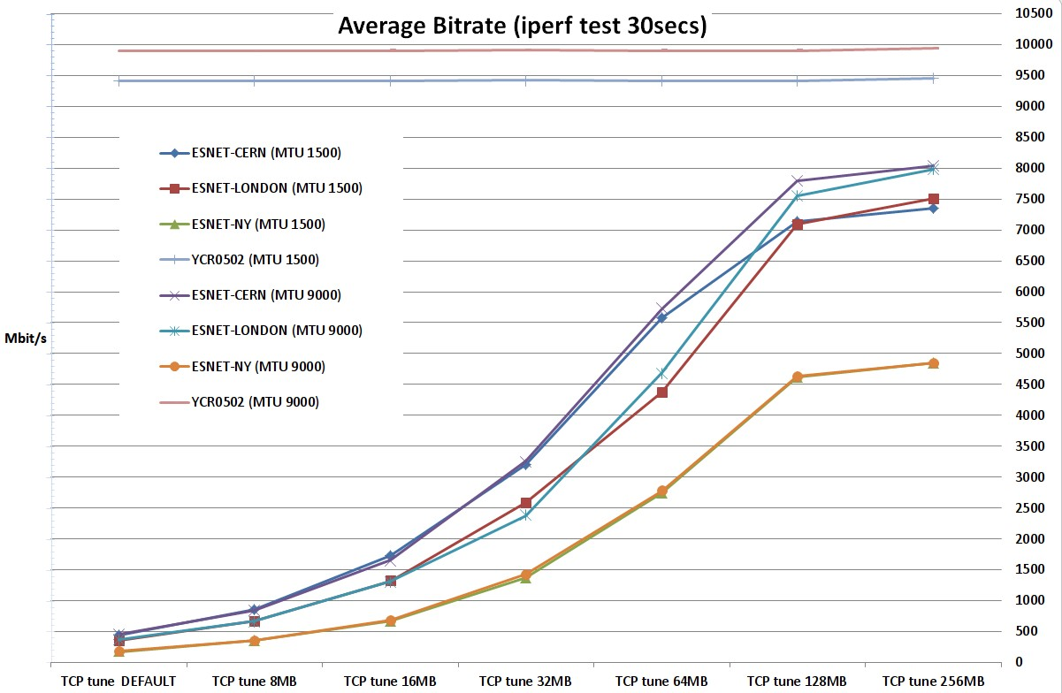
Production environment
Notes:
We performed multiple bandwidth tests with single TCP flow between a server located to GRNET DC facilities and ESnet perfSonar servers to 3 different locations (CERN, London, New York) and an intra-DC test (test defined as YCR0502 to the attached graph). We run the intra-DC test from our testbed end-host to another end-host residing to the same rack, 1 switching device away, in order to have a baseline of the throughput that our server can produce.
For each value of buffer tune set we ran iterations with 1500 and 9000 bytes MTU (Maximum Transmission Unit) size to record the differences.
For our experiments we used 7 different buffer sets with 2 different MTU values (1500, 9000) for each buffer set
In our tests the congestion threshold was ~8-9Gbit/s as defined by the background traffic at the moment of the tests. We see this on GRNET DC server – ESnet London server, GRNET DC server – ESnet CERN server tests. With 9000 MTU and large enough buffers to support the relevant propagation delays (GRNET-CERN, GRNET-London), the maximum bitrate is the same for CERN and London. We also observe that the achieved max bitrate for CERN and London is the same for 1500 MTU size.
Especially for small/default buffer values the effect of the relevant small tcp window size is clearly depicted and the throughput from GRNET DC server to ESnet New York server is the smallest, followed by that of GRNET DC server – ESnet London server, GRNET DC server – ESnet CERN server and GRNET DC – GRNET DC server, which is the biggest.

Slide 33
Conclusions
1) The rx buffer size of the fat flow receiver has the highest impact to tcp performance → defines the TCP window size → should be tuned taking into consideration the RTT
2) The wx buffer size of the fat flow sender must also be tuned, as it defines the maximum number of UN-acknowledged bytes that the sender side will allow to fly on wire
Better to define in both tcp endpoints the rx & the wx buffers, as a TCP connection is bidirectional, unless you know which side is going to create the heavy traffic (sender) & which side is going to receive it
3) The buffers which (at least) should be tuned (for Linux kernel):
net.core.rmem_max {max_value}
net.ipv4.tcp_rmem {min_value default_value max_value}
net.core.wmem_max {max_value}
net.ipv4.tcp_wmem {min_value default_value max_value}

Slide 34
Conclusions
4) For RTTs > 100ms, or/and links > 10/40/100Gbit links you need huge buffers, even 30x or 40x bigger than the default kernel values
Example: 131070 KByte TCP window, 256 Mbyte buffer, 148ms RTT GRNET DC - ESnet New York <= 7254.90 Mbit/sec
5) TCP rx buffer max_value defines the max window size of the rx throttling the max throughput of the TCP over the path & the TCP send buffer max_value defines the max number of bytes on flight (you need window scaling and receive-buffer autotuning on, see RFC-7323)
6) A larger MTU size can support larger throughput when: (a) link congestion arise somewhere to the end-to-end path (b) the bandwidth-delay product is not a bottleneck
(c) there is no packet loss (see the red/blue line for intra-DC tests )

Slide 35
Conclusions
7) MTU size affects the bandwidth performance of a single TCP flow when this TCP flow consumes all the available bandwidth & the window size is not a bottleneck
8) Kernel’s window-size auto-tuning, with unchanged read buffer default_value, is importing delays to the desired high bitrate build-up in large RTT TCP connections

Slide 37
Backup
Provided that you do not change the net.ipv4.tcp_rmem default_value the tcp connection is starting with a small window importing a delay to the desired high bitrate building up . Obviously, the 3-way TCP handshake over large RTTs paths is also an inevitable “a priori” worsening factor.
150ms RTT
[ 15] local xxxx port 5165 connected with yyyy port 5165
[ ID] Interval Transfer Bandwidth
[ 15] 0.0- 1.0 sec 13.9 MBytes 117 Mbits/sec
[ 15] 1.0- 2.0 sec 593 MBytes 4979 Mbits/sec
[ 15] 2.0- 3.0 sec 891 MBytes 7472 Mbits/sec
0.15ms RTT
[ 3] local xxxx port 55414 connected with yyyy port 5001
[ ID] Interval Transfer Bandwidth
[ 3] 0.0- 1.0 sec 1.15 GBytes 9.92 Gbits/sec
[ 3] 1.0- 2.0 sec 1.15 GBytes 9.90 Gbits/sec
[ 3] 2.0- 3.0 sec 1.15 GBytes 9.90 Gbits/sec

